Slide 1









Alcohol Brief Interventions
(CQUIN Slide Set)

Slide 2
What we hope to cover
Why Alcohol? What are the issues?
What can you do about it?
How do you do it?

Slide 3
CMOs low-risk drinking guideline
You are safest not to drink regularly more than 14 units per week to keep health risks from drinking alcohol to a low level. This advice applies to both men and women
It is best to spread this drinking over 3 days or more during the week
A good way to help you keep the risk low is to have several drink-free days each week
If you are pregnant or planning a pregnancy, the safest approach is not to drink alcohol at all, to keep risks to your baby to a minimum

Slide 4
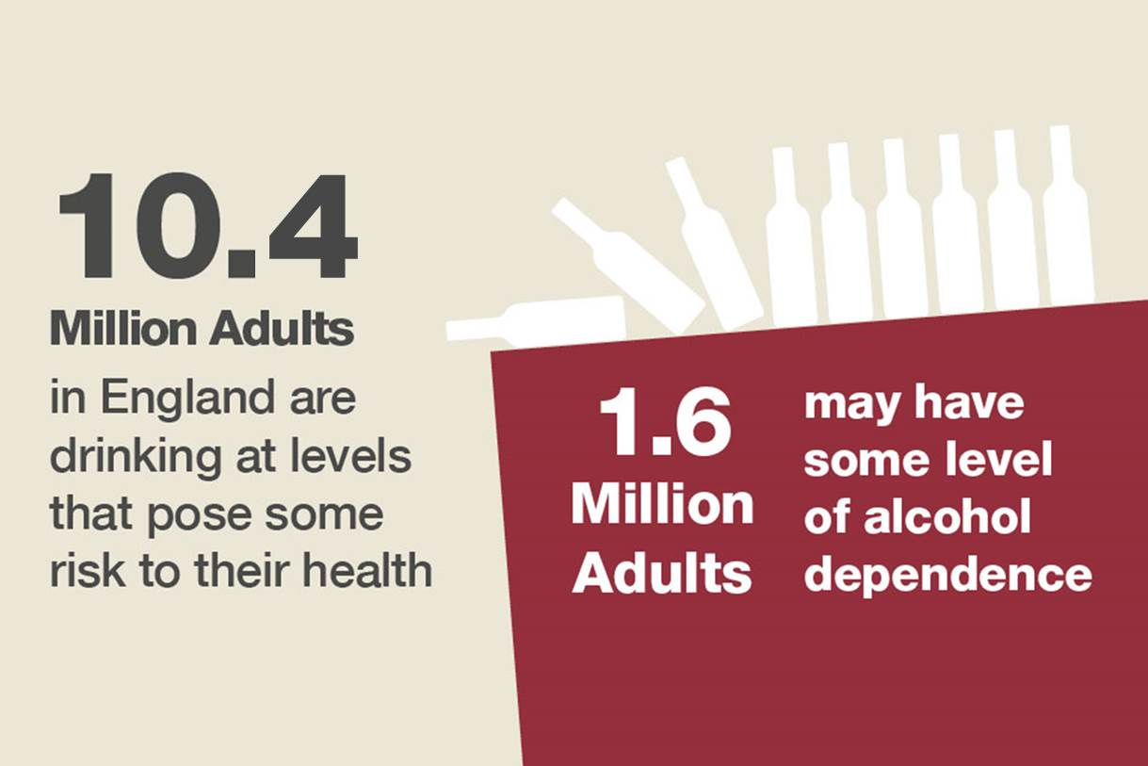
This means that roughly 1 in 4 adults might benefit from reducing their alcohol consumption

Slide 5
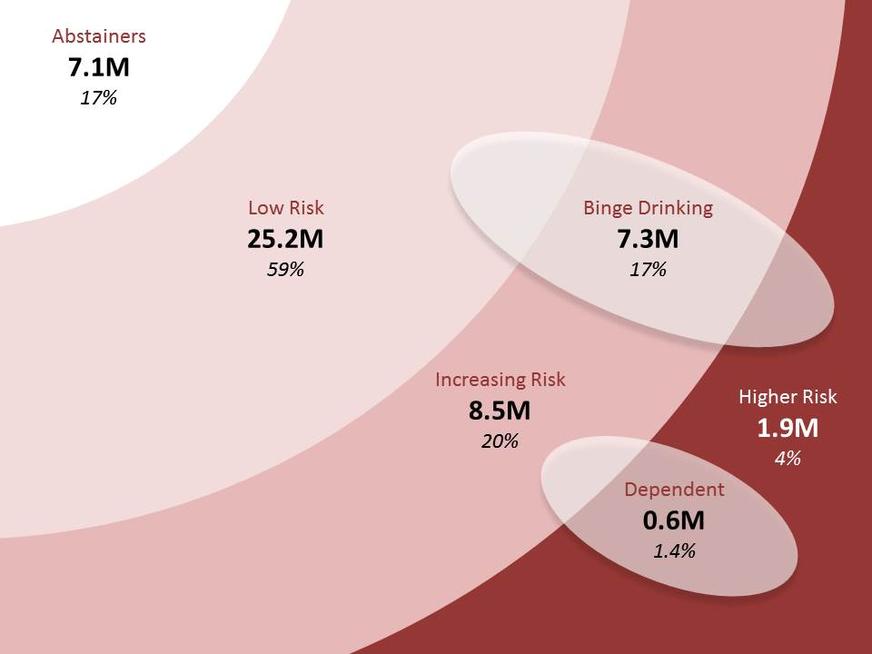
Drinking “At Risk” groups

Slide 6
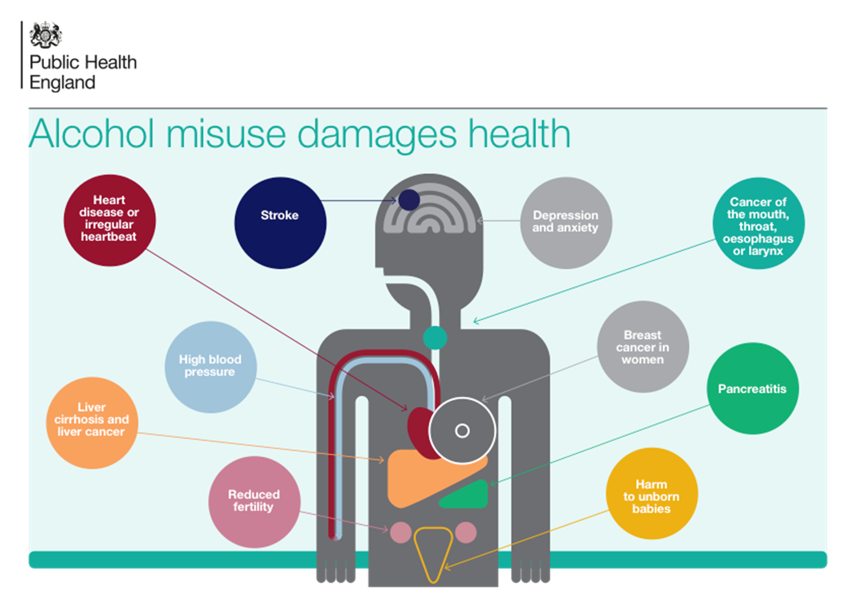
Health Harms

Slide 7
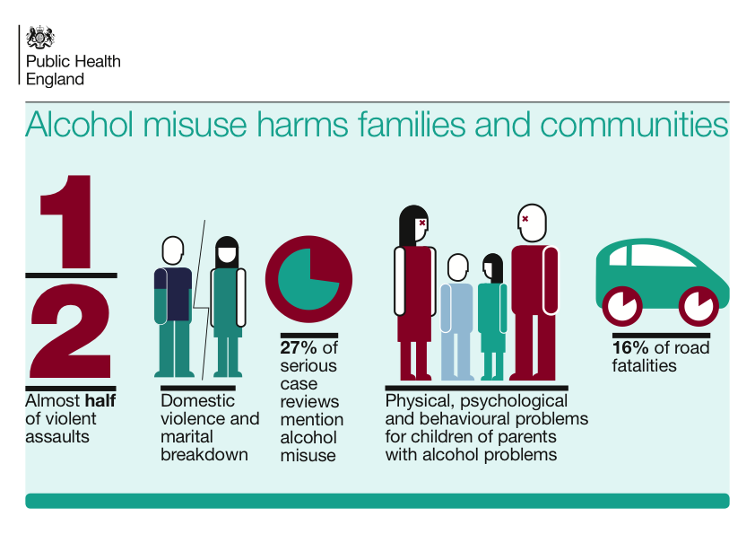
Social Harms from Alcohol

Slide 8
Public perception of alcohol risk
Most people are unaware that they are drinking above the low-risk guidelines
Many do not see drinking above the low-risk guidelines as a problem
Many aware that alcohol caused liver problems, but few aware of its contribution to cancers

Slide 9


What is an Alcohol Identification & Brief Advice (IBA)?
“A short, evidence-based, structured conversation about alcohol consumption with a client to motivate and support the individual to think about and/or plan a change in their drinking behaviour in order to reduce their consumption”
NHS Scotland (2009)
ABI = Alcohol Brief Intervention
ABI
IBA
IBA=Identification and Brief Advice

Slide 10

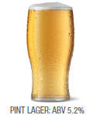
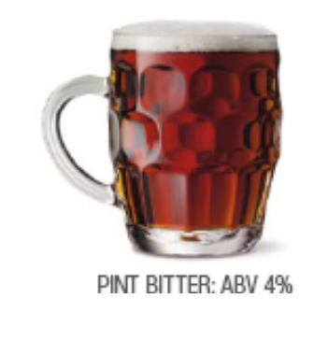

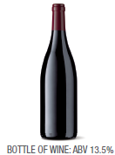
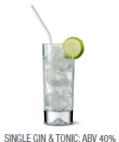
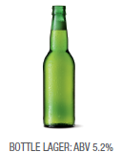
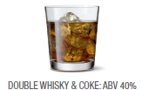
3 UNITS
2.3 UNITS
2.3 UNITS
1 UNIT
1.7 UNITS
10 UNITS
2 UNITS

Slide 11

Always be on the look out for
A naturally occurring life transition or health event that motivate or activate individuals to spontaneously adopt risk-reducing health behaviours.
Timing formal interventions to take advantage of these naturally occurring events increase the effectiveness of that behaviour change.

Slide 12
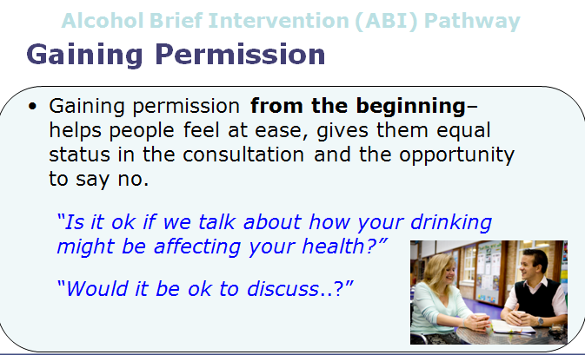
Alcohol Brief Intervention (ABI) Pathway
Notes:
You may already be doing this – there is a ‘subtle difference’ between asking whether someone smokes or drinks is not asking permission to raise the issue
This simple thing sets the collaborative tone for the next couple of minutes right at the start of this brief conversation
This helps the clients engage,
engenders their ownership of the issue and
reduces resistance
MI Principles - Always gain permission before giving advice
Communicate risk sensitively - Smoking, Alcohol, Obesity

Slide 13


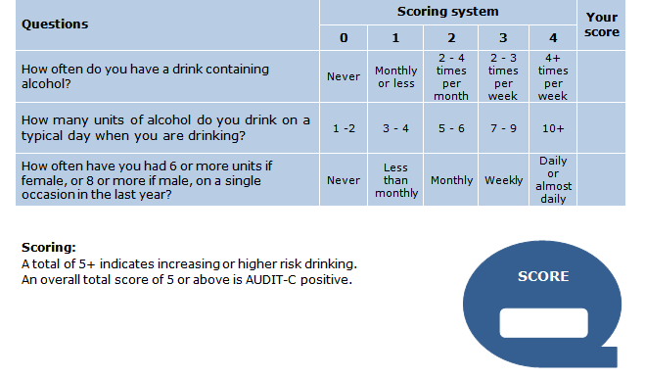
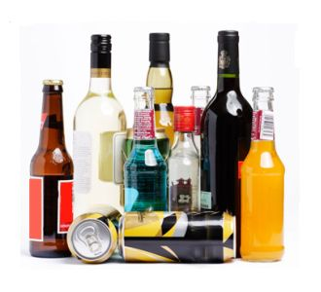

Slide 14
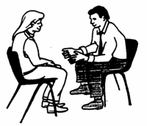
The AUDIT-C Score (0-12)
If time, carry out full AUDIT
0
1
2
3
4
5
6
7
8
9
10
11
12
Non Drinker
Sensible Drinking
Low Risk
Hazardous Drinking
Increasing Risk
Harmful Drinking
Higher Risk
Potentially
Addicted / Dependant
Public Health Wales Alcohol Brief Interventions Train the Trainer Course

Slide 15


FRAMES - the structure of IBA
Feedback-
Tell the person their scored on AUDIT-C and what level of risk they are in.
Responsibility-
It’s the individuals’ own responsibility to change.
Advice-
Set a daily (& weekly) limit
Have alcohol free days
Menu-
Give them a range of options
Empathy-
Be empathetic, non-judgmental
Self Efficacy-
Positive message. Boost their self confidence -“ You can do it!”

Slide 16

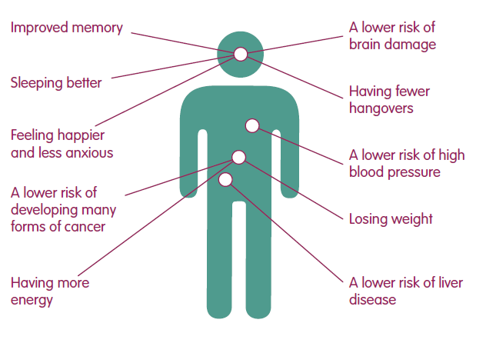

Advice
Health Advice
Feel better in the mornings
More energy!
Improved skin
Fitter, faster
Weight control

Slide 17

Benefits
Psychological, Social and Financial Benefits
Lower risk of accident or injury
Less chance of getting into fights
Developing better relationships
Improved Self esteem
More time
More money
Seen in a different light at work

Slide 18

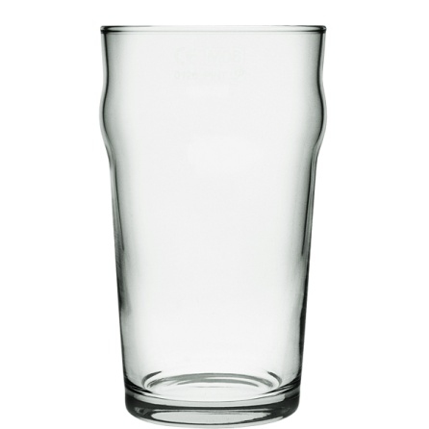
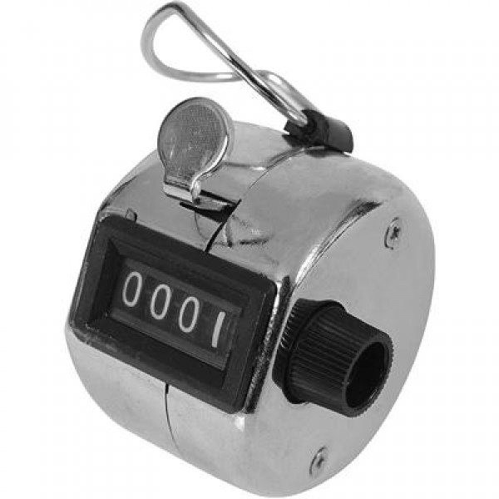
Menu of Options
Simple and Straight Away
“Have drink free days
every week”
“Keep track of how much
you drink”

Slide 19

Menu of Options
Swap your usual for...
A smaller drink
A lower strength drink
A soft drink
A later drink
Drink to relax? Try...
Exercise
Music, movies, books
Use the money saved to do something new
Pamper time

Slide 20

Menu of Options
Tips for a Night Out
Make a plan – set yourself pre-night out limits
Set a budget – only take a set amount of cash out with you
Start later – but don’t start at home
Take your time – don’t get into rounds
Sit one out – have a soft drink when its your round
Stay hydrated – have a few glasses of water through the night

Slide 21


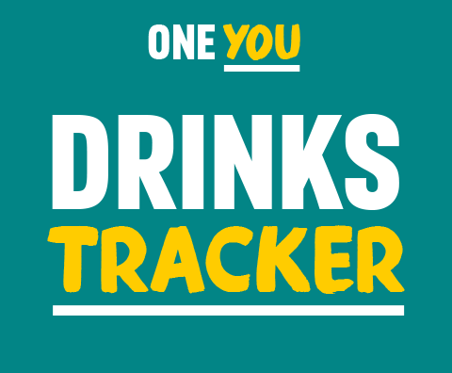
It may seem like you don't drink much, but a drink or two most evenings can do harm to your body. From making you gain weight to increasing your risk of cancer, alcohol can have serious effects on your body.
The more you drink, and the more often, the greater the risk to your health.

Slide 22
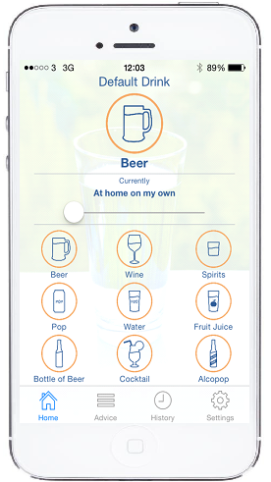
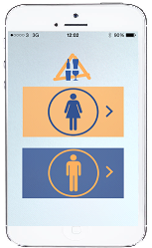
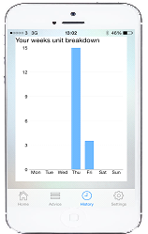
One Drink, One Click App
Launched February 2015
Available Free for an iOS i-Phone
Available from Apple- ‘One Drink- One Click’

Slide 23
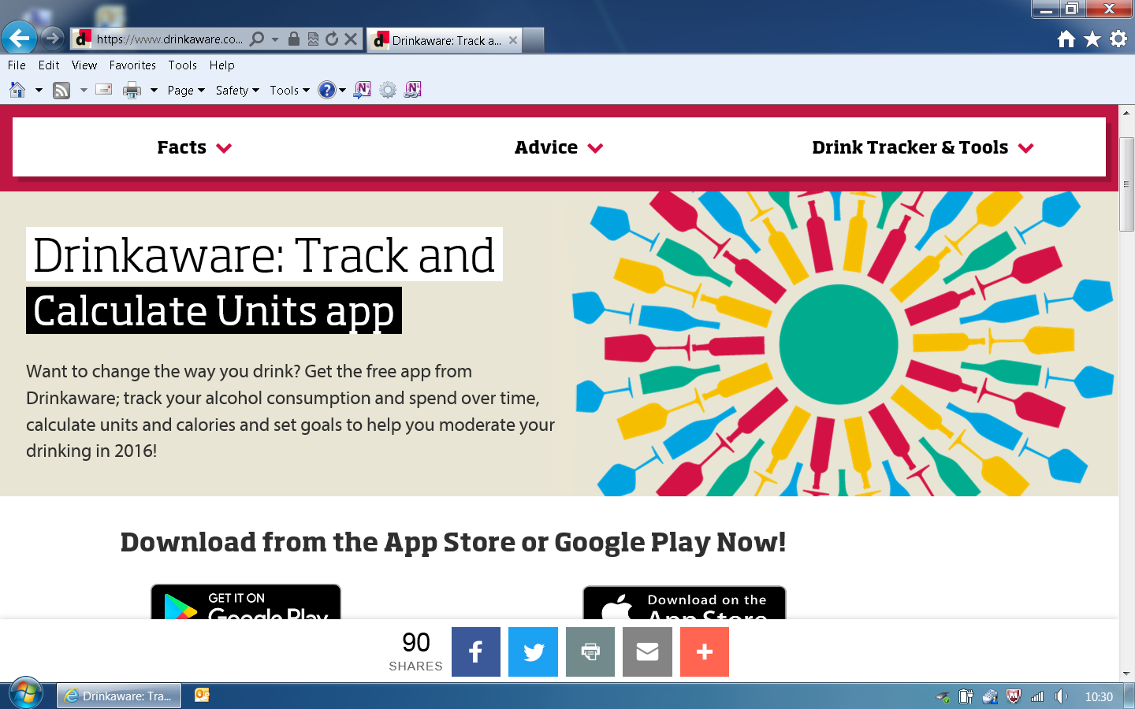
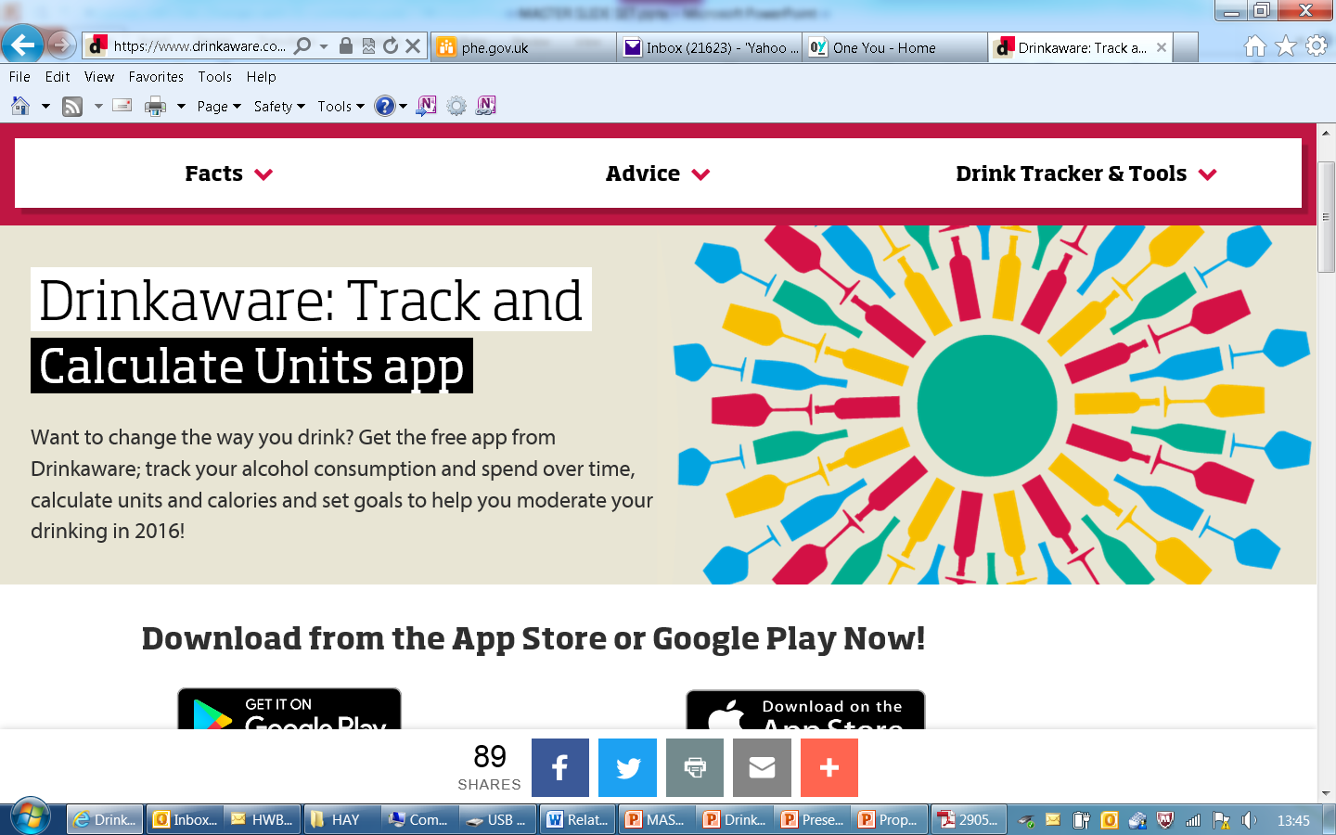
Drinkaware

Slide 24


Referral Agency
Drinkline
0300 1231110
Mon - Fri 9am – 8pm
Weekends 11am – 4pm

Slide 25
Patient reluctant to take up a referral
That is OK
You may have “planted a seed” that will germinate later
Your role is to:
      Assesses the level of risk
      Give the individual the feedback about that level of risk
      Provide information about how to reduce that level of risk
It is up to the patient what they do with that information
The most important thing is to raise the issue and have a brief conversation about alcohol

Slide 26

Points to Remember
Use a non-confrontational manner
Do not use if the client is intoxicated
Tell the client what you are doing and why
Discuss confidentiality
Acknowledge a low score (positive reinforcement)

Slide 27
References
Anderson, P. (2008) Reducing heavy drinking and alcohol admissions (Unpublished) Department of Health.
Fleming, M.F., Marlon, M.P., French, M.T., Manwell, L.B., Stauffacher, E.A. and Barry, K.L. (2000) Benefit cost analysis of brief physician advice with problem drinkers in primary care settings, Medical Care, 31(1): 7-18.
Kaner E, Beyer F, Dickinson H, Pienaar E, Campbell F, Schlesinger C, Heather N, Saunders J, Bernand B. Brief interventions for excessive drinkers in primary health care settings. Cochrane Database of Systematic Reviews 2007, Issue 2. Art No.: CD004148 DOI: 10.1002/14651858.CD004148.pub3.
Kaner E, et.al .Effectiveness of screening and brief alcohol intervention in primary care (SIPS trial): pragmatic cluster randomised controlled trial. BMJ 2013;346:e8501
Moyer, A., Finney, J., Swearingen, C. and Vergun, P. (2002) Brief Interventions for alcohol problems: a meta-analytic review of controlled investigations in treatment -seeking and non-treatment seeking populations, Addiction, 97, 279-292.
University of Sheffield (2009) Modelling to assess the effectiveness and cost effectiveness of public health related strategies and interventions to reduce alcohol attributable harm in England using the Sheffield alcohol policy model version 2.0 [online]. Available from www.nice.org.uk/guidance/PH24
Whitlock, E.P., Polen, M.R., Green, C.A., Orleans, T. and Klein, J. (2004) Behavioral counselling interventions in primary care to reduce risky/harmful alcohol use by adults: a summary of the evidence for the US Preventive Services Task Force. Annals of Internal Medicine, 140, 557-568.
Wilk, A.I., Jensen, N.M. and Havighurst, T.C. (1997) Meta-analysis of randomized control trials addressing brief interventions in heavy alcohol drinkers, Journal of General Internal Medicine, 12, 274-283.
NICE GUIDANCE: http://guidance.nice.org.uk/PH24

