Slide 1









Alcohol Brief Interventions
(Master Slides)

Slide 2
What we hope to cover
Why Alcohol? What are the issues?
What can you do about it?
How do you do it?
Discussion

Slide 3
CMOs low-risk drinking guideline
You are safest not to drink regularly more than 14 units per week to keep health risks from drinking alcohol to a low level. This advice applies to both men and women
It is best to spread this drinking over 3 days or more during the week
A good way to help you keep the risk low is to have several drink-free days each week
If you are pregnant or planning a pregnancy, the safest approach is not to drink alcohol at all, to keep risks to your baby to a minimum

Slide 4
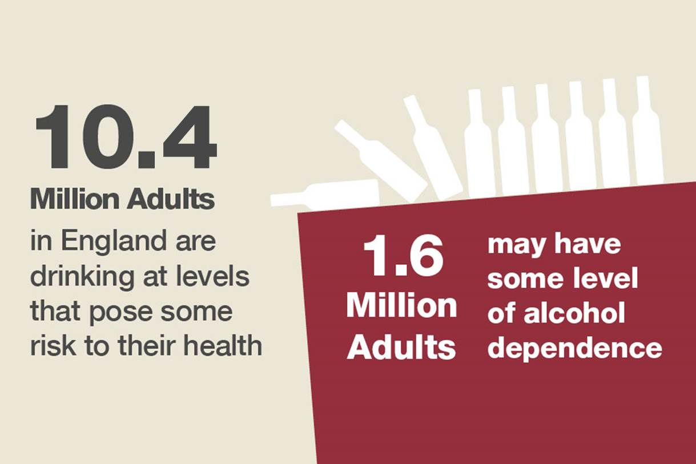
This means that roughly 1 in 4 adults might benefit from reducing their alcohol consumption

Slide 5
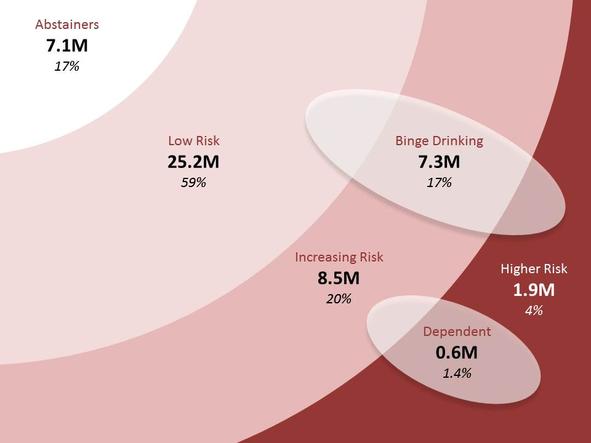
Drinking “At Risk” groups

Slide 6
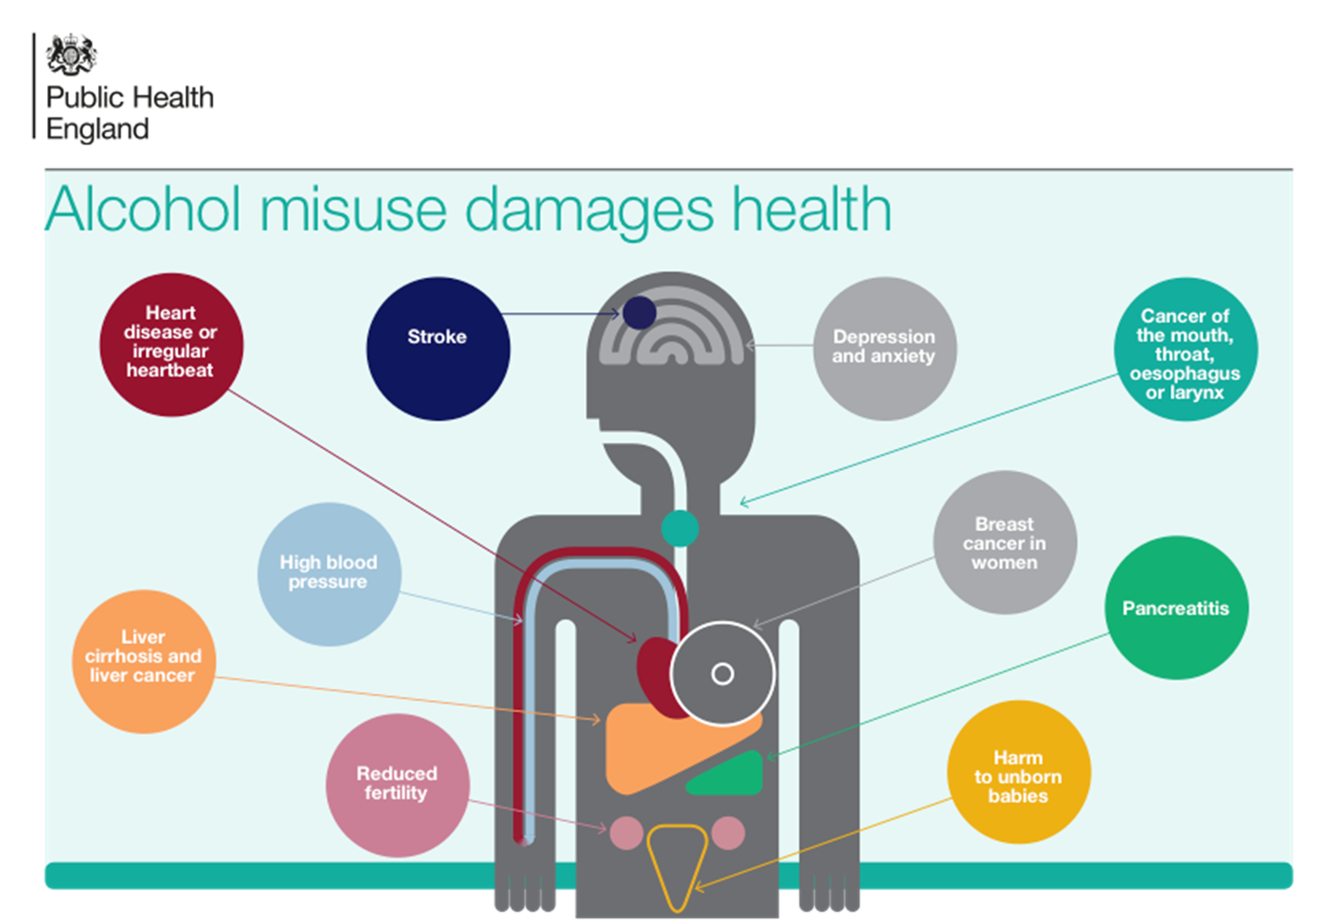
Health Harms

Slide 7
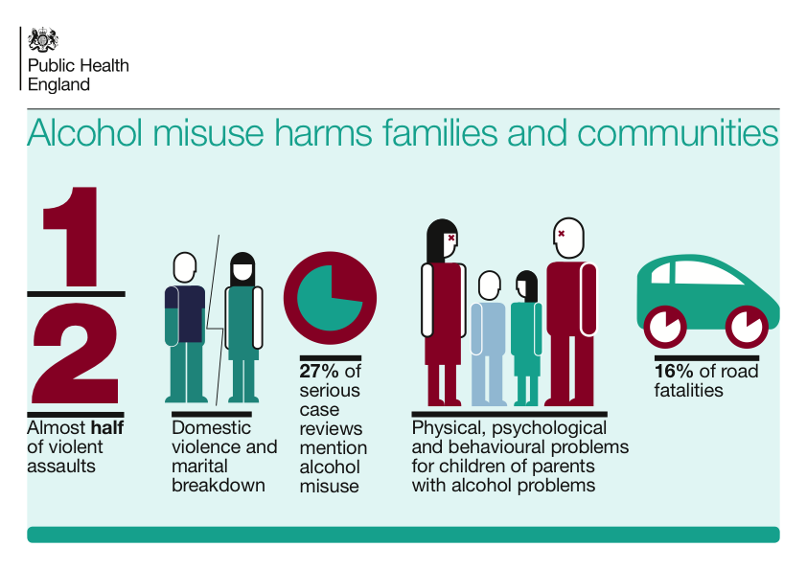
Social Harms from Alcohol

Slide 8
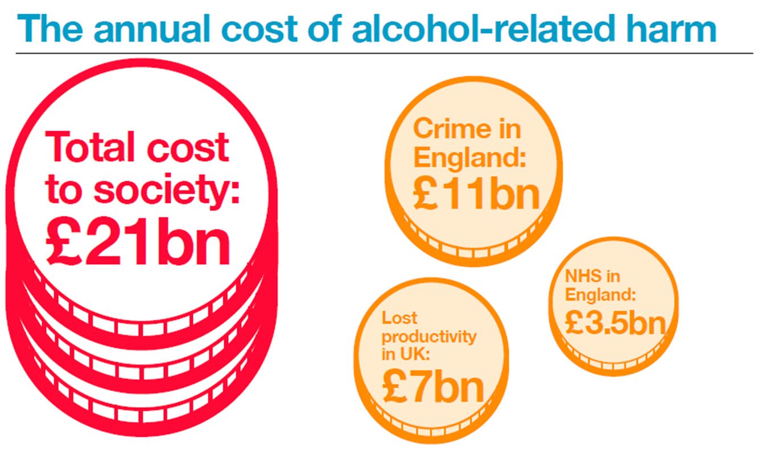

Slide 9
Public perception of alcohol risk
Most people are unaware that they are drinking above the low-risk guidelines
Many do not see drinking above the low-risk guidelines as a problem
Many aware that alcohol caused liver problems, but few aware of its contribution to cancers

Slide 10


What is an Alcohol Identification & Brief Advice (IBA)?
“A short, evidence-based, structured conversation about alcohol consumption with a client to motivate and support the individual to think about and/or plan a change in their drinking behaviour in order to reduce their consumption”
NHS Scotland (2009)
ABI = Alcohol Brief Intervention
ABI
IBA
IBA=Identification and Brief Advice

Slide 11

What’s the point of IBA?
The primary goal of IBA is to reduce alcohol consumption by showing the client...
What the consequences of their drinking might be
What the client can do about it
What help and support can be accessed

Slide 12
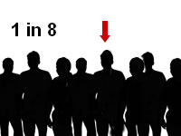

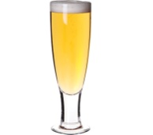



How much impact can YOU really have?
The Numbers Needed to Treat (NNT) for Alcohol Brief Interventions = 8
The average reduction in alcohol consumption (per week) is 38 grams, which equates to 4-5 units.
or
or
Kaner et al (2009) Effectiveness of brief alcohol interventions in primary care populations (Review)
Raistrick et al (2006) Review of the effectiveness of treatment for alcohol problems

Slide 13


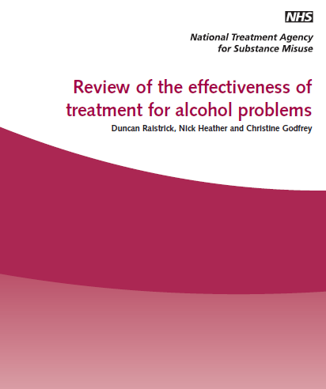
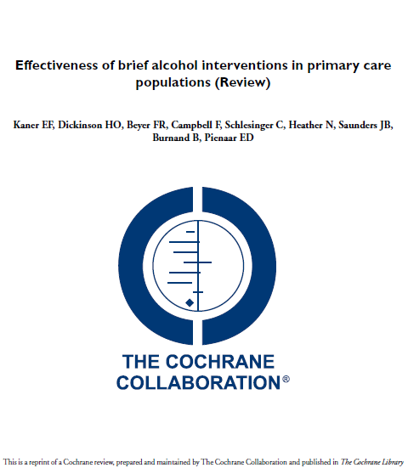
?
All very nice, but does IBA actually work?
56 controlled trials indicate that for every eight people who receive simple alcohol advice, one will reduce their drinking to within low risk levels
Brief interventions are effective and cost-effective!

Slide 14
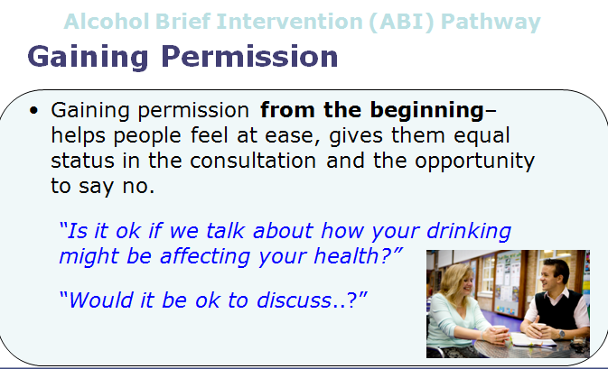
Alcohol Brief Intervention (ABI) Pathway
Notes:
You may already be doing this – there is a ‘subtle difference’ between asking whether someone smokes or drinks is not asking permission to raise the issue
This simple thing sets the collaborative tone for the next couple of minutes right at the start of this brief conversation
This helps the clients engage,
engenders their ownership of the issue and
reduces resistance
MI Principles - Always gain permission before giving advice
Communicate risk sensitively - Smoking, Alcohol, Obesity

Slide 15

Alcohol Screening
What is it?
…it is a method of identifying alcohol consumption at a level sufficiently high enough to cause concern.

Slide 16
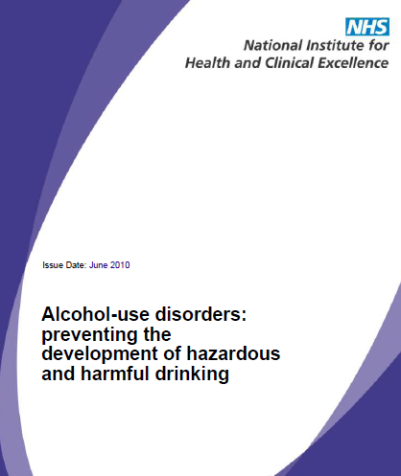


NICE Guidelines
Complete a validated screening
questionnaire, e.g. AUDIT (Alcohol
Use Disorders Identification Test), or
AUDIT-C, or FAST
16 ,17 years
Adult

Slide 17


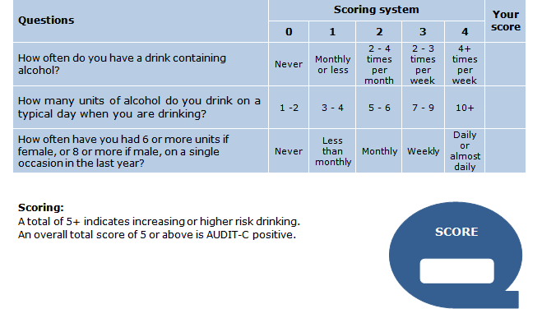
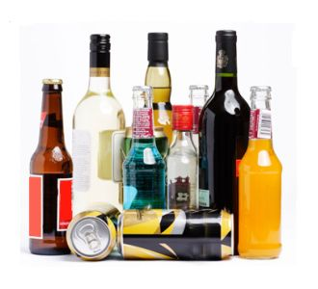

Slide 18
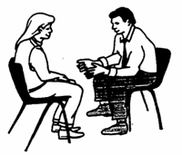
The AUDIT-C Score (0-12)
If time, carry out full AUDIT
0
1
2
3
4
5
6
7
8
9
10
11
12
Non Drinker
Sensible Drinking
Low Risk
Hazardous Drinking
Increasing Risk
Harmful Drinking
Higher Risk
Potentially
Addicted / Dependant
Public Health Wales Alcohol Brief Interventions Train the Trainer Course

Slide 19
FAST
(Fast Alcohol Screening Test)
FAST | Scoring system |  |  |  |  | Your score
 | 0 | 1 | 2 | 3 | 4
How often have you had 6 or more units if female, or 8 or more if male, on a single occasion in the last year? | Never | Less than monthly | Monthly | Weekly | Daily or almost daily
Only answer the following questions if the answer above is Never (0), Less than monthly (1) or Monthly (2). Stop here if the answer is Weekly (3) or Daily (4).
How often during the last year have you failed to do what was normally expected from you because of your drinking? | Never | Less than monthly | Monthly | Weekly | Daily or almost daily
How often during the last year have you been unable to remember what happened the night before because you had been drinking? | Never | Less than monthly | Monthly | Weekly | Daily or almost daily
Has a relative or friend, doctor or other health worker been concerned about your drinking or suggested that you cut down? | No |  | Yes, but not in the last year |  | Yes, during the last year

Slide 20
Adults 18+
Alcohol Care Pathway
Teachable Moment
Screening Tools
FAST
AUDIT - C
AUDIT – C 11+
FAST 6+
Possible Dependence
AUDIT – C 8-10
FAST 4-5
Higher-risk
AUDIT – C 5-7
FAST 3
Increasing-risk
AUDIT – C 0-4
FAST 0-2
Low-risk
Positive
Result
Negative
Result
Consider Referral to
Specialist Services
Brief Advice
No action

Slide 21

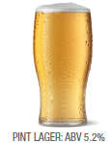
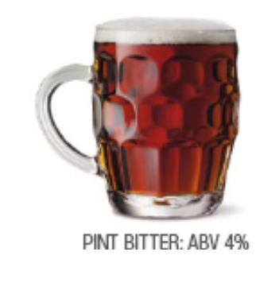
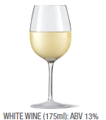
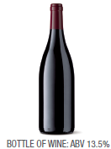
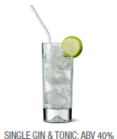
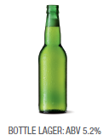
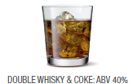
3 UNITS
2.3 UNITS
2.3 UNITS
1 UNIT
1.7 UNITS
10 UNITS
2 UNITS

Slide 22


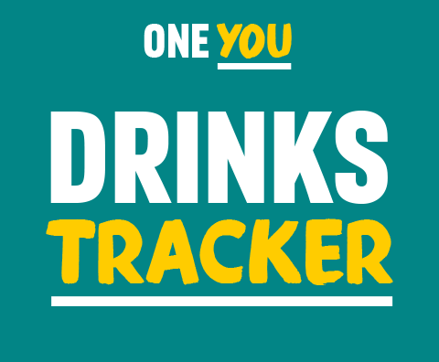
It may seem like you don't drink much, but a drink or two most evenings can do harm to your body. From making you gain weight to increasing your risk of cancer, alcohol can have serious effects on your body.
The more you drink, and the more often, the greater the risk to your health.

Slide 23
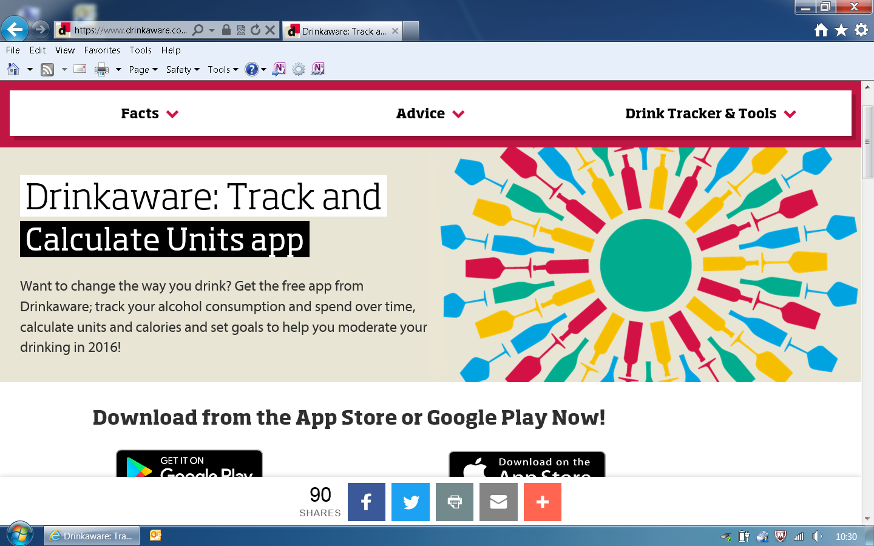
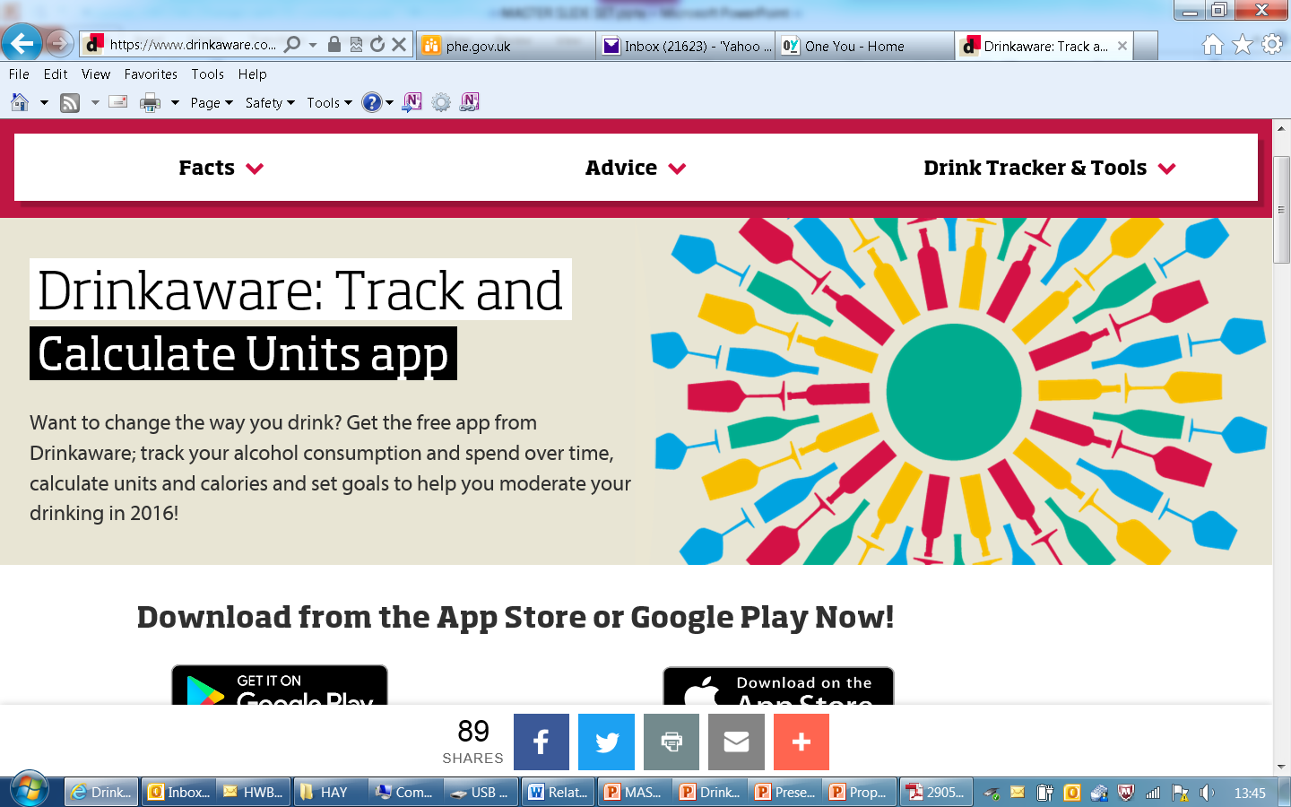
Drinkaware

Slide 24


Frames- the Structure of IBA
Feedback-
Tell the person what they scored. Link their drinking to the situation. Be realistic!
Responsibility-
It’s the individuals’ own responsibility to change.
Advice-
Set a daily (& weekly) limit
Have alcohol free days
Menu-
Give them a range of options
Empathy-
Empathic, Non Judgmental
Self Efficacy-
Positive message. Boost their self confidence -“ You can do it!”

Slide 25

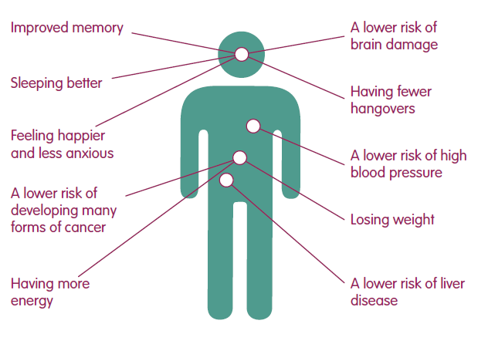
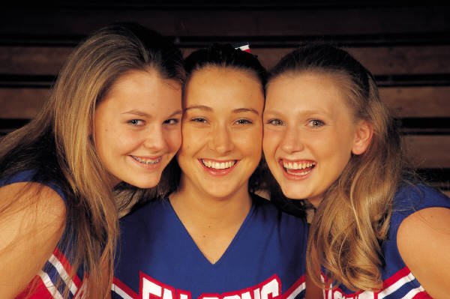
Advice
Health Advice
Feel better in the mornings
More energy!
Improved skin
Fitter, faster
Weight control

Slide 26
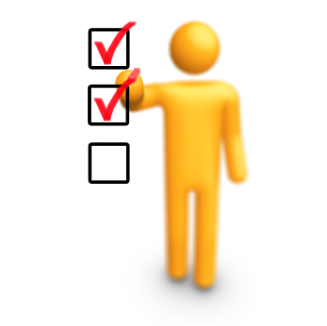
Benefits
Psychological, Social and Financial Benefits
Lower risk of accident or injury
Less chance of getting into fights
Developing better relationships
Improved Self esteem
More time
More money
Seen in a different light at work

Slide 27

Menu of Options
Swap your usual for...
A smaller drink
A lower strength drink
A soft drink
A later drink
Drink to relax? Try...
Exercise
Music, movies, books
Use the money saved to do something new
Pamper time

Slide 28

Menu of Options
Tips for a Night Out
Make a plan – set yourself pre-night out limits
Set a budget – only take a set amount of cash out with you
Start later – but don’t start at home
Take your time – don’t get into rounds
Sit one out – have a soft drink when its your round
Stay hydrated – have a few glasses of water through the night

Slide 29


When to Refer on?
Clients should be referred to their GP or other
specialist services when...
  They express the desire to talk in-depth with someone about alcohol
  They display alcohol dependence
  Have a high level of alcohol harm, physically and mentally
  When brief intervention does not seem appropriate

Slide 30


Referral Agency
Drinkline
0300 1231110
Mon - Fri 9am – 8pm
Weekends 11am – 4pm

Slide 31
References
Anderson, P. (2008) Reducing heavy drinking and alcohol admissions (Unpublished) Department of Health.
Fleming, M.F., Marlon, M.P., French, M.T., Manwell, L.B., Stauffacher, E.A. and Barry, K.L. (2000) Benefit cost analysis of brief physician advice with problem drinkers in primary care settings, Medical Care, 31(1): 7-18.
Kaner E, Beyer F, Dickinson H, Pienaar E, Campbell F, Schlesinger C, Heather N, Saunders J, Bernand B. Brief interventions for excessive drinkers in primary health care settings. Cochrane Database of Systematic Reviews 2007, Issue 2. Art No.: CD004148 DOI: 10.1002/14651858.CD004148.pub3.
Kaner E, et.al .Effectiveness of screening and brief alcohol intervention in primary care (SIPS trial): pragmatic cluster randomised controlled trial. BMJ 2013;346:e8501
Moyer, A., Finney, J., Swearingen, C. and Vergun, P. (2002) Brief Interventions for alcohol problems: a meta-analytic review of controlled investigations in treatment -seeking and non-treatment seeking populations, Addiction, 97, 279-292.
University of Sheffield (2009) Modelling to assess the effectiveness and cost effectiveness of public health related strategies and interventions to reduce alcohol attributable harm in England using the Sheffield alcohol policy model version 2.0 [online]. Available from www.nice.org.uk/guidance/PH24
Whitlock, E.P., Polen, M.R., Green, C.A., Orleans, T. and Klein, J. (2004) Behavioral counselling interventions in primary care to reduce risky/harmful alcohol use by adults: a summary of the evidence for the US Preventive Services Task Force. Annals of Internal Medicine, 140, 557-568.
Wilk, A.I., Jensen, N.M. and Havighurst, T.C. (1997) Meta-analysis of randomized control trials addressing brief interventions in heavy alcohol drinkers, Journal of General Internal Medicine, 12, 274-283.
NICE GUIDANCE: http://guidance.nice.org.uk/PH24

