Slide 1









Alcohol Brief Interventions
(Master Slides)

Slide 2

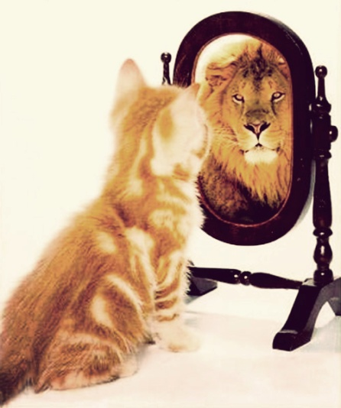
To Increase .....
Understanding... the scope of alcohol harm and how brief interventions work
Knowledge... of alcohol definitions and the tools & techniques of brief interventions
Skill... To deliver and succeed
and importantly to increase
Confidence

Slide 3
What we hope to cover
Why Alcohol? What are the issues?
What can you do about it?
How do you do it?
Discussion

Slide 4
CMOs low-risk drinking guideline
You are safest not to drink regularly more than 14 units per week to keep health risks from drinking alcohol to a low level. This advice applies to both men and women
It is best to spread this drinking over 3 days or more during the week
A good way to help you keep the risk low is to have several drink-free days each week
If you are pregnant or planning a pregnancy, the safest approach is not to drink alcohol at all, to keep risks to your baby to a minimum

Slide 5
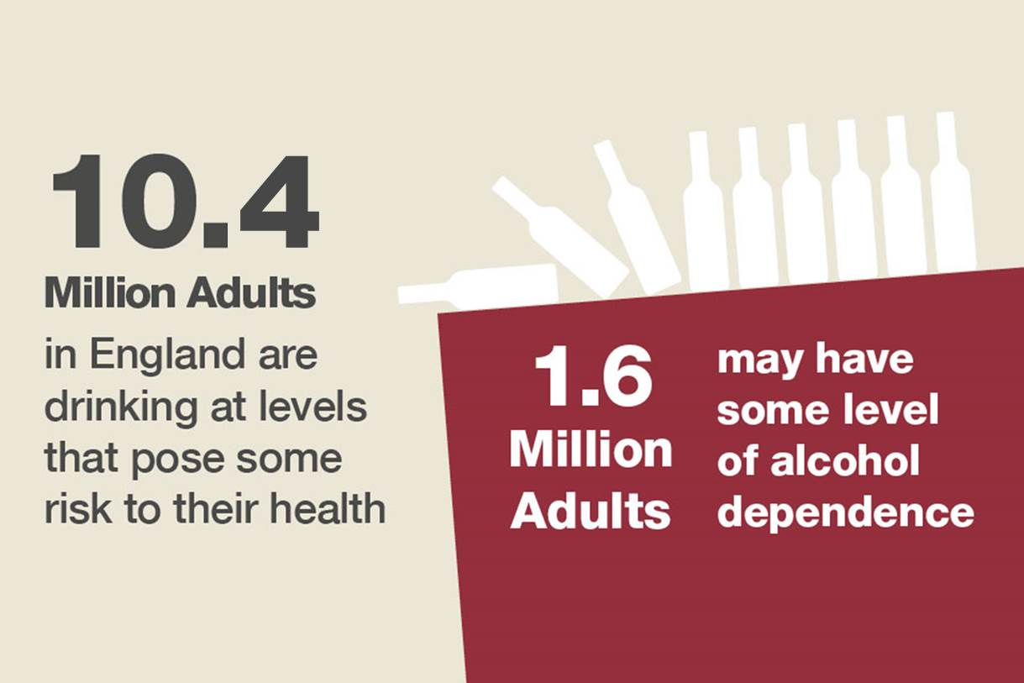
This means that roughly 1 in 4 adults might benefit from reducing their alcohol consumption

Slide 6
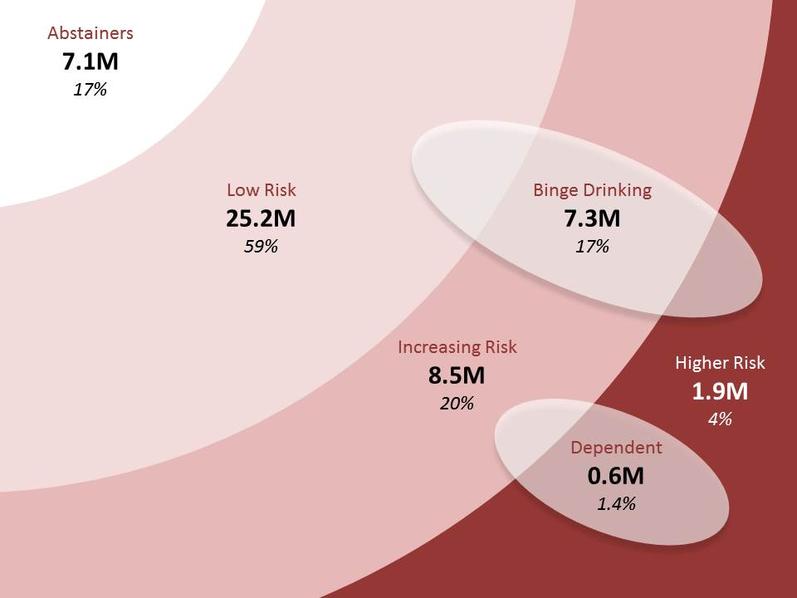
Drinking “At Risk” groups

Slide 7
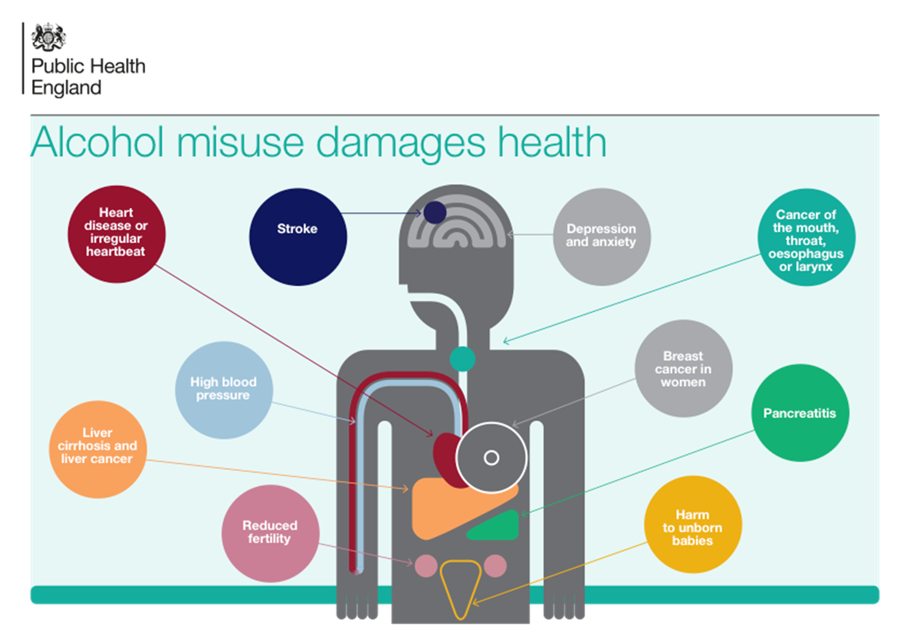
Health Harms

Slide 8
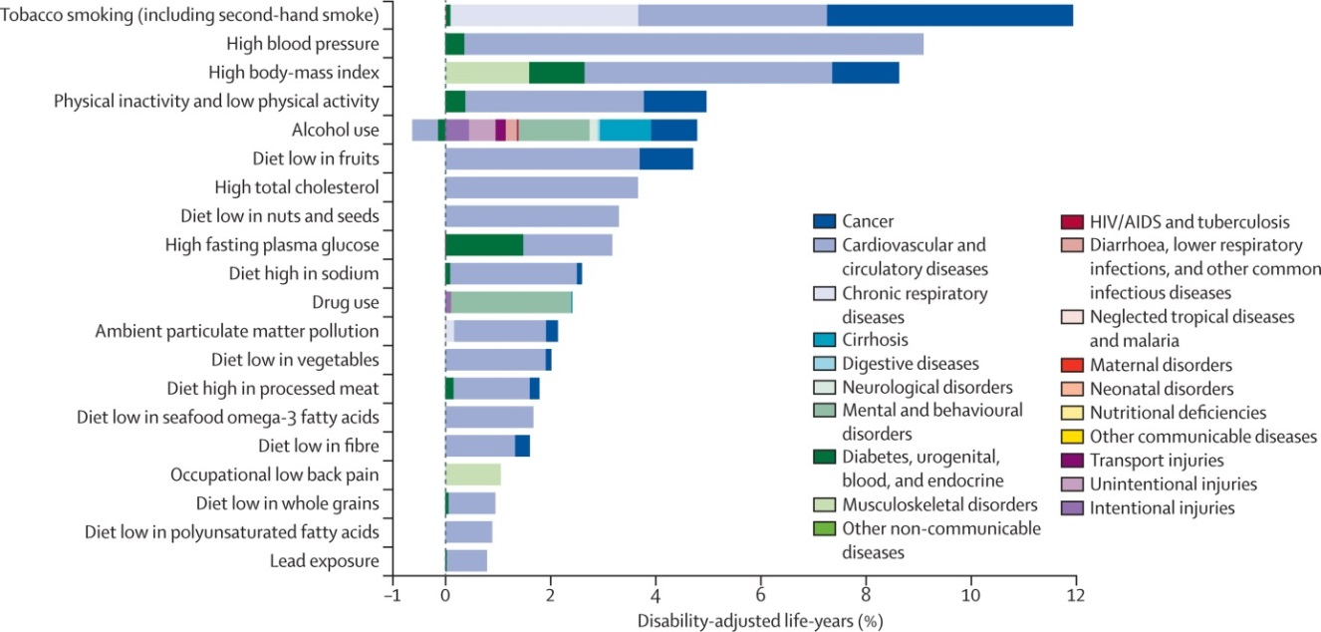
Burden of disease attributable to 20 leading risk factors for both sexes in 2010, expressed as a percentage of UK disability-adjusted life-years

Slide 9
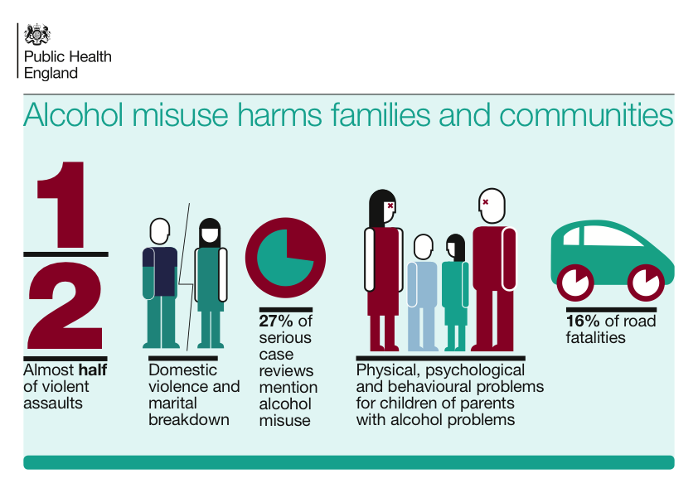
Social Harms from Alcohol

Slide 10
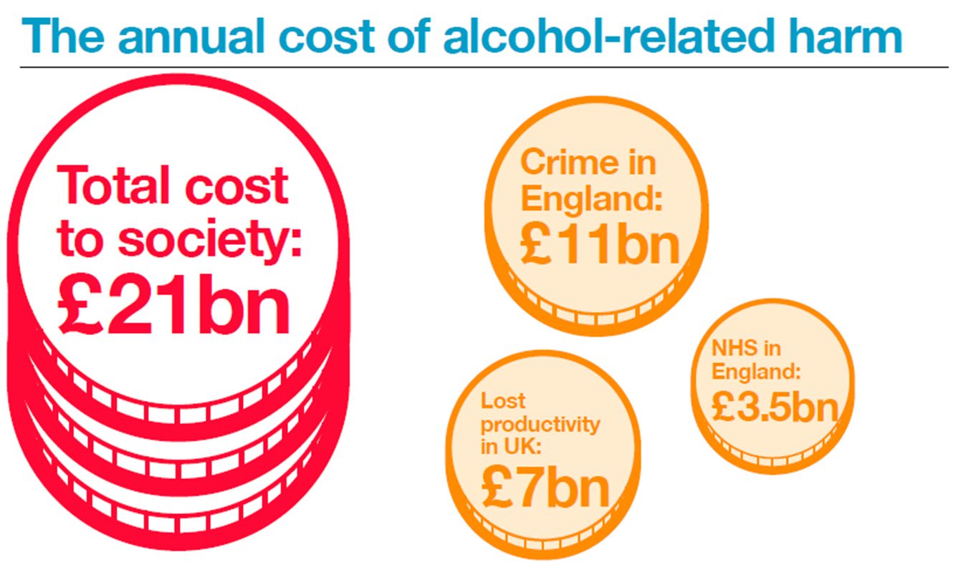

Slide 11
So who is at risk of alcohol related harm?
Potentially 10+ million people in England
It doesn’t take much to be at risk
It’s not just the hard core dependent individuals
It’s about minimising the risk where possible

Slide 12
Public perception of alcohol risk
Most people are unaware that they are drinking above the low-risk guidelines
Many do not see drinking above the low-risk guidelines as a problem
Many aware that alcohol caused liver problems, but few aware of its contribution to cancers

Slide 13
What we hope to cover
Why Alcohol? What are the issues?
What can you do about it?
How do you do it?
Discussion

Slide 14

What is an Alcohol Identification & Brief Advice (IBA)?
“A short, evidence-based, structured conversation about alcohol consumption with a client to motivate and support the individual to think about and/or plan a change in their drinking behaviour in order to reduce their consumption”
NHS Scotland (2009)
ABI = Alcohol Brief Intervention
ABI
IBA
IBA=Identification and Brief Advice

Slide 15

Always be on the look out for
A naturally occurring life transition or health event that motivate or activate individuals to spontaneously adopt risk-reducing health behaviours.
Timing formal interventions to take advantage of these naturally occurring events increase the effectiveness of that behaviour change.

Slide 16

What’s the point of IBA?
The primary goal of IBA is to reduce alcohol consumption by showing the client...
What the consequences of their drinking might be
What the client can do about it
What help and support can be accessed

Slide 17

Identification & Brief Advice (IBA) pathway
Raise the issue or look/ listen for ‘Triggers’
Exit strategy – remember that you or the client can stop the conversation at any time
Close the conversation but keep an ‘open door’ and sign post or refer onto further support
Screen and give feedback
Listen for readiness to change
Use a suitable approach
Build Confidence
Coping Strategies
Info and advice
Menu of Options
Motivate

Slide 18

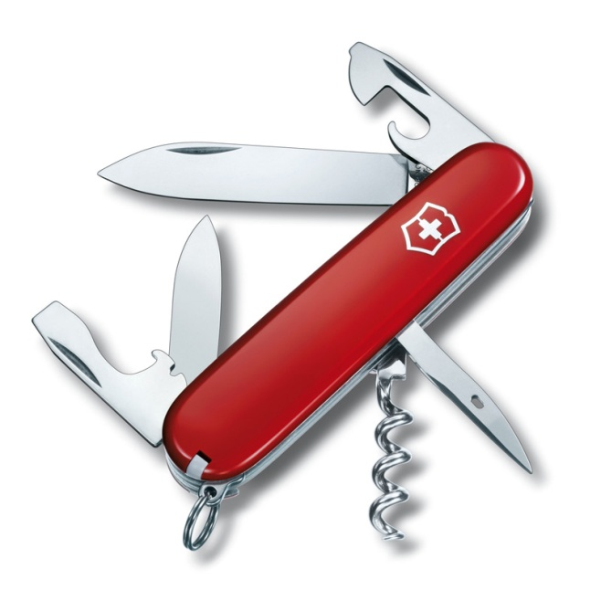
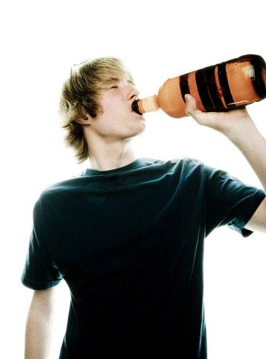
IBA
IBA is an efficient, attentive and evidence based intervention that can:
Provide a valuable opportunity to facilitate referral of cases of alcohol dependence to specialist services
Significantly reduce the alcohol consumed by people who have been identified as drinking above the low-risk guidelines

Slide 19
‘Have A Word’ builds on
Making Every Contact Count (MECC)
Refines MECC further into
Making Every RELEVANT Contact Count

Slide 20

The ‘Good to Go’ Boxes
The “right person” to intervene :
In regular contact with people; and
see the relevance of discussing alcohol
Present at the teachable moment when people may be ready and able to engage with IBA
Practical opportunity to deliver IBA – have the time, have a quiet & confidential space for discussion

Slide 21
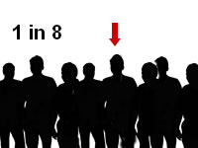

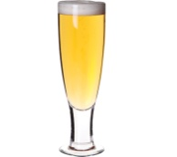



How much impact can YOU really have?
The Numbers Needed to Treat (NNT) for Alcohol Brief Interventions = 8
The average reduction in alcohol consumption (per week) is 38 grams, which equates to 4-5 units.
or
or
Kaner et al (2009) Effectiveness of brief alcohol interventions in primary care populations (Review)
Raistrick et al (2006) Review of the effectiveness of treatment for alcohol problems

Slide 22


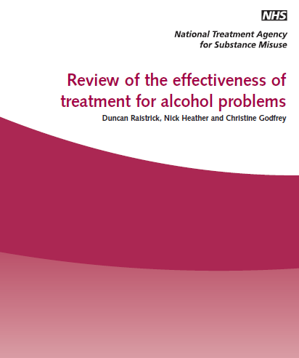
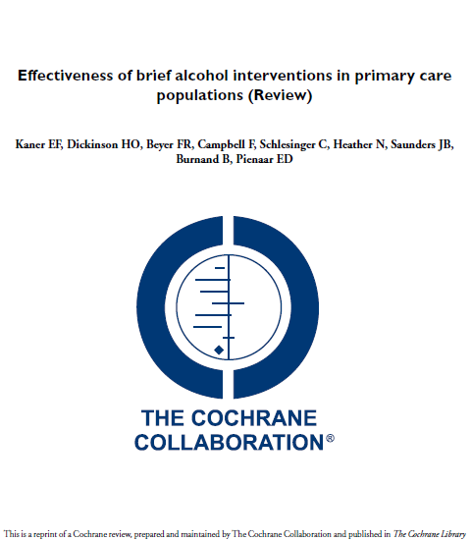
?
All very nice, but does IBA actually work?
56 controlled trials indicate that for every eight people who receive simple alcohol advice, one will reduce their drinking to within low risk levels
Brief interventions are effective and cost-effective!

Slide 23
What we hope to cover
Why Alcohol? What are the issues?
What can you do about it?
How do you do it?
Discussion

Slide 24
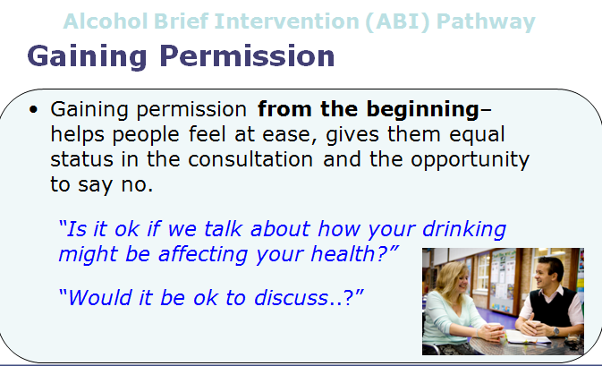
Alcohol Brief Intervention (ABI) Pathway
Notes:
You may already be doing this – there is a ‘subtle difference’ between asking whether someone smokes or drinks is not asking permission to raise the issue
This simple thing sets the collaborative tone for the next couple of minutes right at the start of this brief conversation
This helps the clients engage,
engenders their ownership of the issue and
reduces resistance
MI Principles - Always gain permission before giving advice
Communicate risk sensitively - Smoking, Alcohol, Obesity

Slide 25

Alcohol Screening
What is it?
…it is a method of identifying alcohol consumption at a level sufficiently high enough to cause concern.

Slide 26
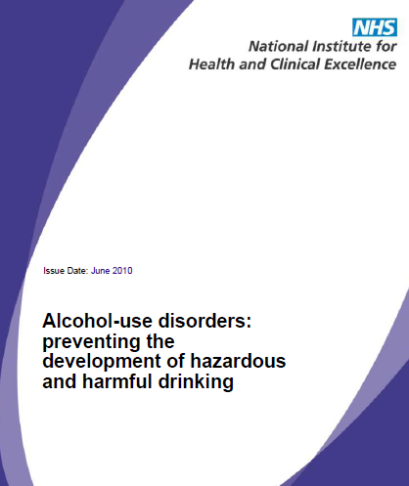


NICE Guidelines
Complete a validated screening
questionnaire, e.g. AUDIT (Alcohol
Use Disorders Identification Test), or
AUDIT-C, or FAST
16 ,17 years
Adult

Slide 27
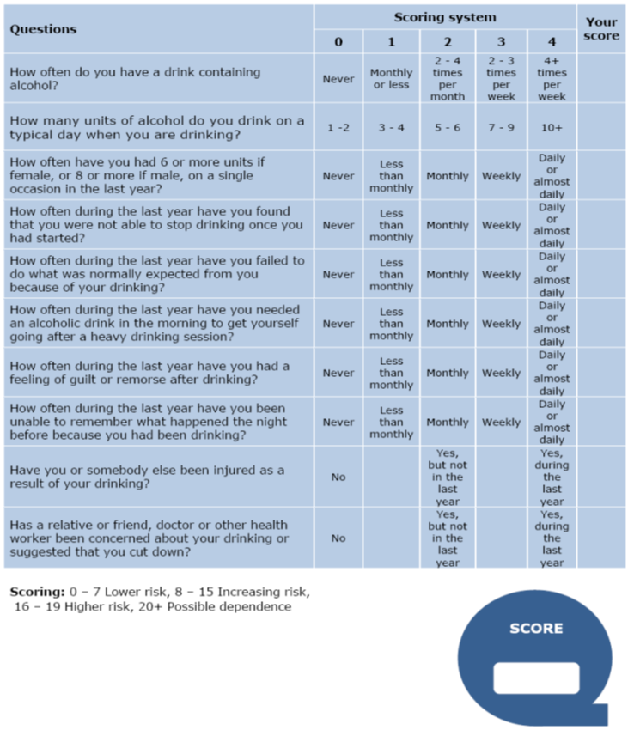
GOLD STANDARD
AUDIT
(Alcohol
Use Disorders Identification Test) but 10 questions version too long for many settings

Slide 28
Adults 18 +
Alcohol Care Pathway
Teachable Moment
Initial Screening Tools
FAST
AUDIT - C
Positive
Result
Negative
Result
Full Screen
AUDIT
No action
AUDIT Score
20+
Possible Dependence
AUDIT Score
16-19
Higher-risk
AUDIT Score
8-15
Increasing-risk
AUDIT Score
0-7
Low-risk
Consider Referral to
Specialist Services
Brief Advice

Slide 29


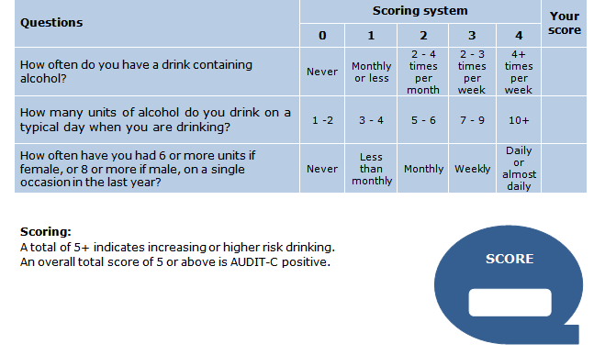
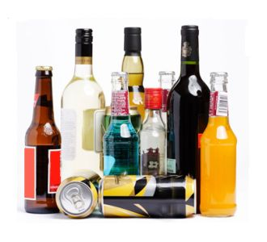

Slide 30
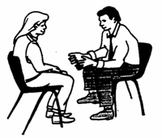
The AUDIT-C Score (0-12)
If time, carry out full AUDIT
0
1
2
3
4
5
6
7
8
9
10
11
12
Non Drinker
Sensible Drinking
Low Risk
Hazardous Drinking
Increasing Risk
Harmful Drinking
Higher Risk
Potentially
Addicted / Dependant
Public Health Wales Alcohol Brief Interventions Train the Trainer Course

Slide 31
FAST
(Fast Alcohol Screening Test)
FAST | Scoring system |  |  |  |  | Your score
 | 0 | 1 | 2 | 3 | 4
How often have you had 6 or more units if female, or 8 or more if male, on a single occasion in the last year? | Never | Less than monthly | Monthly | Weekly | Daily or almost daily
Only answer the following questions if the answer above is Never (0), Less than monthly (1) or Monthly (2). Stop here if the answer is Weekly (3) or Daily (4).
How often during the last year have you failed to do what was normally expected from you because of your drinking? | Never | Less than monthly | Monthly | Weekly | Daily or almost daily
How often during the last year have you been unable to remember what happened the night before because you had been drinking? | Never | Less than monthly | Monthly | Weekly | Daily or almost daily
Has a relative or friend, doctor or other health worker been concerned about your drinking or suggested that you cut down? | No |  | Yes, but not in the last year |  | Yes, during the last year

Slide 32
Adults 18+
Alcohol Care Pathway
Teachable Moment
Screening Tools
FAST
AUDIT - C
AUDIT – C 11+
FAST 6+
Possible Dependence
AUDIT – C 8-10
FAST 4-5
Higher-risk
AUDIT – C 5-7
FAST 3
Increasing-risk
AUDIT – C 0-4
FAST 0-2
Low-risk
Positive
Result
Negative
Result
Consider Referral to
Specialist Services
Brief Advice
No action

Slide 33

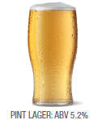
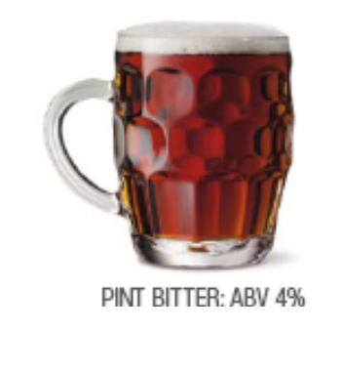
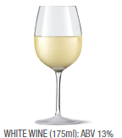
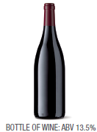
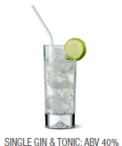
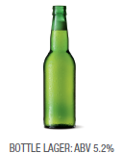
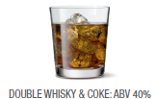
3 UNITS
2.3 UNITS
2.3 UNITS
1 UNIT
1.7 UNITS
10 UNITS
2 UNITS

Slide 34
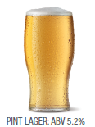
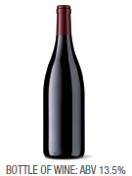
Typical night out
14
UNITS
Half
Half

Slide 35


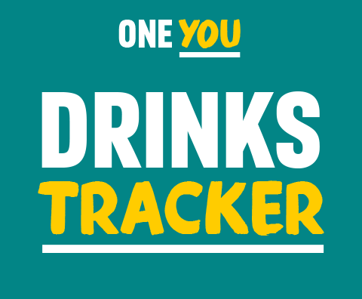
It may seem like you don't drink much, but a drink or two most evenings can do harm to your body. From making you gain weight to increasing your risk of cancer, alcohol can have serious effects on your body.
The more you drink, and the more often, the greater the risk to your health.

Slide 36
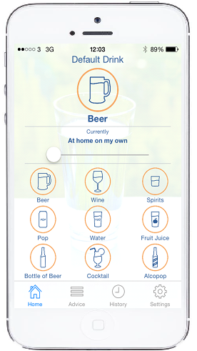
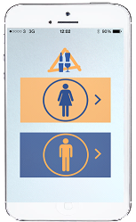
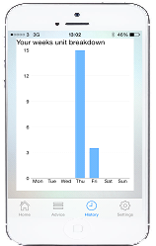
One Drink, One Click App
Launched February 2015
Available Free for an iOS i-Phone
Available from Apple- ‘One Drink- One Click’

Slide 37
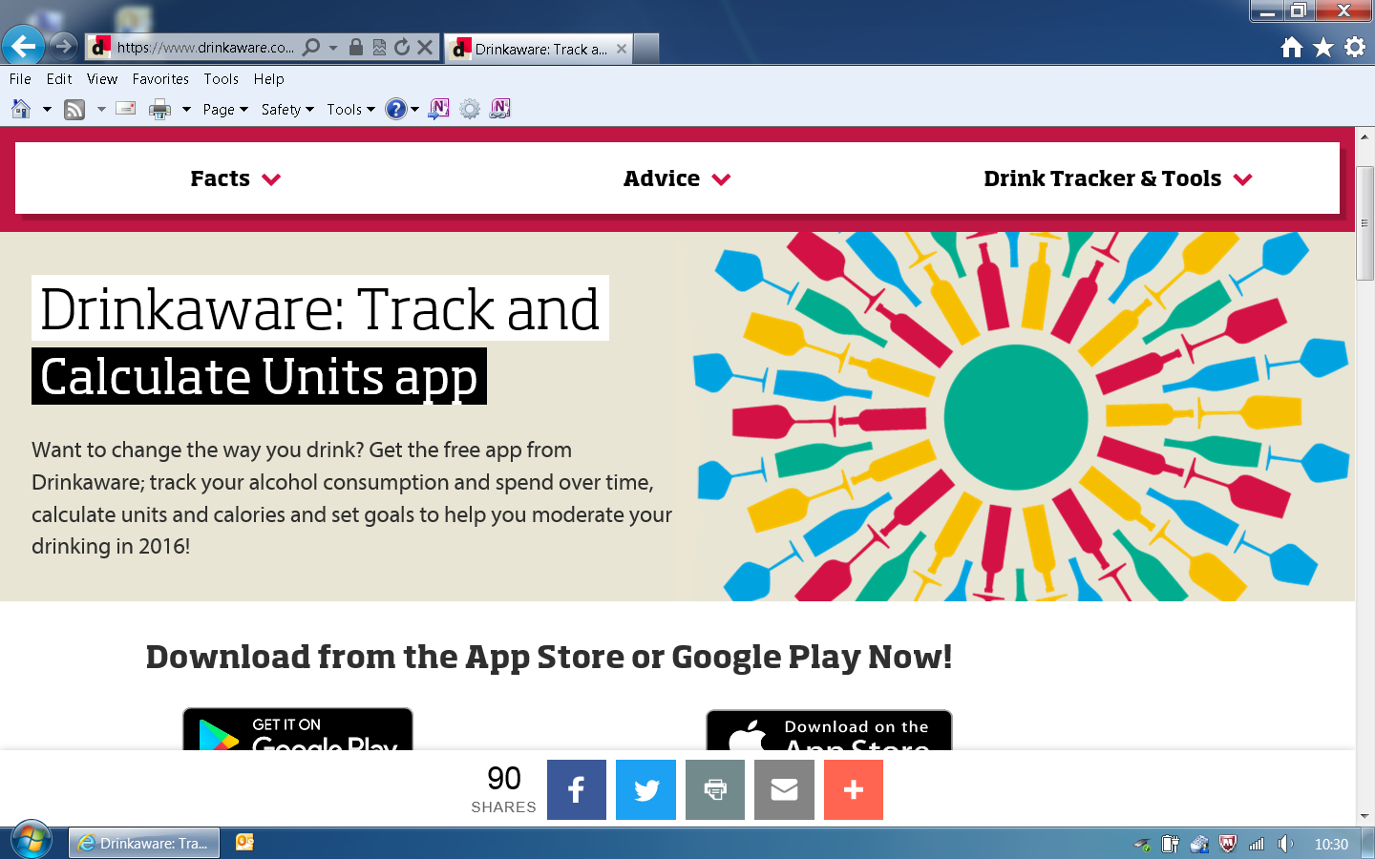
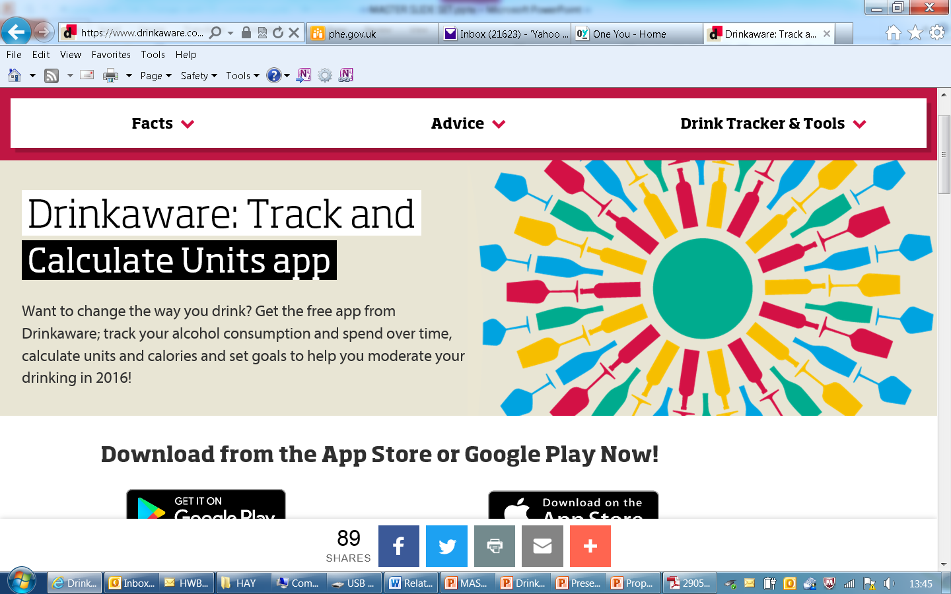
Drinkaware

Slide 38
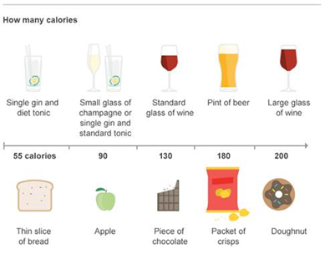
Alcohol and Calories

Slide 39


Frames- the Structure of IBA
Feedback-
Tell the person what they scored. Link their drinking to the situation. Be realistic!
Responsibility-
It’s the individuals’ own responsibility to change.
Advice-
Set a daily (& weekly) limit
Have alcohol free days
Menu-
Give them a range of options
Empathy-
Empathic, Non Judgmental
Self Efficacy-
Positive message. Boost their self confidence -“ You can do it!”

Slide 40

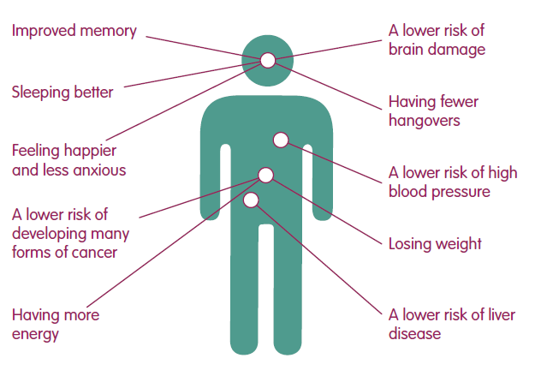
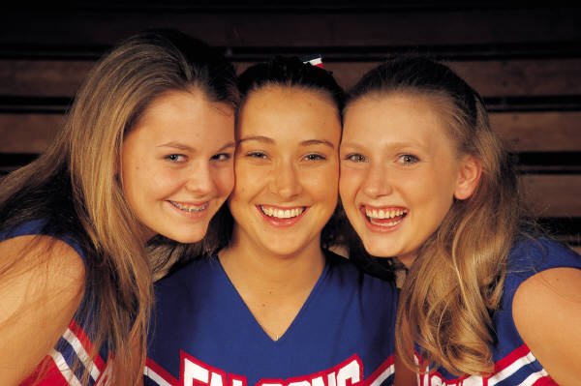
Advice
Health Advice
Feel better in the mornings
More energy!
Improved skin
Fitter, faster
Weight control

Slide 41
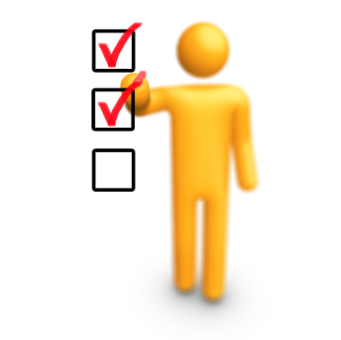
Benefits
Psychological, Social and Financial Benefits
Lower risk of accident or injury
Less chance of getting into fights
Developing better relationships
Improved Self esteem
More time
More money
Seen in a different light at work

Slide 42

Menu of Options
Swap your usual for...
A smaller drink
A lower strength drink
A soft drink
A later drink
Drink to relax? Try...
Exercise
Music, movies, books
Use the money saved to do something new
Pamper time

Slide 43

Menu of Options
Tips for a Night Out
Make a plan – set yourself pre-night out limits
Set a budget – only take a set amount of cash out with you
Start later – but don’t start at home
Take your time – don’t get into rounds
Sit one out – have a soft drink when its your round
Stay hydrated – have a few glasses of water through the night

Slide 44


When to Refer on?
Clients should be referred to their GP or other
specialist services when...
  They express the desire to talk in-depth with someone about alcohol
  They display alcohol dependence
  Have a high level of alcohol harm, physically and mentally
  When brief intervention does not seem appropriate

Slide 45


Referral Agency
Drinkline
0300 1231110
Mon - Fri 9am – 8pm
Weekends 11am – 4pm

Slide 46
References
Anderson, P. (2008) Reducing heavy drinking and alcohol admissions (Unpublished) Department of Health.
Fleming, M.F., Marlon, M.P., French, M.T., Manwell, L.B., Stauffacher, E.A. and Barry, K.L. (2000) Benefit cost analysis of brief physician advice with problem drinkers in primary care settings, Medical Care, 31(1): 7-18.
Kaner E, Beyer F, Dickinson H, Pienaar E, Campbell F, Schlesinger C, Heather N, Saunders J, Bernand B. Brief interventions for excessive drinkers in primary health care settings. Cochrane Database of Systematic Reviews 2007, Issue 2. Art No.: CD004148 DOI: 10.1002/14651858.CD004148.pub3.
Kaner E, et.al .Effectiveness of screening and brief alcohol intervention in primary care (SIPS trial): pragmatic cluster randomised controlled trial. BMJ 2013;346:e8501
Moyer, A., Finney, J., Swearingen, C. and Vergun, P. (2002) Brief Interventions for alcohol problems: a meta-analytic review of controlled investigations in treatment -seeking and non-treatment seeking populations, Addiction, 97, 279-292.
University of Sheffield (2009) Modelling to assess the effectiveness and cost effectiveness of public health related strategies and interventions to reduce alcohol attributable harm in England using the Sheffield alcohol policy model version 2.0 [online]. Available from www.nice.org.uk/guidance/PH24
Whitlock, E.P., Polen, M.R., Green, C.A., Orleans, T. and Klein, J. (2004) Behavioral counselling interventions in primary care to reduce risky/harmful alcohol use by adults: a summary of the evidence for the US Preventive Services Task Force. Annals of Internal Medicine, 140, 557-568.
Wilk, A.I., Jensen, N.M. and Havighurst, T.C. (1997) Meta-analysis of randomized control trials addressing brief interventions in heavy alcohol drinkers, Journal of General Internal Medicine, 12, 274-283.
NICE GUIDANCE: http://guidance.nice.org.uk/PH24

