Slide 1









Alcohol Brief Interventions
(Master Slides)

Slide 2

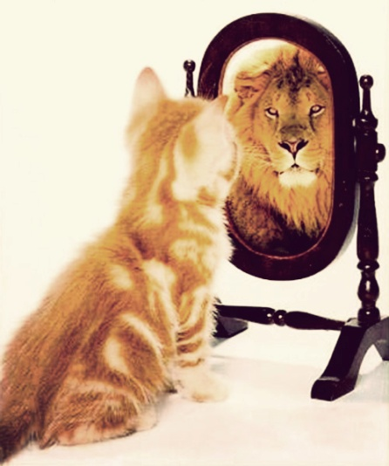
To Increase .....
Understanding... the scope of alcohol harm and how brief interventions work
Knowledge... of alcohol definitions and the tools & techniques of brief interventions
Skill... To deliver and succeed
and importantly to increase
Confidence

Slide 3
What we hope to cover
Why Alcohol? What are the issues?
What can you do about it?
How do you do it?
What are the barriers?
Discussion

Slide 4
CMOs low-risk drinking guideline
You are safest not to drink regularly more than 14 units per week to keep health risks from drinking alcohol to a low level. This advice applies to both men and women
It is best to spread this drinking over 3 days or more during the week
A good way to help you keep the risk low is to have several drink-free days each week
If you are pregnant or planning a pregnancy, the safest approach is not to drink alcohol at all, to keep risks to your baby to a minimum

Slide 5
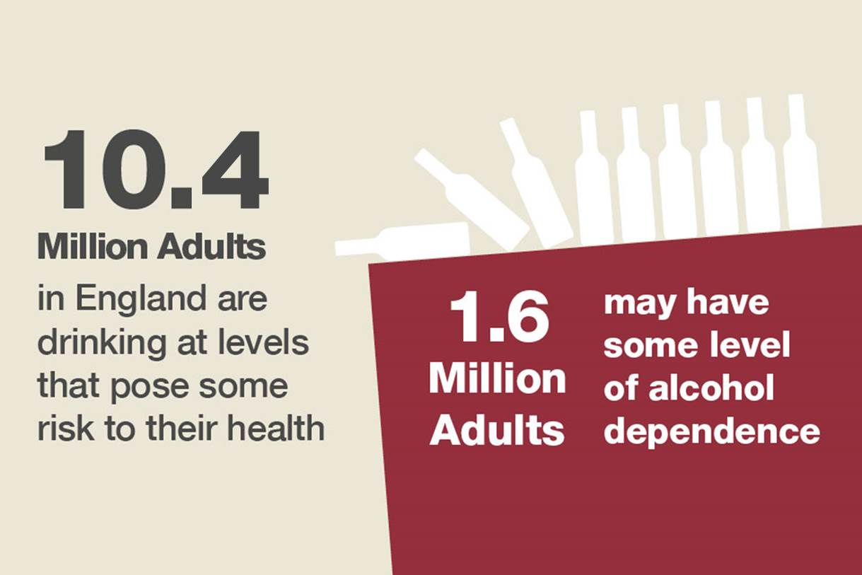
This means that roughly 1 in 4 adults might benefit from reducing their alcohol consumption

Slide 6
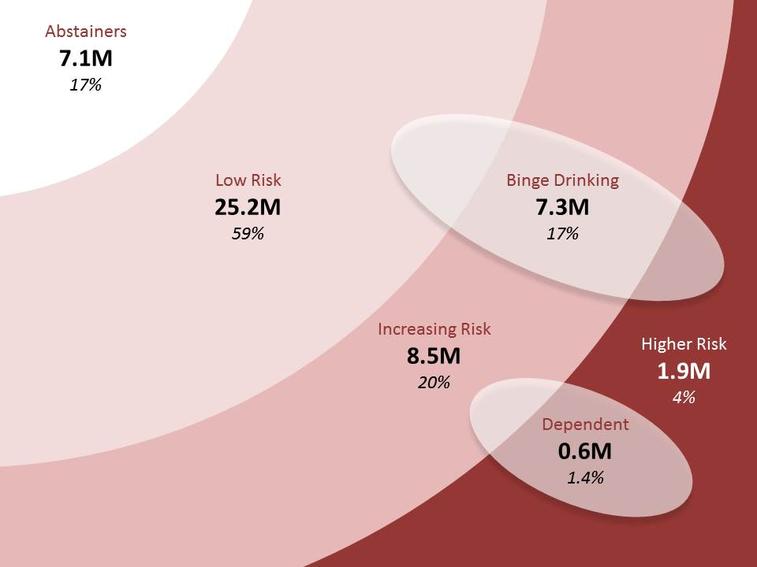
Drinking “At Risk” groups

Slide 7
Increasing-risk = Hazardous
Higher-risk = Harmful

Slide 8
Alcohol drunk now- compared to five years ago

Slide 9
Higher-risk by ethnic groups

Slide 10
Risk group and the amount of alcohol consumed
1% of the population drink 15% of all the alcohol!
4% drink over 30%!

Slide 11
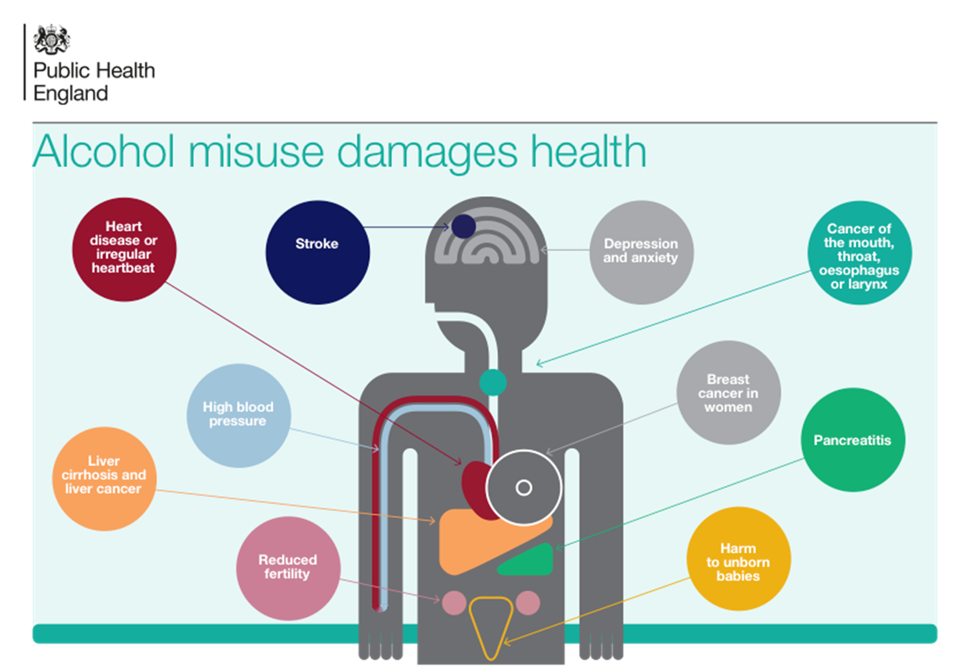
Health Harms

Slide 12
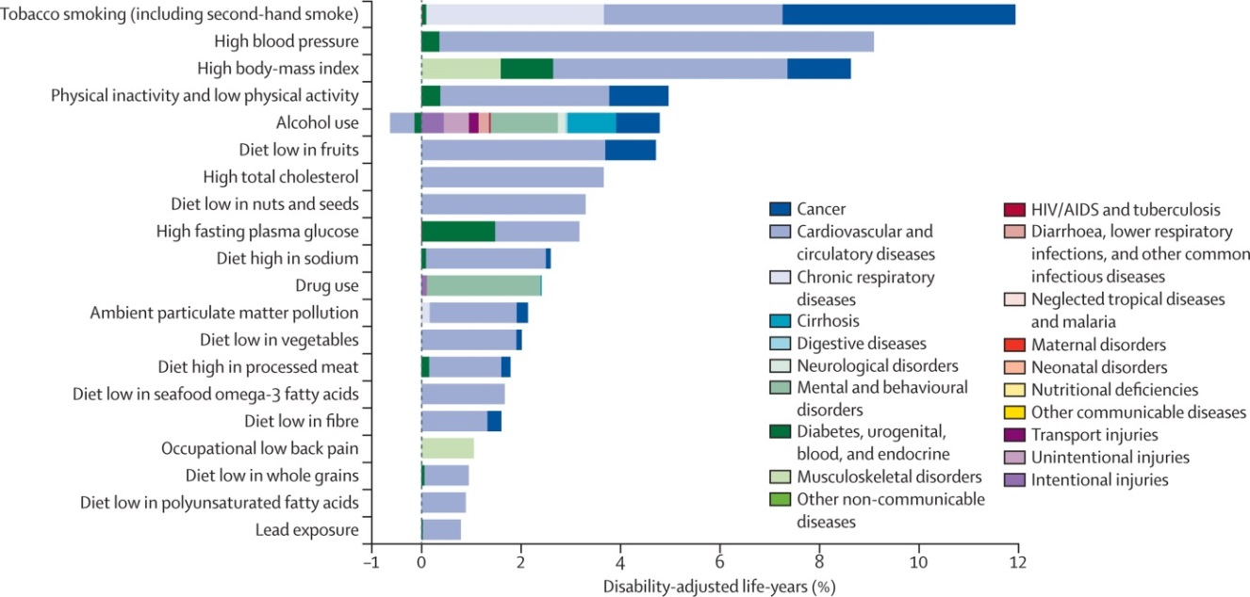
Burden of disease attributable to 20 leading risk factors for both sexes in 2010, expressed as a percentage of UK disability-adjusted life-years

Slide 13
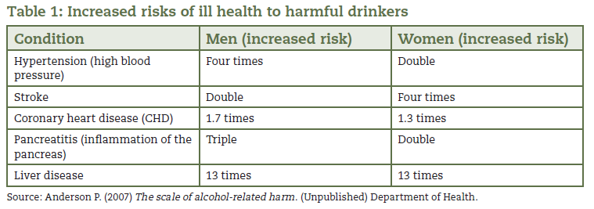

Increased risks of ill health to harmful drinkers

Slide 14
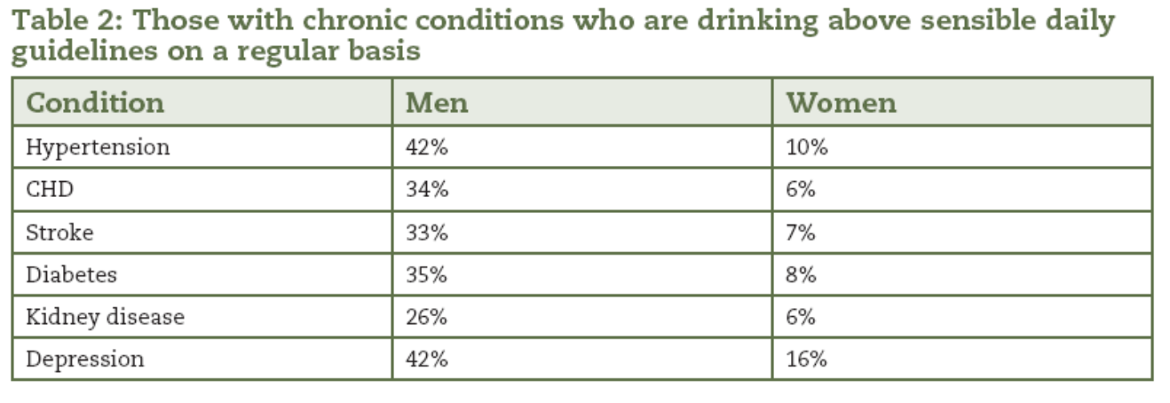
QOF registers and risky drinking

Slide 15
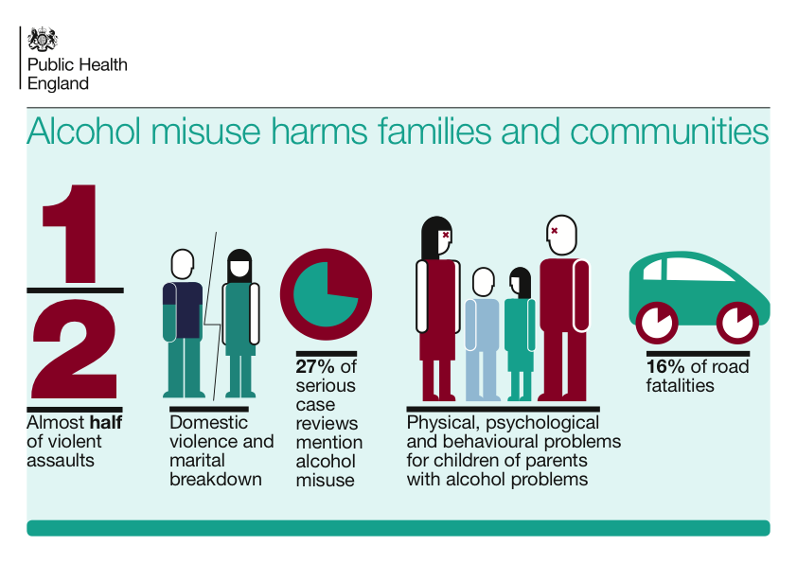
Social Harms from Alcohol

Slide 16
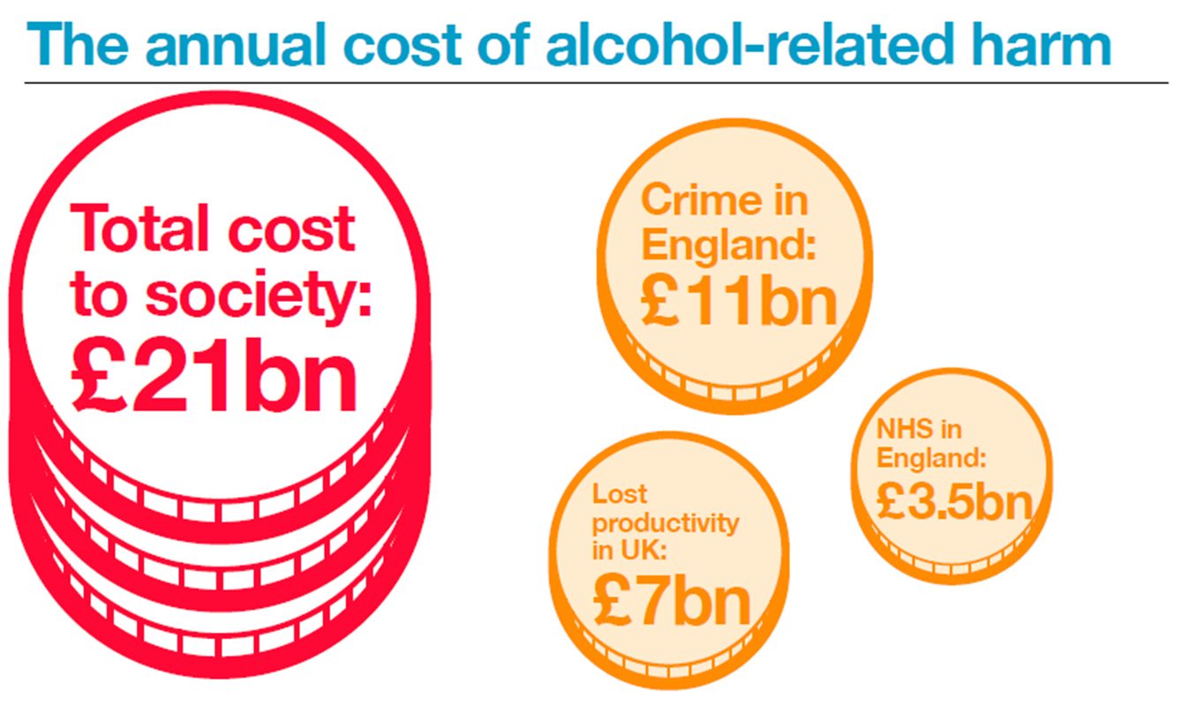

Slide 17
So who is at risk of alcohol related harm?
Potentially 10+ million people in England
It doesn’t take much to be at risk
It’s not just the hard core dependent individuals
It’s about minimising the risk where possible

Slide 18
Public perception of alcohol risk
Most people are unaware that they are drinking above the low-risk guidelines
Many do not see drinking above the low-risk guidelines as a problem
Many aware that alcohol caused liver problems, but few aware of its contribution to cancers

Slide 19
What we hope to cover
Why Alcohol? What are the issues?
What can you do about it?
How do you do it?
What are the barriers?
Discussion

Slide 20

What is an Alcohol Identification & Brief Advice (IBA)?
“A short, evidence-based, structured conversation about alcohol consumption with a client to motivate and support the individual to think about and/or plan a change in their drinking behaviour in order to reduce their consumption”
NHS Scotland (2009)
ABI = Alcohol Brief Intervention
ABI
IBA
IBA=Identification and Brief Advice

Slide 21

Always be on the look out for
A naturally occurring life transition or health event that motivate or activate individuals to spontaneously adopt risk-reducing health behaviours.
Timing formal interventions to take advantage of these naturally occurring events increase the effectiveness of that behaviour change.

Slide 22

What’s the point of IBA?
The primary goal of IBA is to reduce alcohol consumption by showing the client...
What the consequences of their drinking might be
What the client can do about it
What help and support can be accessed

Slide 23

Identification & Brief Advice (IBA) pathway
Raise the issue or look/ listen for ‘Triggers’
Exit strategy – remember that you or the client can stop the conversation at any time
Close the conversation but keep an ‘open door’ and sign post or refer onto further support
Screen and give feedback
Listen for readiness to change
Use a suitable approach
Build Confidence
Coping Strategies
Info and advice
Menu of Options
Motivate

Slide 24

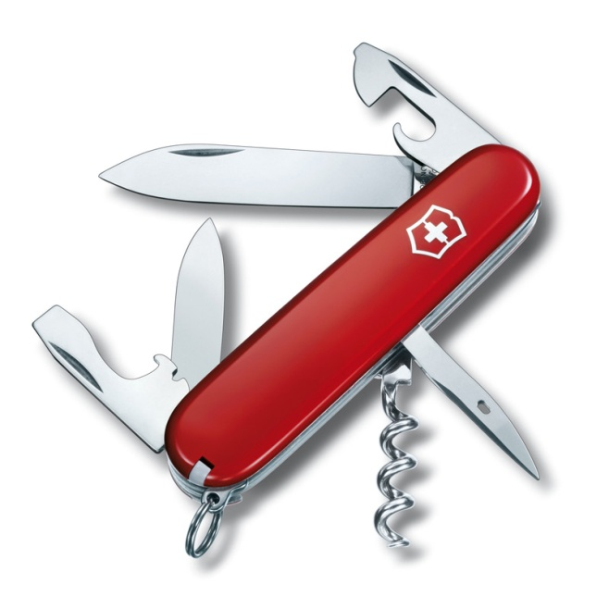
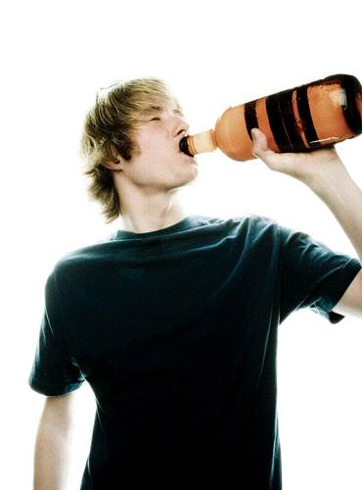
IBA
IBA is an efficient, attentive and evidence based intervention that can:
Provide a valuable opportunity to facilitate referral of cases of alcohol dependence to specialist services
Significantly reduce the alcohol consumed by people who have been identified as drinking above the low-risk guidelines

Slide 25
‘Have A Word’ builds on
Making Every Contact Count (MECC)
Refines MECC further into
Making Every RELEVANT Contact Count

Slide 26

The ‘Good to Go’ Boxes
The “right person” to intervene :
In regular contact with people; and
see the relevance of discussing alcohol
Present at the teachable moment when people may be ready and able to engage with IBA
Practical opportunity to deliver IBA – have the time, have a quiet & confidential space for discussion

Slide 27
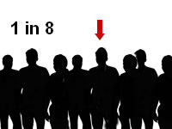

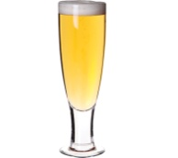



How much impact can YOU really have?
The Numbers Needed to Treat (NNT) for Alcohol Brief Interventions = 8
The average reduction in alcohol consumption (per week) is 38 grams, which equates to 4-5 units.
or
or
Kaner et al (2009) Effectiveness of brief alcohol interventions in primary care populations (Review)
Raistrick et al (2006) Review of the effectiveness of treatment for alcohol problems

Slide 28


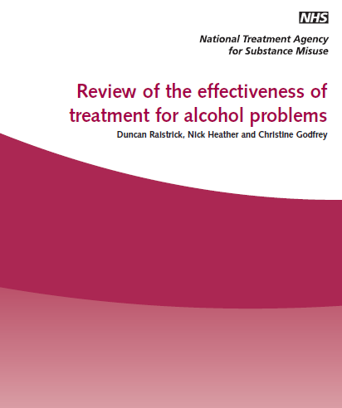
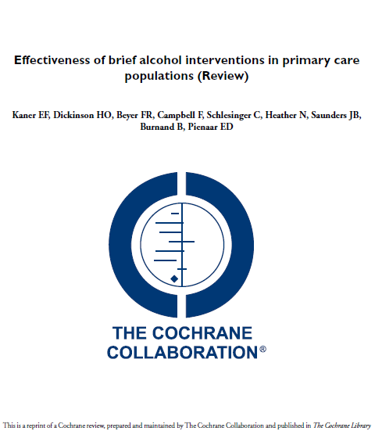
?
All very nice, but does IBA actually work?
56 controlled trials indicate that for every eight people who receive simple alcohol advice, one will reduce their drinking to within low risk levels
Brief interventions are effective and cost-effective!

Slide 29
What we hope to cover
Why Alcohol? What are the issues?
What can you do about it?
How do you do it?
What are the barriers?
Discussion

Slide 30
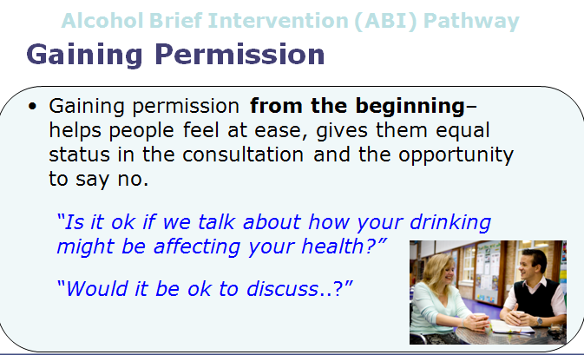
Alcohol Brief Intervention (ABI) Pathway
Notes:
You may already be doing this – there is a ‘subtle difference’ between asking whether someone smokes or drinks is not asking permission to raise the issue
This simple thing sets the collaborative tone for the next couple of minutes right at the start of this brief conversation
This helps the clients engage,
engenders their ownership of the issue and
reduces resistance
MI Principles - Always gain permission before giving advice
Communicate risk sensitively - Smoking, Alcohol, Obesity

Slide 31

Alcohol Screening
What is it?
…it is a method of identifying alcohol consumption at a level sufficiently high enough to cause concern.

Slide 32

Requirements of a Screening Tool
Ease of Use
Easy to interpret
Brevity
Effective at case finding
Non threatening / judgemental to the patient
Accuracy for the user

Slide 33
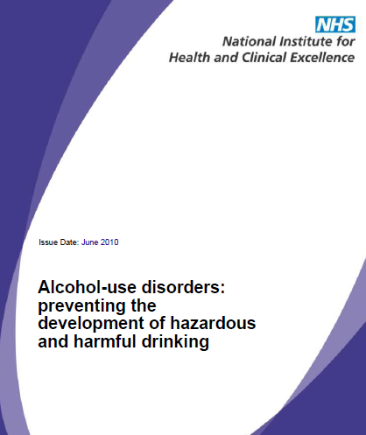


NICE Guidelines
Complete a validated screening
questionnaire, e.g. AUDIT (Alcohol
Use Disorders Identification Test), or
AUDIT-C, or FAST
16 ,17 years
Adult

Slide 34
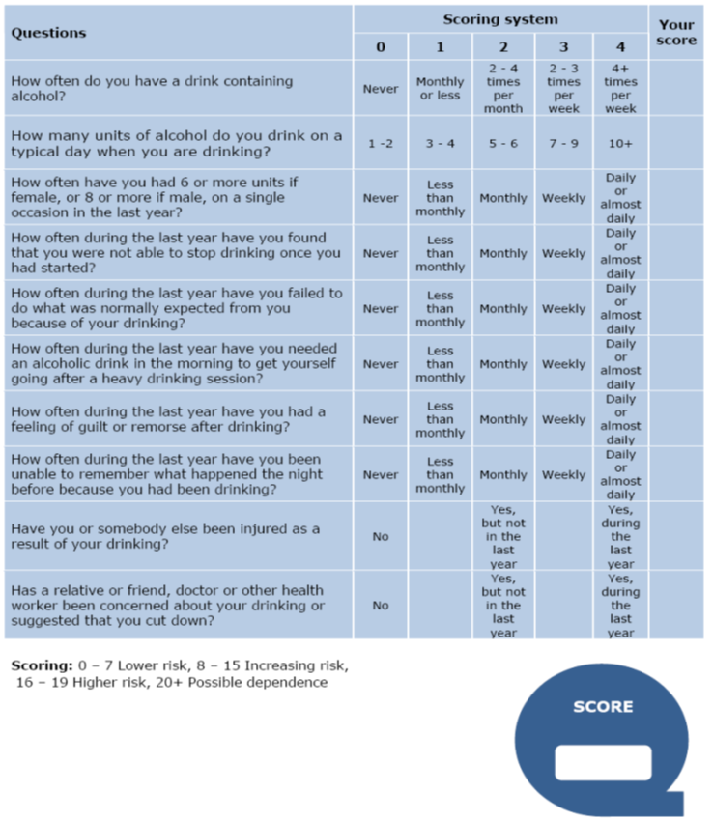
GOLD STANDARD
AUDIT
(Alcohol
Use Disorders Identification Test) but 10 questions version too long for many settings

Slide 35
Adults 18 +
Alcohol Care Pathway
Teachable Moment
Initial Screening Tools
FAST
AUDIT - C
Positive
Result
Negative
Result
Full Screen
AUDIT
No action
AUDIT Score
20+
Possible Dependence
AUDIT Score
16-19
Higher-risk
AUDIT Score
8-15
Increasing-risk
AUDIT Score
0-7
Low-risk
Consider Referral to
Specialist Services
Brief Advice

Slide 36


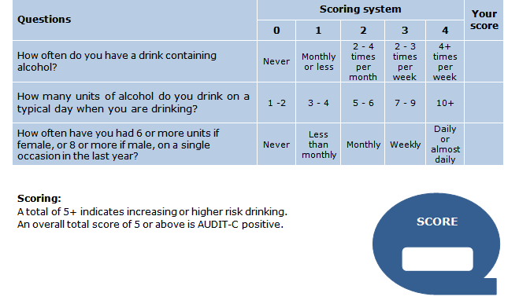
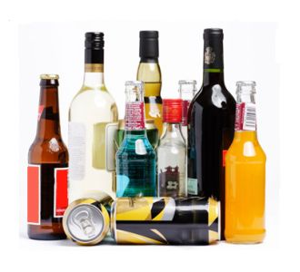

Slide 37
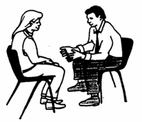
The AUDIT-C Score (0-12)
If time, carry out full AUDIT
0
1
2
3
4
5
6
7
8
9
10
11
12
Non Drinker
Sensible Drinking
Low Risk
Hazardous Drinking
Increasing Risk
Harmful Drinking
Higher Risk
Potentially
Addicted / Dependant
Public Health Wales Alcohol Brief Interventions Train the Trainer Course

Slide 38
FAST
(Fast Alcohol Screening Test)
FAST | Scoring system |  |  |  |  | Your score
 | 0 | 1 | 2 | 3 | 4
How often have you had 6 or more units if female, or 8 or more if male, on a single occasion in the last year? | Never | Less than monthly | Monthly | Weekly | Daily or almost daily
Only answer the following questions if the answer above is Never (0), Less than monthly (1) or Monthly (2). Stop here if the answer is Weekly (3) or Daily (4).
How often during the last year have you failed to do what was normally expected from you because of your drinking? | Never | Less than monthly | Monthly | Weekly | Daily or almost daily
How often during the last year have you been unable to remember what happened the night before because you had been drinking? | Never | Less than monthly | Monthly | Weekly | Daily or almost daily
Has a relative or friend, doctor or other health worker been concerned about your drinking or suggested that you cut down? | No |  | Yes, but not in the last year |  | Yes, during the last year

Slide 39
Adults 18+
Alcohol Care Pathway
Teachable Moment
Screening Tools
FAST
AUDIT - C
AUDIT – C 11+
FAST 6+
Possible Dependence
AUDIT – C 8-10
FAST 4-5
Higher-risk
AUDIT – C 5-7
FAST 3
Increasing-risk
AUDIT – C 0-4
FAST 0-2
Low-risk
Positive
Result
Negative
Result
Consider Referral to
Specialist Services
Brief Advice
No action

Slide 40

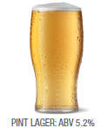
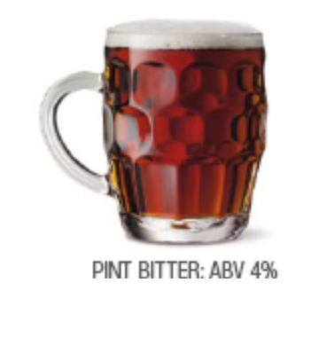

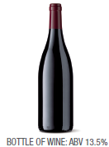
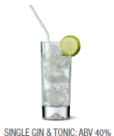
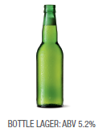
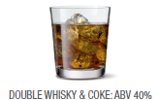
3 UNITS
2.3 UNITS
2.3 UNITS
1 UNIT
1.7 UNITS
10 UNITS
2 UNITS

Slide 41
Typical night in
8.4
UNITS
Half

Slide 42
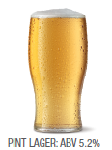
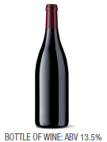
Typical night out
14
UNITS
Half
Half

Slide 43


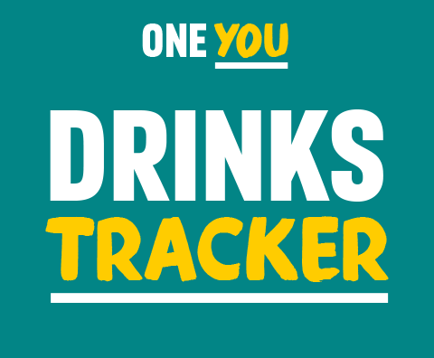
It may seem like you don't drink much, but a drink or two most evenings can do harm to your body. From making you gain weight to increasing your risk of cancer, alcohol can have serious effects on your body.
The more you drink, and the more often, the greater the risk to your health.

Slide 44
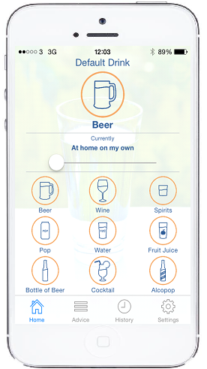
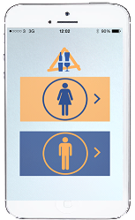
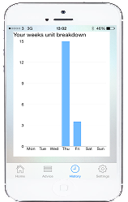
One Drink, One Click App
Launched February 2015
Available Free for an iOS i-Phone
Available from Apple- ‘One Drink- One Click’

Slide 45
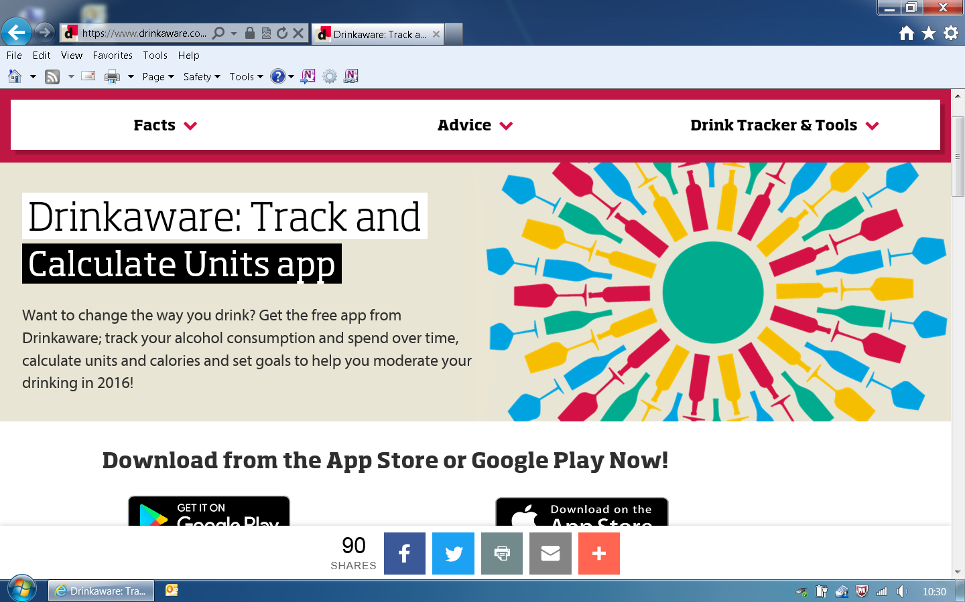
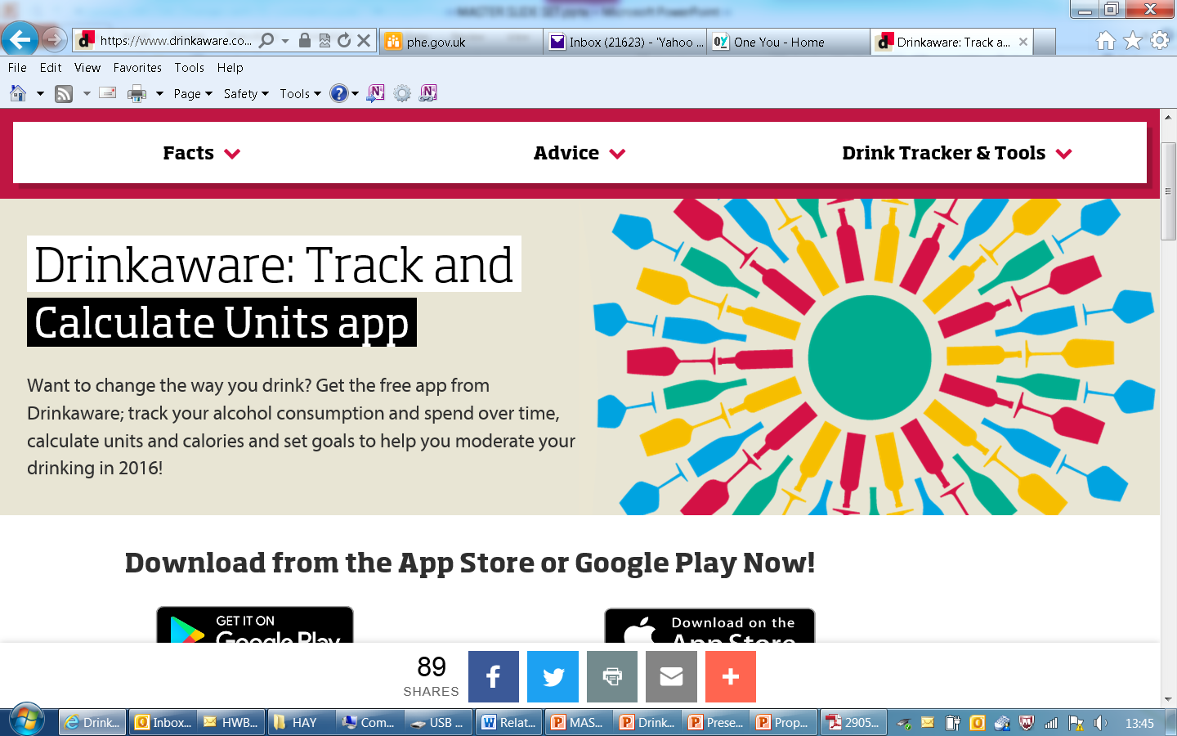
Drinkaware

Slide 46
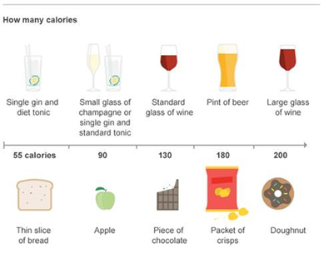
Alcohol and Calories

Slide 47


Frames- the Structure of IBA
Feedback-
Tell the person what they scored. Link their drinking to the situation. Be realistic!
Responsibility-
It’s the individuals’ own responsibility to change.
Advice-
Set a daily (& weekly) limit
Have alcohol free days
Menu-
Give them a range of options
Empathy-
Empathic, Non Judgmental
Self Efficacy-
Positive message. Boost their self confidence -“ You can do it!”

Slide 48

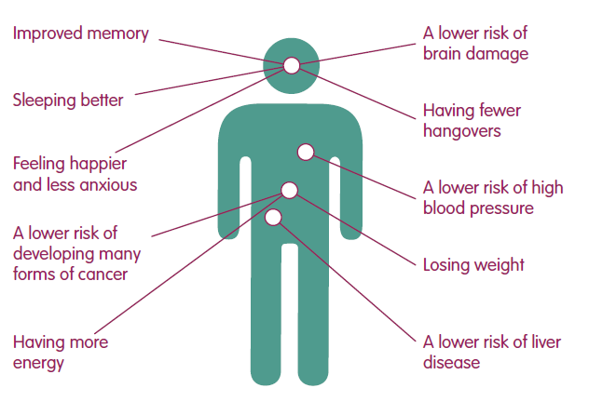
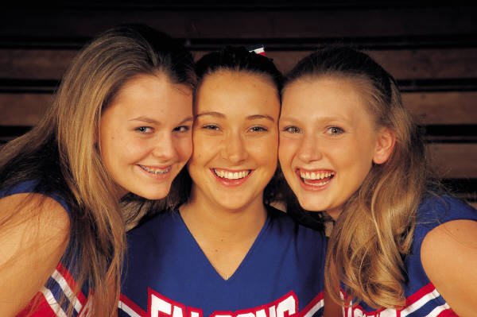
Advice
Health Advice
Feel better in the mornings
More energy!
Improved skin
Fitter, faster
Weight control

Slide 49
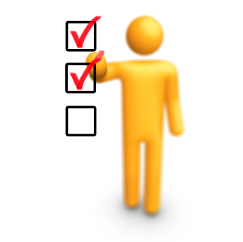
Benefits
Psychological, Social and Financial Benefits
Lower risk of accident or injury
Less chance of getting into fights
Developing better relationships
Improved Self esteem
More time
More money
Seen in a different light at work

Slide 50

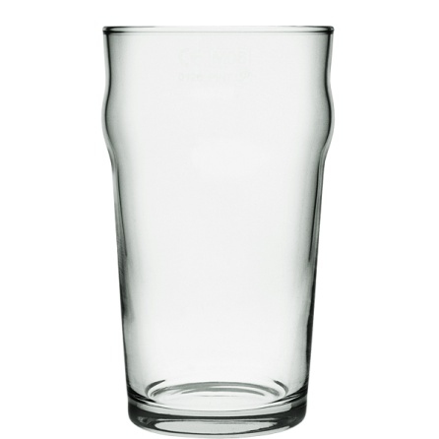
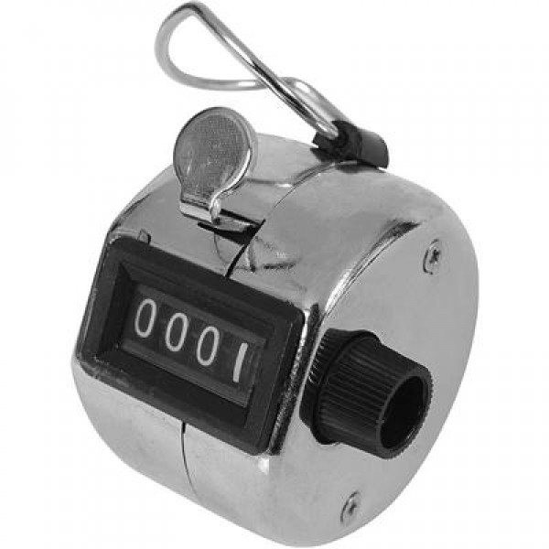
Menu of Options
Simple and Straight Away
“Have drink free days
every week”
“Keep track of how much
you drink”

Slide 51

Menu of Options
Swap your usual for...
A smaller drink
A lower strength drink
A soft drink
A later drink
Drink to relax? Try...
Exercise
Music, movies, books
Use the money saved to do something new
Pamper time

Slide 52

Menu of Options
Tips for a Night Out
Make a plan – set yourself pre-night out limits
Set a budget – only take a set amount of cash out with you
Start later – but don’t start at home
Take your time – don’t get into rounds
Sit one out – have a soft drink when its your round
Stay hydrated – have a few glasses of water through the night

Slide 53

Expressing Empathy
Empathy is not sympathy, pity, warmth, acceptance or identification.
Empathy is showing an active interest in and effort to see the world through their eyes
  Explore opinions and ideas about the behaviour
  Accurate reflection
Notes:
Notes for reference
Empathy is not sympathy, a feeling of pity or camaraderie with the person. Neither is it identification: “I've been there and I know what you’re experiencing. Let me tell you my story”. Empathy is not warmth, acceptance, genuineness or client advocacy.
Empathy is an active interest in and effort to understand the other’s internal perspective, to see the world through their eyes. “put self in clients shoes”
Clinicians high in empathy are curious, approach the session as an opportunity to learn about the client. Explore the clients opinions and ideas about the behaviour.
The clinician makes active effort to understand the client point of view, shows interest, offers accurate reflections of what the client has said

Slide 54


When to Refer on?
Clients should be referred to their GP or other
specialist services when...
  They express the desire to talk in-depth with someone about alcohol
  They display alcohol dependence
  Have a high level of alcohol harm, physically and mentally
  When brief intervention does not seem appropriate

Slide 55


Referral Agency
Drinkline
0300 1231110
Mon - Fri 9am – 8pm
Weekends 11am – 4pm

Slide 56
What we hope to cover
Why Alcohol? What are the issues?
What can you do about it?
How do you do it?
What are the barriers?
Discussion

Slide 57
Insufficient time to deliver brief advice
Screening and feedback on the patient’s AUDIT score and what it means about their level of risk may be the most important part of Identification and Brief Advice
Brief advice does not have to be extensive. A simple discussion about:
      Benefits of cutting down
      Tips for cutting down
This should take 2-3 minutes
Give the patient written information to take home to reflect on later

Slide 58
Not be trained to deliver the alcohol brief intervention
Research has shown that effective brief advice can be as simple as:
      Feedback about the patient’s AUDIT score and what that score means about their level of risk
      Providing further information in the form of a leaflet that the patient can take home
The brief advice needs to be delivered there and then following screening. Research has shown that referring the patient to someone else for the brief advice will result in fewer than 50% getting that advice. Patients will not go - You will have missed the opportunity

Slide 59
Not confident asking AUDIT questions
No screening tool is perfect
AUDIT is the best we have
      AUDIT was developed by the World Health Organisation
      AUDIT is used all over the world
      Alternatives (CAGE , MAST) are ONLY about dependence
10 questions of AUDIT
      1-3 all about CONSUMPTION (this is AUDIT-C)
      4-6 all about DEPENDENCE
      7-10 various CONSEQUENCES of drinking
Give feedback about TOTAL score

Slide 60
Patient reluctant to take up a referral
That is OK
You may have “planted a seed” that will germinate later
Your role is to:
      Assesses the level of risk
      Give the individual the feedback about that level of risk
      Provide information about how to reduce that level of risk
It is up to the patient what they do with that information
The most important thing is to raise the issue and have a brief conversation about alcohol

Slide 61
References
Anderson, P. (2008) Reducing heavy drinking and alcohol admissions (Unpublished) Department of Health.
Fleming, M.F., Marlon, M.P., French, M.T., Manwell, L.B., Stauffacher, E.A. and Barry, K.L. (2000) Benefit cost analysis of brief physician advice with problem drinkers in primary care settings, Medical Care, 31(1): 7-18.
Kaner E, Beyer F, Dickinson H, Pienaar E, Campbell F, Schlesinger C, Heather N, Saunders J, Bernand B. Brief interventions for excessive drinkers in primary health care settings. Cochrane Database of Systematic Reviews 2007, Issue 2. Art No.: CD004148 DOI: 10.1002/14651858.CD004148.pub3.
Kaner E, et.al .Effectiveness of screening and brief alcohol intervention in primary care (SIPS trial): pragmatic cluster randomised controlled trial. BMJ 2013;346:e8501
Moyer, A., Finney, J., Swearingen, C. and Vergun, P. (2002) Brief Interventions for alcohol problems: a meta-analytic review of controlled investigations in treatment -seeking and non-treatment seeking populations, Addiction, 97, 279-292.
University of Sheffield (2009) Modelling to assess the effectiveness and cost effectiveness of public health related strategies and interventions to reduce alcohol attributable harm in England using the Sheffield alcohol policy model version 2.0 [online]. Available from www.nice.org.uk/guidance/PH24
Whitlock, E.P., Polen, M.R., Green, C.A., Orleans, T. and Klein, J. (2004) Behavioral counselling interventions in primary care to reduce risky/harmful alcohol use by adults: a summary of the evidence for the US Preventive Services Task Force. Annals of Internal Medicine, 140, 557-568.
Wilk, A.I., Jensen, N.M. and Havighurst, T.C. (1997) Meta-analysis of randomized control trials addressing brief interventions in heavy alcohol drinkers, Journal of General Internal Medicine, 12, 274-283.
NICE GUIDANCE: http://guidance.nice.org.uk/PH24

