Slide 1
Exploring the ICU Education Experience Across London During the COVID Pandemic: Survey Results Doctors redeployed to ICU
London Transformation and Learning Collaboration (LTLC)

Slide 2
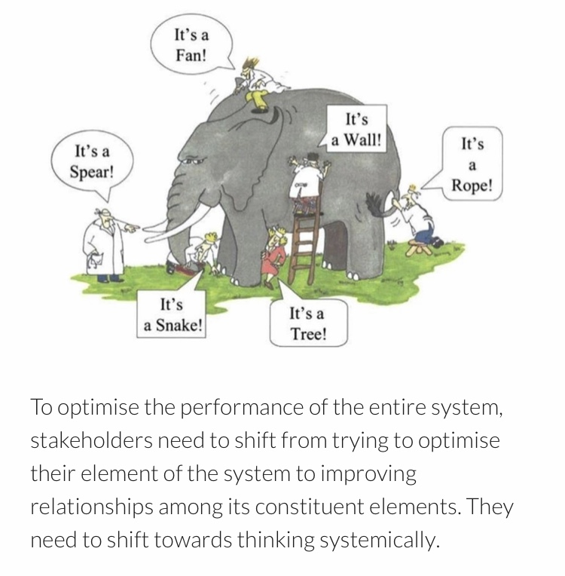
Purpose of the London Transformation & Learning Collaborative (LTLC)
We want to assist system working and move forward in a way that will support growth and optimise effectiveness.
Work collaboratively
Share best practice across organisations, systems and the region
Enable colleagues to be more prepared to work in an expanded critical care as well as in the event of a second surge thereby improving staff experience
Support each other in improving patient outcomes
Providing training content and structure that can be delivered consistently and effectively
Notes:
Purpose of the collaborative is to:
shift towards thinking collaboratively to optimise the performance of the entire system
to work together,
sharing our strengths,
improving the experiences of our staff and their physical and psychological safety,
improving patient outcomes and
providing training that can be delivered consistently and effectively across the patch.

Slide 3
Purpose
About the LTLC Programme:
To increase the supply and resilience of staffing for critical care across London
To develop a London plan that seeks to ensure that the NHS workforce is equipped with the skills and capabilities to manage existing demand, potential future spikes in demand as a result of Covid-19 and longer-term permanent expansion of critical care capacity in London.
Primary outcome
To cross-skill staff to support the London region to expand ICU capacity with the potential to open more critical care beds in surge
Scope
Develop clinical education transformation capability across the NHS in London: Develop transformation programmes which align to patient need, service model, and workforce models.
Co-ordinate design and delivery of training to support London’s response to Covid-19: Establish innovative education delivery models that will support the development of an agile workforce that has the robust capability to deal with a second surge.

Slide 4
Survey Aims and Research Questions
Aim: Explore education experiences of those who worked in ICUs across London during the COVID pandemic; both those who worked in ICU and those who were redeployed to ICU
Research Questions:
1
ICU staff delivering education
Demographics
Education successes
Education challenges
Useful professional groups
Support needed for a second surge
Would collaborating with other ICUs help?
Training resources and IT systems used
2
ICU staff receiving education
Demographics
Useful elements of training
Elements of preparation that were missing
What would you do differently?
3
Non-ICU/Redeployed staff
Useful elements of training
Training that was missing
Useful things learnt (how and from who)
Steepest learning curve (how it was overcome)
Training resources used
What would you do differently?
Advice to a colleague going to work in ICU
179 responses
138 responses
616 responses
Total = 933 responses

Slide 5
Survey Results: Reponses from Doctors that were redeployed to ICU during the pandemic *Resources that were suggested in the survey responses are being collated separately and are not discussed in this summary
Total = 78 Responses

Slide 6
Redeployed Doctors: Area and Location
Normal Area of Work | No.
Surgery | 25
Medicine | 16
Anaesthetics/ theatres | 13
Rotating | 10
Paediatrics | 5
Sexual Health | 5
Obstetrics and gynaecology | 4
Cardiology | 3
Radiology | 2
General Practioner | 2
TOTAL | 78
Level | No
Consultant | 14
Registrar | 29
SHO | 31
F1 | 4
North
Central
South
West
South East
North West
North East

Slide 7
Q1: During the initial COVID response what was the most useful and important elements of training you received?*
ICU Skills and Knowledge |  | General
Ventilation | 18 | Introduction/cross-skilling course | 18
Patient assessment in ITU | 10 | No training | 9
PPE | 10 | Hands-on training in ICU | 8
Proning | 10 | Online resources | 8
Line insertion | 7 | Equipment | 4
Simulation | 4 | Crib sheet/cheat sheets | 3
Circulatory support | 4
ICU medications | 4
COVID knowledge | 3
Documentation | 2
*Topics mentioned only once are not included
Notes:
1 response – ECMO tracheotomy

Slide 8
Discussion Q1: During the initial COVID response what was the most useful and important elements of training you received?
Many doctors said that they did not receive any formal training before redeployment
Elements of training that were deemed most useful were: Ventilation, assessment of ICU patients, PPE, proning and learning procedures such as line insertion
Cross-skilling or introductory ICU courses were deemed to be very useful, however many discussed the need for more hands-on training and shadowing within ICU
A “cheat sheet” was mentioned several times from North West doctors as a useful resource for summarising key ICU information
“We did not receive any formal training prior to starting however we were directed to some online modules that covered generic ICU principles which was helpful” Redeployed doctor, SHO

Slide 9
Q2: What do you wish you had known more about / had more specific training before you worked in CC?
ICU Skills and Knowledge |  | Other
Ventilation/airway management | 32 | Nothing | 12
ICU Medications | 8 | Orientation to ward, role and team structure | 10
Delirium | 6 | Equipment | 4
Deteriorating Patients | 6 | Simulation Training | 4
Renal Replacement therapy | 5 | Supporting others | 4
Tracheostomy | 4 | Wellbeing | 3
Procedures | 3 | Hands-on training | 2
PPE | 2 | Communication | 1
COVID knowledge | 2
Proning and manual handling | 2
End of life care | 1

Slide 10
Discussion Q2: What do you wish you had known more about/ had more specific training before you worked in CC?
Some doctors said that there was no additional training that was needed however they were commonly doctors who had previous ICU experience
Elements of training felt to be lacking were: Ventilation, ICU drugs (including inotropes and sedative drugs), delirium, deteriorating patients and renal replacement therapy
There was a lack of local induction and orientation to the ward, role and team
Orientation to equipment was a common theme and was felt to be lacking - particularly ventilators
Several doctors commented on how they had wished they were able to support the other staff better
“Basic ICU nursing tasks- changing syringe drivers, mixing drugs, observations etc. The nurses were overwhelmed it would have been nice to gave been in a better position to support them” Redeployed doctor, NEL
“I would have liked a proper induction. We weren’t inducted meaning we didn’t know where crash trolleys were, what systems we needed to use” Redeployed doctor, NWL
“More details on the role and what was involved. Specific training on some of the tasks to be carried out through the role” Redeployed doctor, NWL

Slide 11
Q3. What were the most useful things you learnt whilst looking after patients in CC?* Who did you learn this from and how?
Useful Things Learnt
Ventilation | 23
Practical Skills | 12
Circulatory support | 11
Patient assessment | 10
Deteriorating patient | 10
Communication/teamwork | 9
Proning | 8
ICU drugs | 7
Sedation | 5
COVID knowledge | 5
Procedures | 5
Ceilings of care/ End of life care | 4
From Who and How
Doctors | 38
Nurses | 23
Hands-on experience | 22
Self-directed | 13
Ward round | 10
Team generally | 9
Simulation | 3
Grand round | 1
Educators | 1
Operating department practitioner | 1
Physiotherapist | 1
*Top 12 responses only

Slide 12
Discussion Q3: What were the most useful things you learnt whilst looking after patient in CC? Who did you learn this from and how?
It was felt that most learning occurred within ICU as opposed to during training
Ventilation, practical ICU skills (such as drawing up infusions, giving medications, doing observations) and patient assessment were felt to be the most useful skills learnt on ICU
Training on managing the deteriorating patient was felt to be lacking in formal training but was the most useful thing leant on ICU
Non-technical skills including communication (between colleagues as well as with patients and families) and teamwork were also useful skills learned within ICU
Other doctors and nursing staff were the greatest source on knowledge for redeployed doctors, with many again highlighting the importance of hands-on experience
“Practical skills - taking blood from central/arterial lines, setting up infusions, drawing up drugs How to fill out the monitoring charts How to interpret the values on a ventilator and make basic adjustments if required…” Redeployed doctor, SWL

Slide 13
Q4a: What were the steepest learning curves you faced on redeployment?
Skills and Knowledge |  | Other
Equipment including ventilators | 20 | Caring for ICU patients | 16
Deteriorating patient | 12 | New Environment or role | 12
PPE and infection control | 11 | Physical stress | 8
ICU medications | 7 | Psychological Stress | 7
ICU specific medical knowledge | 5 | Lack of support | 7
COVID knowledge | 4 | Workload | 6
Procedures (including line insertion) | 4 | Communication with families | 5
 |  | Working with non-ICU trained staff | 4
 |  | Lack of training | 4
 |  | No learning curve | 1

Slide 14
Q4b: How did you overcome them?
Responses | No.
Colleagues | 49
Internet including apps | 36
Books/Literature | 14
None | 6
Intranet | 5
Self-care | 3
Online Courses | 3
Counselling | 2
Reflection/Debrief | 1

Slide 15
Discussion Q4: What were the steepest learning curves you faced on redeployment? How did you overcome them?
Using ICU equipment including ventilators/ventilation was a common response, along with discussion around the general challenges of caring for ICU patients
Dealing with acutely unwell, deteriorating patients was a steep learning curve commonly discussed
Coping with psychological and physical stress was a steep learning curve for many and there were comments about the lack of support that was given
The lack of knowledge about the new working environment and what was expected in the new role was commonly discussed
Colleagues were crucial to managing the steep learning curves
Additional training that people undertook was often online
“How to communicate with relatives of patients on ITU, balancing the hope that people would recover with the expectation that they were likely to die. The emotional toll of such overwhelming numbers of very sick patients” Redeployed doctor
Notes:
Emotional challenges of dealing with death “Emotional and stress management watching patients dying one after the other was harrowing. 2 were colleagues. “ “PPE is difficult. Death is difficult.” “Physical strength for the long shifts in PPE Emotional strength to process the disordered deaths” How have you coped? “i havent - I am seeking counselling and CBT”
Challenges of communicaitons with family “How to communicate with relatives of patients on ITU, balancing the hope that people would recover with the expectation that they were likely to die. The emotional toll of such overwhelming numbers of very sick patients.” “I think the most difficult part was not being able to have the family members there and the daily phone calls - when people didn't change or largely would be one step forward two steps back it was so so hard to try and articulate this to the families” “One of the organ donation nurses set up a pathway of how to do family discussions over the phone which was useful. We also developed a system to use iPads to communicate via video with families, which they really liked.” “The communication team / line and video calls arranged by that service were exceptional invaluable - they gave the families a way to see their loved ones even when they were intubated and ventilated, and took some of the immence pressure from the families off us”
Managing unfamiliar equipment and paitents “Ventilated patients suddenly having problems with machines and having little experience to help the situation “
Big mix of background ability “All of it, not currently doing medicine and working in sexual health, remembering how to read blood tests etc was a learning curve “ “doing my usual job with less staff and no anaesthetic cover as well as additional shifts on ITU, but not a steep learning curve just busy”
Useful resources mentioned include” -E-Lfh intensive care modules were mentioned several times as useful resources - Medmastery - medcalc, green book, guidelines -Headspace - ARDSnet resources
Using ICU equipment including ventilators/ventilation was a common response, along with discussion around the general challenges of caring for ICU patients
Dealing with acutely unwell deteriorating patients was a steep learning curve for many
Coping with psychological and physical stress was a steep learning curve for many and many commented on the lack of support that was given
The lack of knowledge about the new working environment and what was expected in the new role were commonly discussed
Colleagues were crucial to managing the steep learning curves
Additional training that people undertook was often online literature

Slide 16
Q5: What would you do differently if you had to go back to your initial redeployment?
Responses | No.
Nothing | 19
More self-directed learning | 13
Be more assertive/contribute more | 12
Have more training | 11
Better self-care | 7
Orientation to ICU | 6
Supernumerary/Shadowing in ICU | 4
Support others more | 3
Be more positive | 1
Many said they would not do anything differently and they tended to be those with ICU experience
Many said that would undertake more self-directed learning before and after redeployment
Some doctors would be more confident and assertive in their abilities
Looking after themselves as well as supporting others more was a common response
“Learn more nursing tasks to support nurses with drugs” Redeployed doctor, NWL
“Ideally more training/reading up prior to the role being carried out” Redeployed doctor, SEL
Notes:
“Learn more nursing tasks to support nurses with drugs “
“I dont understand the question” (ive just put this in as they are all very similar questions which leads to a lot of repetition as surely its unlikely people would have read through all the questions first and then gone back to them. Not so useful now, but maybe for future questionaires! ….probably just been spending too long looking at the excel document!)
“In reality I think I prepared as well as I could have - it was always going to be challenging. Pre deployment, I gave very little thought to the challenges of communicating bad news on the ITU, to relatives who hadn't seen their loved ones in days whom I had never met, via the telephone. Perhaps being better prepared for that is my only slight regret. “
Some doctors wanted to be given more responsibility “I think I was be more confident from the beginning, as I actually knew what to do from a paediatric perspective. Although I think I would have liked to have more adult airway skills, as this was reqally needed from a workflow and equal distribution of labour point of view.” “I would start to participate in doing procedures from the start. I would like to run a cardiac arrest I would like to find the answers to manage common complaints of critically ill patients in ICU. “
Many said they would not do anything differently and they tended to be those with ICU experience
Many said that would undertake more self-directed learning before and after redeployment
Some doctors would be more confident and assertive in their abilities
Looking after themselves as well as supporting others more was a common response

Slide 17
Q6: What is the one piece of advice you would give a colleague going to work on CC?
Responses | No.
Ask questions/ ask for help | 20
Improve knowledge | 15
Better psychological care | 12
Support ICU nursing staff more | 10
Better physical care | 8
Improve practical skills | 7
Consider basics | 7
Not being afraid to ask questions or ask for help was the most common advice
Improving knowledge before and during redeployment was commonly advised
Looking after yourself psychologically and physically was mentioned and included drinking plenty of water and good sleep hygiene
Having the skills to support colleagues better was a frequent response
“To ensure you read ahead and brush up on interpretation of gasses, ventilation and tracheostomies” Redeployed doctor, NWL
“The ICU nurses know everything! Ask for help” Redeployed doctor, NEL

Slide 18
Conclusions:
There was a lack of training prior to redeployment. The most important elements missing were: Ventilation, ICU drugs (including inotropes and sedative drugs), delirium, deteriorating patients and renal replacement therapy
It was commonly mentioned that hands-on training and shadowing/supernumerary days within ICU prior to redeployment would have been useful
Not being able to support nursing staff with practical skills such as drawing up and administering drugs was a common theme throughout
There was a lack of local induction and orientation to the ward and role prior to redeployment
Equipment training was lacking particularly on ventilators
Coping with psychological and physical stress as well as the emotional challenges of end of life care were steep learning curves

Slide 19
The LTLC: Education Workstream
The LTLC are using these survey results (as well as focus groups) to inform the following:
Support role definition
Publish a skills matrix mapped to existing competency frameworks for all critical care roles
Share Education Content
Curate existing high quality education content into modules mapped to the skills matrix
Create a Skills Passport
Create electronic competency passports, interfacing with IT systems, e-learning and face to face education
Leadership training
Explore compatibility with e-rostering platforms
ICU equipment
Wellbeing
This can be used locally to inform learning objectives and avoid “over-teaching”
Specific areas include:
Teamworking

Slide 20
Close

