Slide 1
Exploring the ICU Education Experience Across London During the COVID Pandemic: Survey Results
Healthcare Scientists Redeployed to ICU
London Transformation and Learning Collaboration (LTLC)

Slide 2
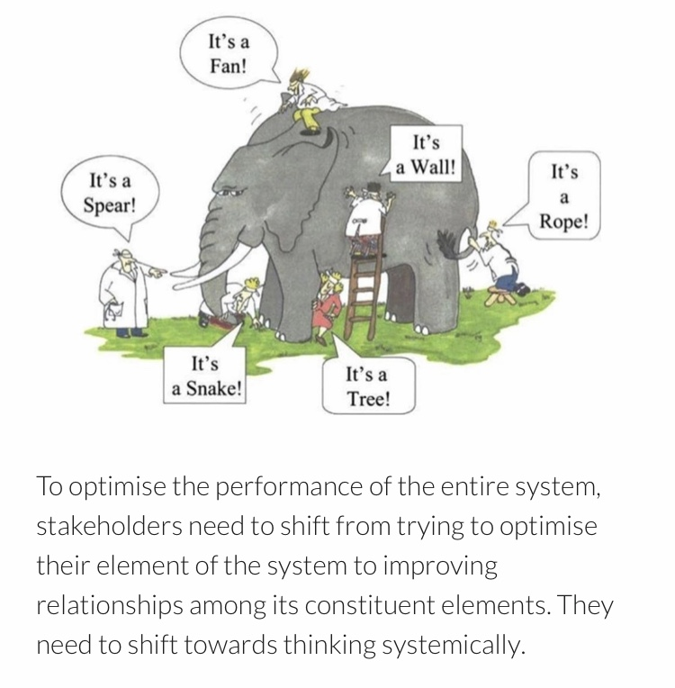
Purpose of the London Transformation & Learning Collaborative (LTLC)
We want to assist system working and move forward in a way that will support growth and optimise effectiveness.
Work collaboratively
Share best practice across organisations, systems and the region
Enable colleagues to be more prepared to work in an expanded critical care as well as in the event of a second surge thereby improving staff experience
Support each other in improving patient outcomes
Providing training content and structure that can be delivered consistently and effectively
Notes:
Purpose of the collaborative is to:
shift towards thinking collaboratively to optimise the performance of the entire system
to work together,
sharing our strengths,
improving the experiences of our staff and their physical and psychological safety,
improving patient outcomes and
providing training that can be delivered consistently and effectively across the patch.

Slide 3
Purpose
About the LTLC Programme:
To increase the supply and resilience of staffing for critical care across London
To develop a London plan that seeks to ensure that the NHS workforce is equipped with the skills and capabilities to manage existing demand, potential future spikes in demand as a result of Covid-19 and longer-term permanent expansion of critical care capacity in London.
Primary outcome
To cross-skill staff to support the London region to expand ICU capacity with the potential to open more critical care beds in surge
Scope
Develop clinical education transformation capability across the NHS in London: Develop transformation programmes which align to patient need, service model, and workforce models.
Co-ordinate design and delivery of training to support London’s response to Covid-19: Establish innovative education delivery models that will support the development of an agile workforce that has the robust capability to deal with a second surge.

Slide 4
Survey Aims and Research Questions
Aim: Explore education experiences of those who worked in ICUs across London during the COVID pandemic; both those who worked in ICU and those who were redeployed to ICU
Research Questions:
1
ICU staff delivering education
Demographics
Education successes
Education challenges
Useful professional groups
Support needed for a second surge
Would collaborating with other ICUs help?
Training resources and IT systems used
2
ICU staff receiving education
Demographics
Useful elements of training
Elements of preparation that were missing
What would you do differently?
3
Non-ICU/Redeployed staff
Useful elements of training
Training that was missing
Useful things learnt (how and from who)
Steepest learning curve (how it was overcome)
Training resources used
What would you do differently?
Advice to a colleague going to work in ICU
179 responses
138 responses
616 responses
Total = 933 responses

Slide 5
Survey Results: Reponses from Healthcare Scientists that were redeployed to ICU during the pandemic
*Resources that were suggested in the survey responses are being collated separately and are not discussed in this summary
Total = 14 Responses

Slide 6
Redeployed Healthcare Scientists: Area and Location
Normal Area of Work | No.
Auditory Implants | 1
Gastroenterology | 1
Cardiology | 1
Outpatients | 1
Radiology | 1
Radiation Safety | 1
Urology | 1
Physiological Measurement | 1
Gait laboratory | 3
Clinical Engineering | 1
Medical physics | 1
Biomechanics | 1
TOTAL | 14
Banding | No.
Band 6 | 7
Band 7 | 6
Band 8 | 1
TOTAL | 14
Notes:
Other
Cardiac rehab 1
Womens, pelvic health 3
Vascular 1
Pain management 1
Vestibular 1
Rheumatology 1
Coordinator 1
Oncology 2

Slide 7
Q1: During the initial COVID response what was the most useful and important elements of training you received?
Responses
Equipment training generally | 6
Specific simulation/training course | 6
Ventilation/ventilators | 4
PPE and infection control | 1
Anatomy/physiology | 1
ABG (taking and analysing) | 1
Shadowing in ICU | 1

Slide 8
Discussion Q1: During the initial COVID response what was the most useful and important elements of training you received?
The healthcare scientist responses mainly related to equipment training with ventilators being commonly discussed
Many health care scientists specifically mentioned the SIMV (Southwest Intensive Care Mechanical Ventilation) course as being useful
Hands- on training within ICU was commonly cited as being the most useful part of training
“Learning how to carryout quality assurance on the machines, how the machine operate, and what equipment is used for clinically” Redeployed healthcare scientist

Slide 9
Q2: What do you wish you had known more about / had more specific training before you worked in CC?
Responses
Role definitions | 5
Equipment knowledge | 5
Better training generally | 1
Hands-on training | 1
ABGS | 1
Proning | 1
Humans factors | 1
Meeting the team | 1

Slide 10

Discussion Q2: What do you wish you had known more about/ had more specific training before you worked in CC?
Many healthcare scientists said they would like more information about the role that they and others were expected to do
Knowledge of equipment was commonly felt to be lacking - particularly around ventilators (knowledge on failures, faults and testing ventilators was mentioned)
“As someone who does not usually work in a CC setting, understanding the hierarchies and responsibilities of the different professionals ahead of going would have been beneficial” Redeployed healthcare scientist
“More familiarity with the equipment used... e.g. water traps and components to measure SpO2, humidifiers, non-invasive ventilation” Redeployed healthcare scientist
“I wish I had known more about the equipment from the very beginning. As a physicist redeployed as a support engineer I did not have any knowledge about ventilators, monitors, pumps etc” Redeployed healthcare scientist
Notes:
There wasn't time or the staffing to thoroughly train us before we went onto the ward. So of course, more thorough training of equipment and testing beforehand would have made us more valuable to the ward from the start. However, as we were fully supported the whole time it wasn't actually much of an issue that we learnt most on the job.

Slide 11
Q3. What were the most useful things you learnt whilst looking after patients in CC? Who did you learn this from and how?
Most useful things learnt on CC
Ventilation/ventilators | 6
Equipment generally | 4
Personal growth/skills | 3
ICU generally | 2
PPE | 1
Blood gas machines | 1
ABGs (taking and analysis) | 1
Proning | 1
Patient experience | 1
From Who and How
Colleagues generally | 4
Nurses | 3
Courses | 2
Healthcare scientists | 1
Doctors | 1
Machine representatives | 1
Supervision | 1
Biomedical scientists | 1

Slide 12
Discussion Q3: What were the most useful things you learnt whilst looking after patient in CC? Who did you learn this from and how?
It was felt that most learning occurred within ICU as opposed to during training
Knowledge around ventilators was felt to be the most useful thing learnt on ICU. Things discussed included set up, testing, faults and troubleshooting
Colleagues were the greatest source on knowledge for redeployed healthcare scientists
“How to swap ventilators that are attached to patients, trouble shooting common issues with equipment, working with a wide range of other professionals in an usual environment. Also learned about the issues that are likely to crop up when a large group of people are working under these new unusual conditions” Redeployed healthcare scientist
“The fundamentals of mechanical ventilation. I was able to apply that understanding to different problems that arose with the equipment” Redeployed healthcare scientist

Slide 13
Q4a: What were the steepest learning curves you faced on redeployment? How did you overcome them?
Steepest Learning Curves
New environment and role | 4
Coping with physical stress | 3
Team dynamics | 3
Equipment use | 2
Respiratory physiology | 1
Coping with psychological stress | 1
How did you overcome them?
Colleagues | 10
Internet | 3
Courses | 2
Books/literature | 2
Hands on experience | 1
Radio | 1

Slide 14
Discussion Q4: What were the steepest learning curves you faced on redeployment? How did you overcome them?
The lack of knowledge about the new working environment and role was commonly mentioned
Coping with psychological and physical stress were steep learning curves for many. Physical stress included working night shifts
Equipment use was a steep learning curve for some
Colleagues were crucial to managing the steep learning curves
“…actually the toughest thing to learn was how to work in the ICU environment effectively; to integrate and therefore appropriately support the ICU at a time when a large amount of people on the ward were learning too” Redeployed healthcare scientist
“Learning about all of the new pieces of equipment and how they make up an intensive care unit” Redeployed healthcare scientist
Notes:
Environmental change and working night shifts
Learning about all of the new pieces of equipment and how they make up an intensive care unit.
As a 'technical' person in a department with lots of new redeployed staff, I think that learning the equipment and how to fix it played to our strengths and actually the toughest thing to learn was how to work in the ICU environment effectively; to integrate and therefore appropriately support the ICU at a time when a large amount of people on the ward were learning too.

Slide 15
Q5: What would you do differently if you had to go back to your initial redeployment?
Knowing the role expectations was commonly discussed as well as knowing other staff members' roles
Other things mentioned were knowing the equipment prior to redeployment, having better knowledge prior to redeployment, asking for help and being more assertive
Responses | No.
Improve role definition/role allocation | 3
Know equipment better | 1
Improve clinical knowledge | 1
Ask for help/support/ask questions | 1
More self-directed learning | 1
Supernumerary time/shadowing | 1
Be more assertive/confident | 1
“Work our exactly what our role is prior to redeployment and what exactly we’d be expected to do and not do” Redeployed healthcare scientist
“Find out exactly where my expertise could help, and also make it known what my skills are to most people on the floor” Redeployed healthcare scientist

Slide 16
Q6: What is the one piece of advice you would give a colleague going to work on CC?
Responses | No.
Be positive | 3
Seek advice/help/support | 2
Talk to colleagues/others | 2
Prioritise self Care | 2
Remain calm | 2
Don’t worry/pressurise yourself | 2
Know role expectations | 2
Be confident | 1
Know your limitations | 1
Learn equipment | 1
Having a positive attitude to the experience was a common piece of advice
Many advised to seek help advice or support where needed
“Just do the best you can and keep a positive team spirit” Redeployed healthcare scientist
“Dont be afraid to ask for help and support” Redeployed healthcare scientist
Notes:
Dont be afraid to ask for help and support

Slide 17
Conclusions:
The theme of equipment was the strongest theme discussed by healthcare scientists
  It was the most important element of training received
  Training on equipment was commonly lacking
  Ventilators were the commonest piece of equipment discussed; knowledge on failures, faults and testing ventilators was mentioned
It was commonly mentioned that hands-on training and shadowing/supernumerary days within ICU prior to redeployment would have been useful
Coping with psychological and physical stress were steep learning curves
Many healthcare scientists said they would like more information about the role that they and others were expected to do. This theme was stronger for healthcare scientists than other staff groups

Slide 18
The LTLC: Education Workstream
The LTLC are using these survey results (as well as focus groups) to inform the following:
Support role definition
Publish a skills matrix mapped to existing competency frameworks for all critical care roles
Share Education Content
Curate existing high quality education content into modules mapped to the skills matrix
Create a Skills Passport
Create electronic competency passports, interfacing with IT systems, e-learning and face to face education
Leadership training
Explore compatibility with e-rostering platforms
ICU equipment
Wellbeing
This can be used locally to inform learning objectives and avoid “over-teaching”
Specific areas include:
Teamworking

Slide 19
Close

