Slide 1
Exploring the ICU Education Experience Across London During the COVID Pandemic: Survey Results Pharmacists redeployed to ICU
London Transformation and Learning Collaboration (LTLC)

Slide 2
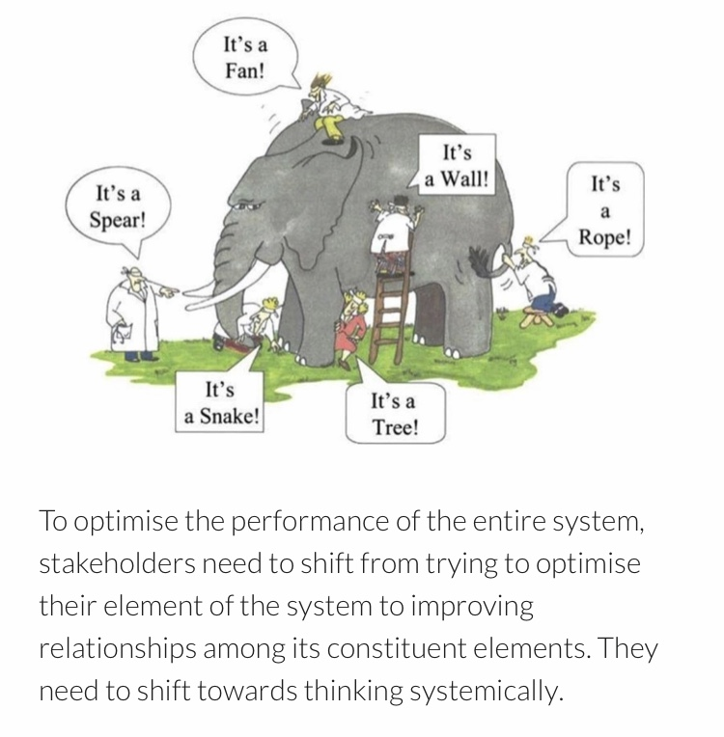
Purpose of the London Transformation & Learning Collaborative (LTLC)
We want to assist system working and move forward in a way that will support growth and optimise effectiveness.
Work collaboratively
Share best practice across organisations, systems and the region
Enable colleagues to be more prepared to work in an expanded critical care as well as in the event of a second surge thereby improving staff experience
Support each other in improving patient outcomes
Providing training content and structure that can be delivered consistently and effectively
Notes:
Purpose of the collaborative is to:
shift towards thinking collaboratively to optimise the performance of the entire system
to work together,
sharing our strengths,
improving the experiences of our staff and their physical and psychological safety,
improving patient outcomes and
providing training that can be delivered consistently and effectively across the patch.

Slide 3
Purpose
About the LTLC Programme:
To increase the supply and resilience of staffing for critical care across London
To develop a London plan that seeks to ensure that the NHS workforce is equipped with the skills and capabilities to manage existing demand, potential future spikes in demand as a result of Covid-19 and longer-term permanent expansion of critical care capacity in London.
Primary outcome
To cross-skill staff to support the London region to expand ICU capacity with the potential to open more critical care beds in surge
Scope
Develop clinical education transformation capability across the NHS in London: Develop transformation programmes which align to patient need, service model, and workforce models.
Co-ordinate design and delivery of training to support London’s response to Covid-19: Establish innovative education delivery models that will support the development of an agile workforce that has the robust capability to deal with a second surge.

Slide 4
Survey Aims and Research Questions
Aim: Explore education experiences of those who worked in ICUs across London during the COVID pandemic; both those who worked in ICU and those who were redeployed to ICU
Research Questions:
1
ICU staff delivering education
Demographics
Education successes
Education challenges
Useful professional groups
Support needed for a second surge
Would collaborating with other ICUs help?
Training resources and IT systems used
2
ICU staff receiving education
Demographics
Useful elements of training
Elements of preparation that were missing
What would you do differently?
3
Non-ICU/Redeployed staff
Useful elements of training
Training that was missing
Useful things learnt (how and from who)
Steepest learning curve (how it was overcome)
Training resources used
What would you do differently?
Advice to a colleague going to work in ICU
179 responses
138 responses
616 responses
Total = 933 responses

Slide 5
Survey Results: Reponses from Pharmacists that were redeployed to ICU during the pandemic *Resources that were suggested in the survey responses are being collated separately and are not discussed in this summary
Total = 47 Responses

Slide 6
Redeployed Pharmacists: Level and Location
Banding | No
Band 5 | 3
Band 6 | 2
Band 7 | 10
Band 8A | 19
Band 8B | 10
Band 8C | 2
Band 9 | 1
Total | 47
South
West
North
Central
South East
North West
North East

Slide 7
Q1: During the initial COVID response what was the most useful and important elements of training you received?
ICU Skills and Knowledge |  | General
Pharmacy specific knowledge | 16 | Support from other pharmacists | 17
Sedation | 4 | Introduction/cross-skilling course | 9
PPE | 3 | Shadowing in ICU | 9
COVID knowledge | 2 | Online resources | 8
Filtration/renal replacement | 2 | Pharmacy organisations | 8
Infusions | 2 | Drug shortages and procurement | 3
Ventilation | 2 | Trust guidelines | 3

Slide 8
Discussion Q1: During the initial COVID response what was the most useful and important elements of training you received?
Pharmacy related knowledge was the most common response, such as drugs and dosing
Other elements of training that pharmacists deemed most useful were: sedation, PPE, COVID knowledge, filtration, infusions and ventilation
Support from other pharmacists (such as lead pharmacists and ICU pharmacists) and cross-skilling or introductory ICU courses were very useful
Some discussed how hands-on training and shadowing pharmacists within ICU was how most learning took place
RPS and UKCPA provided several resources that pharmacists mentioned as useful
“common drugs seen in CC and how to screen these” Redeployed pharmacist NWL
“shadowing pharmacists and applying training to actual patients” Redeployed pharmacist NWL

Slide 9
Q2: What do you wish you had known more about / had more specific training before you worked in CC?
ICU Skills and Knowledge |  | Other
ICU medications | 9 | Nothing | 7
Delirium | 5 | Orientation to ward, role and team structure | 7
Ventilation | 4 | Equipment | 3
Circulatory Support | 4 | Shadowing/Hands-on training | 3
ARDS / respiratory failure | 3 | Ordering medications | 2
Filtration/ renal replacement | 3 | Introduction to ward staff | 2
Clinical trial selection | 2 | Managing stock shortages | 2
COVID knowledge | 2 | Guidelines | 1
Anticoagulation | 1 | Computer systems | 1
PPE | 1 | More training | 1

Slide 10
Discussion Q2: What do you wish you had known more about/ had more specific training before you worked in CC?
Many pharmacists said that no additional training that was needed
Elements of training felt to be lacking were: ICU medications (including sedation), delirium, ventilation, circulatory support, ARDS/respiratory failure and filtration
In relation to ICU medications, some felt that there wasn’t enough time to develop familiarity with medications that they do not normally see that were being given to patients with abnormal parameters
Orientation to the ward, team and the role was a common theme and was felt to be lacking
“Half a day training/refresher is not sufficient to build confidence in practice no matter how high your banding is. Having to refresh on IVs that are predominantly given in CC would have been a lot more helpful it was ongoing training” Redeployed pharmacist
“List of alternative medications for basic ITU drugs - to be used in case of stock shortages” Redeployed pharmacist
“More an intro to permanent staff on ITU: I was new to them, they were new to new, but everyone was so busy that often I was never introduced properly” Redeployed pharmacist

Slide 11
Q3. What were the most useful things you learnt whilst looking after patients in CC?* Who did you learn this from and how?
From Who
ICU pharmacy team | 27
Other staff members | 7
Doctors | 4
Nurses | 3
Wellbeing team | 1
Useful Things Learnt
Patient assessment | 10
Sedation | 6
Teamwork/communication | 6
ICU drugs | 5
COVID knowledge | 5
Anticoagulation | 4
Ventilation | 4
Drug shortages | 3
Cardiovascular support | 3
Filtration/renal replacement | 2
Proning | 2
Infusions | 1
How
Shadowing | 8
Huddles | 3
Teaching sessions | 2
Self-directed study | 2
Ward round | 2
Microsoft teams | 1

Slide 12
Discussion Q3: What were the most useful things you learnt whilst looking after patient in CC? Who did you learn this from and how?
It was felt that learning how to carry out a patient assessments in ICU was useful and some mentioned Mnemonics such as FLATCHUGs, RAAS and the A-E assessment
ICU drugs, particularly those relating to sedation and anticoagulation, were felt to be useful knowledge learnt on ICU
Non-technical skills including communication and teamwork were useful skills learned
The ICU pharmacy team were the greatest source on knowledge for redeployed pharmacists mainly whilst shadowing, although many commented on the importance of other staff members

Slide 13
Q4a: What were the steepest learning curves you faced on redeployment? How did you overcome them?
Skills and Knowledge |  | Other
ICU Drugs/drug formulation | 9 | New Environment/role | 11
PPE and infection control | 6 | Psychological stress | 9
Drug shortages/substitutes | 5 | Workload | 6
Patient assessment | 5 | Working with non-ICU staff | 3
Clinical trials | 2 | Physical stress | 3
 |  | Working as MDT | 1
How were they overcome
Internet including apps | 21
Colleague support | 20
ICU pharmacists | 15
Books/literature | 7
Intranet/local guidelines | 3
Support from trust | 3
Induction | 2
Clinical trial team | 1
Self-care | 1

Slide 14
Discussion Q4: What were the steepest learning curves you faced on redeployment? How did you overcome them?
ICU drugs and drug formulations were a common response, along with PPE, drug shortages and patient assessment
The lack of knowledge about the new working environment and the new role was commonly discussed including where things were, how a shift worked and how the ICU team was structured
Coping with psychological and physical stress were steep learning curves for many
Physical stress included fatigue, dehydration and wearing PPE
Colleagues, mainly ICU pharmacists, were crucial to managing the steep learning curves
Additional training that people undertook was often online
“knowledge base of the drugs used, infusion rates, various routes of administrations. how to get the information required” Redeployed Pharmacist
“The procurement of medications. I had to predict usage and apply this to our orders. Finding out alternatives for medications that were no longer available in the supply chain” Redeployed Pharmacist
“getting to grips with drugs that prior to ITU exposure i had never come across before” Redeployed Pharmacist

Slide 15
Q5: What would you do differently if you had to go back to your initial redeployment?
Responses | No.
More training | 7
More self-directed study | 7
Supernumerary/shadowing in ICU | 7
Nothing | 5
Be more confident | 4
Improve teamwork/communication | 4
Better self-care | 2
Discuss with colleagues more | 2
Attend ward rounds | 2
Many pharmacists mentioned that they would like more training and many discussed they would have done more self-directed learning
Spending in time in ICU before starting redeployment was considered important
Some say they would not do anything differently and some that they would be more positive about the experience
Some commented that they would like to see better teamwork and communication
“I would be optimistic and familiarise myself with all the relevant information. I would also get more training and insight to the unit before start working” Redeployed pharmacist
“Ideally, be able to spend more time with ITU pharmacist in training as this was the most useful aspect to put theory into practice” Redeployed pharmacist
“I would take time to talk to my colleagues more. I would engage with psych support-talking therapies more and not bring my worries home with me” Redeployed pharmacist

Slide 16
Q6: What is the one piece of advice you would give a colleague going to work on CC?
Responses | No.
Ask questions/for help | 14
Improve knowledge | 12
Get involved with MDT | 8
Be systematic | 6
Better psychological care | 5
Ensure sufficient training | 5
Consider basics | 4
Better physical care | 3
Not being afraid to ask questions or for help was the most common advice
Improving knowledge before and during redeployment was commonly advised
Getting involved with the MDT including attending ward round was a theme
Better psychological and physical care was mentioned
“It can be overwhelming but make sure you do your research before and ask for help to aid your learning throughout!” Redeployed pharmacist
“80% of the things you initially think are scary are actually the medications/conditions that you work with day to day and they become familiar very quickly - and failing that you just have to take it back to first principles and work through” Redeployed pharmacist

Slide 17
Conclusions:
The most important elements missing from training were: ICU medications, delirium, ventilation, circulatory support, ARDS/respiratory failure and filtration
In relation to ICU medications, some felt that they were not given sufficient training on ICU drugs including sedation, anticoagulation and drug shortages
Support from other pharmacists (including lead pharmacists and ICU pharmacists) was seen as a very important part of training
It was commonly mentioned that hands-on training and shadowing/supernumerary days within ICU prior to redeployment was important
There was a lack of local induction and orientation to the ward as well as role expectation prior to redeployment
Coping with psychological and physical stress were steep learning curves
It was felt that learning how to carry out a patient assessments in ICU was valuable with many commenting how going on the ward round was a crucial part of learning

Slide 18
The LTLC: Education Workstream
The LTLC are using these survey results (as well as focus groups) to inform the following:
Support role definition
Publish a skills matrix mapped to existing competency frameworks for all critical care roles
Share Education Content
Curate existing high quality education content into modules mapped to the skills matrix
Create a Skills Passport
Create electronic competency passports, interfacing with IT systems, e-learning and face to face education
Leadership training
Explore compatibility with e-rostering platforms
ICU equipment
Wellbeing
This can be used locally to inform learning objectives and avoid “over-teaching”
Specific areas include:
Teamworking

Slide 19
Close

