Slide 1
Exploring the ICU Education Experience Across London During the COVID Pandemic: Survey Results Speech and Language Therapists Redeployed to ICU
London Transformation and Learning Collaboration (LTLC)

Slide 2
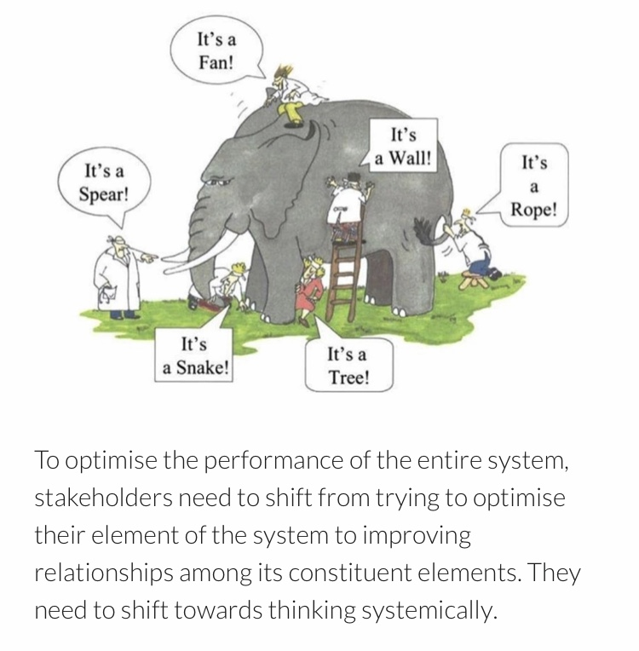
Purpose of the London Transformation & Learning Collaborative (LTLC)
We want to assist system working and move forward in a way that will support growth and optimise effectiveness.
Work collaboratively
Share best practice across organisations, systems and the region
Enable colleagues to be more prepared to work in an expanded critical care as well as in the event of a second surge thereby improving staff experience
Support each other in improving patient outcomes
Providing training content and structure that can be delivered consistently and effectively
Notes:
Purpose of the collaborative is to:
shift towards thinking collaboratively to optimise the performance of the entire system
to work together,
sharing our strengths,
improving the experiences of our staff and their physical and psychological safety,
improving patient outcomes and
providing training that can be delivered consistently and effectively across the patch.

Slide 3
Purpose
About the LTLC Programme:
To increase the supply and resilience of staffing for critical care across London
To develop a London plan that seeks to ensure that the NHS workforce is equipped with the skills and capabilities to manage existing demand, potential future spikes in demand as a result of Covid-19 and longer-term permanent expansion of critical care capacity in London.
Primary outcome
To cross-skill staff to support the London region to expand ICU capacity with the potential to open more critical care beds in surge
Scope
Develop clinical education transformation capability across the NHS in London: Develop transformation programmes which align to patient need, service model, and workforce models.
Co-ordinate design and delivery of training to support London’s response to Covid-19: Establish innovative education delivery models that will support the development of an agile workforce that has the robust capability to deal with a second surge.

Slide 4
Survey Aims and Research Questions
Aim: Explore education experiences of those who worked in ICUs across London during the COVID pandemic; both those who worked in ICU and those who were redeployed to ICU
Research Questions:
1
ICU staff delivering education
Demographics
Education successes
Education challenges
Useful professional groups
Support needed for a second surge
Would collaborating with other ICUs help?
Training resources and IT systems used
2
ICU staff receiving education
Demographics
Useful elements of training
Elements of preparation that were missing
What would you do differently?
3
Non-ICU/Redeployed staff
Useful elements of training
Training that was missing
Useful things learnt (how and from who)
Steepest learning curve (how it was overcome)
Training resources used
What would you do differently?
Advice to a colleague going to work in ICU
179 responses
138 responses
616 responses
Total = 933 responses

Slide 5
Survey Results: Reponses from Speech and Language Therapists that were redeployed to ICU during the pandemic *Resources that were suggested in the survey responses are being collated separately and are not discussed in this summary
Total = 28 Responses

Slide 6
Redeployed Speech and Language Therapists: Area and Location
Normal Area of Work | No.
Community Paediatrics | 14
Inpatients | 8
Community | 4
Mental Health | 1
Outpatients | 1
TOTAL | 28
Banding | No.
Band 5 | 7
Band 6 | 10
Band 7 | 5
Band 8 | 5
Other | 1
South
West
North Central
South East
North West
North
East

Slide 7
Q1: During the initial COVID response what was the most useful and important elements of training you received?
ICU Skills and Knowledge |  | General
Proning | 10 | Orientation to ICU | 8
PPE | 9 | Hands-on training | 6
Observations | 4 | Had no training/minimal training | 5
Patient care | 2 | Support from staff | 2
Ventilators | 2 | Equipment | 1
Suctioning | 1
Patient assessment | 1

Slide 8
Discussion Q1: During the initial COVID response what was the most useful and important elements of training you received?
Many speech and language therapists said that they did not receive any training before redeployment, or very minimal training
Elements of training that were deemed most useful were: proning, PPE, patient observations (taking and interpreting) and patient care
Orientation to ICU was deemed to be very useful and many discussed the importance of hands-on training and shadowing within ICU
“We had an hour's training before our first shift on how to turn a patient on a ventilator. The rest was training 'on the job'” Band 7 redeployed SALT, NWL
“A "welcome tour" by nurse in charge with other people who were redeployed, to look at a dummy person in a bed, try out suctioning, look at central line, try pressing buttons on ventilator not connected to a real person, time to ask questions in front of other new people” Band 5 redeployed SALT, NCL
“On the job training from nurses and doctors. The induction day was helpful as well but too rushed” Band 6 redeployed SALT, SWL

Slide 9
Q2: What do you wish you had known more about / had more specific training before you worked in CC?
ICU Skills and Knowledge |  | Other
Patient observations/monitoring | 10 | Orientation to ward, role and team structure | 10
Proning and manual handling | 7 | ICU terminology | 3
Patient care | 5 | Psychological support | 3
Ventilators | 5 | Nothing | 2
Patient assessment | 2 | More training generally | 2
Suctioning | 2
Lines | 2
PPE | 1
ABGs | 1

Slide 10
Discussion Q2: What do you wish you had known more about/ had more specific training before you worked in CC?
Elements of training felt to be lacking were: interpretation of patient observations and monitoring, proning and manual handling, aspects of patient care, assessment of an ICU patient and suctioning
Orientation to the ICU ward and the role was felt to be lacking. Many commented that the role expectations were not known by them or other staff groups
Psychological support was felt to be lacking
“How to read the monitors and complete the monitoring form before starting. I would like to have known critical levels for the readings on monitors and bloods so to know when to alert the nursing staff” Redeployed SALT, band 8, NCL
“Practical training on how to support nurses – e.g. how to take obs, empty a catheter etc” Redeployed SALT, band 5, NCL
“It’s also really important that the nurses are aware of what our role entails and what jobs we are unable to do” Redeployed SALT, band 5, NCL
“I knew nothing about CC and had never stepped foot in an ICU until my first shift. It would have been helpful to have known what the different lines and machines were, what the types of ventilation were, even just the names of things… the first few shifts I was going in completely blind” Redeployed SALT, band 6, SEL

Slide 11
Q3. What were the most useful things you learnt whilst looking after patients in CC?* Who did you learn this from and how?
Useful Things Learnt
Communication | 11
Patient observations | 9
Proning and moving and handling | 6
Patient care | 6
Tracheostomy | 4
Ventilation/ventilators | 3
Teamwork | 3
ABGs | 2
ECGs | 2
Patient dignity | 2
Equipment generally | 2
ICU medication | 2
From Who and How
Nurses | 18
Colleagues generally | 13
On the job | 8
Physiotherapists | 6
Doctors | 3
Self-directed learning | 1
*Themes with only 1 response not included

Slide 12
Discussion Q3: What were the most useful things you learnt whilst looking after patient in CC? Who did you learn this from and how?
It was felt that most learning occurred within ICU as opposed to during formal training
Patient observations (mainly interpretation), proning, tracheostomy care and providing patient care were felt to be the most useful skills learnt on ICU
Non-technical skills including communication (mainly between colleagues) and teamwork were also useful skills learned within ICU
Nursing staff and other ICU colleagues were the greatest source of knowledge for redeployed speech and language therapists, although many commented on the how much was learnt ‘on the job’ generally
“from a SLT perspective it was a useful experience in the challenges of communicating with severely ill patients who were unable to speak and in may cases were very confused and disorientated ” Redeployed SALT, band 5, NCL
“I became more familiar with equipment used in CC as well as with tracheostomy management and hygiene” Redeployed SALT, band 6, NWL
Notes:
working as a team in a high paced/ at times highly stressful environment 6 NWL

Slide 13
Q4a: What were the steepest learning curves you faced on redeployment? How did you overcome them?
Skills and Knowledge |  | Other
Patient care | 8 | New environment and role | 16
PPE and infection control | 7 | Psychological Stress | 9
Patient observations | 2 | Physical stress | 5
Proning and manual handling | 2 | ICU terminology | 2
Difficult conversations | 2 | Workload | 2
How were they overcome?
Colleague Support | 20
Shadowing/Observing | 4
Internet including apps | 3
Debriefs | 2
Counselling | 2
Specific SALT resources | 1
Support from Trust | 1
Self-care | 1
Notes:
Everything involved in patient care in ICU NCL 8
How to support the nurses in any way - quite exasperating as I did not feel I was much use and they were so busy. NCL 5
Learning the names for medical equipment and where things were kept, the set up on ICU and what different people's roles were. NWL 7
Probably jsut the environment. It was very overwhelming SWL 6

Slide 14
Discussion Q4: What were the steepest learning curves you faced on redeployment? How did you overcome them?
Providing patient care and PPE and infection control were the steepest skill related learning curves
The lack of knowledge about the new working environment and the expectations of the role were commonly discussed
Coping with psychological and physical stress were steep learning curves for many
Physical stress included fatigue, dehydration and wearing PPE
Colleagues were crucial to managing the steep learning curves
“Everything involved in patient care in ICU ” Redeployed SALT, band 8, NCL
“Learning the names for medical equipment and where things were kept, the set up on ICU and what different people's roles were” Redeployed SALT, band 7, NWL
“How to support the nurses in any way - quite exasperating as I did not feel I was much use and they were so busy” Redeployed SALT, band 5, NCL
“Probably just the environment. It was very overwhelming” Redeployed SALT, band 6, SWL

Slide 15
Q5: What would you do differently if you had to go back to your initial redeployment?
Many said they would be more confident from the beginning as well as ask more questions
Many said that they wouldn’t do anything differently whilst others said that they would like more training
Some said they would do more self-directed learning
Knowing the role expectations was important
Looking after themselves better with the aim of reducing stress and anxiety was mentioned
Responses | No.
Be more Confident | 5
Ask more questions | 5
Nothing | 5
Have more training | 4
Do more self-directed study | 4
Know role expectations | 4
ICU orientation | 4
Better self-care | 3
Equipment orientation | 2
Understand patient observations | 2
Not go back to ICU | 2
“Be more confident with my opinion… I didn't feel confident to speak up until a few shifts in. Also using my skill set to do more, e.g. oral care” Band 6 redeployed SALT, NWL
“ask more specific questions in training and about the process” Band 5 Redeployed Nurse SWL

Slide 16
Q6: What is the one piece of advice you would give a colleague going to work on CC?
Responses | No.
Ask questions/as for help | 10
Ensure psychological support | 7
Don’t do anything you’re not comfortable with | 5
Care for others | 5
Self-care | 4
Ensure ICU orientation | 3
Be compassionate | 1
Not being afraid to ask questions or ask for help was the most common advice
Looking after yourself psychologically and physically was mentioned and included things such as drinking plenty of water and good sleep hygiene
Improving knowledge before and during redeployment was commonly advised
“Make sure you have supervisions and debriefs, it can be very emotionally & mentally challenging and it's important to look after yourself and your colleagues!” Band 5 redeployed SALT, SWL
“Look after yourself and talk about what you are seeing with colleagues (family/friends if feel able) in order to deal and make sense of it ” Band 7 redeployed SALT, NCL

Slide 17
Conclusions:
There was a lack of training prior to redeployment for speech and language therapists
The most important elements missing were: interpretation of patient observations and monitoring, proning and manual handling, aspects of patient care, assessment of an ICU patient and suctioning
It was commonly mentioned that most learning and training happened within the ICU environment
There was a lack of local induction and orientation to the ward prior to redeployment
There was a lack of knowledge about the new role for speech and language therapists
Non-technical skills including communication (within a team as well as to patients) and teamwork were deemed important and some mentioned the lack of training on these
Coping with psychological and physical stress were steep learning curves of redeployment

Slide 18
The LTLC: Education Workstream
The LTLC are using these survey results (as well as focus groups) to inform the following:
Support role definition
Publish a skills matrix mapped to existing competency frameworks for all critical care roles
Share Education Content
Curate existing high quality education content into modules mapped to the skills matrix
Create a Skills Passport
Create electronic competency passports, interfacing with IT systems, e-learning and face to face education
Leadership training
Explore compatibility with e-rostering platforms
ICU equipment
Wellbeing
This can be used locally to inform learning objectives and avoid “over-teaching”
Specific areas include:
Teamworking

Slide 19
Close

