Slide 1
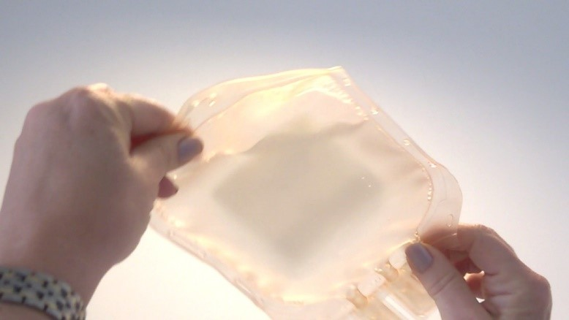

Visual inspection of cell therapy medicinal products
Notes:
Image: © 2020 NHS Blood and Transplant. All rights reserved.

Slide 2
Learning outcomes
Understand how the appearance of cell therapies may be different to that of traditional injectable pharmaceutical drugs.
Describe how to visually inspect a cell therapy medicinal product and what you might expect to see.
List strategies to reduce the chance of cell clumping in a cell therapy medicinal product.
Describe what to do if there are concerns about the appearance of a cell therapy medicinal product.

Slide 3

The correct product for the correct patient
The label of a cell therapy medicinal product must have several unique identifiers that can be matched between the patient and the original manufacturing/prescription request.
These reviews should be carried out on receipt of the product at the clinical site (and any issues addressed immediately), and then again at issue and thawing.
Patients may have received pre-conditioning therapies and it will cause delays to send the therapy back at a later stage.
If the product itself cannot be inspected at receipt, the checks must be done against the paperwork sent with the shipment.
Thawing another patient's therapy in error would almost certainly render it unusable.
Giving the product to the wrong patient may have catastrophic consequences.
Notes:
This Photo by Unknown Author is licensed under CC BY

Slide 4
Cell therapy medicinal products versus traditional pharmaceutical drugs
Injectable pharmaceutical drugs:
are usually expected to be “free of particulate matter”
may be discarded and replaced if particulate matter is visible.
In contrast, cell therapy medicinal products may:
be described as “essentially free of particulate matter”
have a cloudy, turbid, swirling appearance
contain small cellular aggregates or proteinaceous strands
sometimes be irreplaceable – discarding may be inappropriate!
Notes:
Image: Orbsen Therapeutics

Slide 5
Aligning expectations
Holding the cell therapy medicinal product up to a light source can help with visual inspection
Ensure good communication with cell therapy manufacturer to understand what is normal/not normal to expect for each product’s appearance.
Choose appropriate wording in guidance documents and protocols to align expectations about how the product should/should not look.
Notes:
Image: © 2020 NHS Blood and Transplant. All rights reserved.

Slide 6
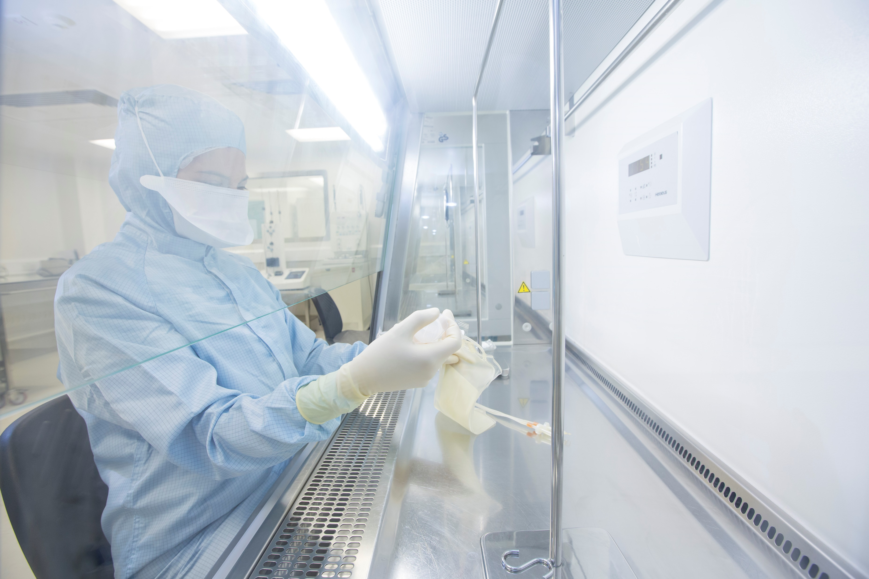
Sources of particulates
Manufacturing staff and their clothing, raw materials, consumables and packaging may generate particulates that could end up in the final product.
It is the responsibility of the cell therapy manufacturer to produce a product that is free of microbial contamination, however sterility testing is not 100% accurate and may not always be possible.
Notes:
Image: © 2020 NHS Blood and Transplant. All rights reserved.

Slide 7
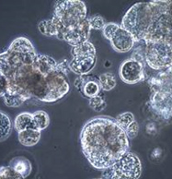
Cell clumping
Cells in suspension may attach to one another and form clumps for a variety of reasons.
A common cause of cell clumping is the presence of free DNA and cell debris produced when cells lyse (break open).
The sticky nature of DNA causes cells and cell debris to aggregate into large clumps.
Notes:
Image: Signma Aldrich. Taken from https://www.sigmaaldrich.com/technical-documents/articles/biology/cell-culture-troubleshooting-cell-clumping.html

Slide 8
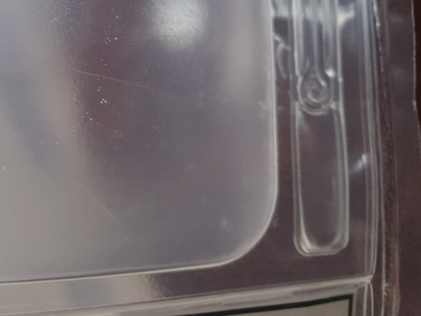
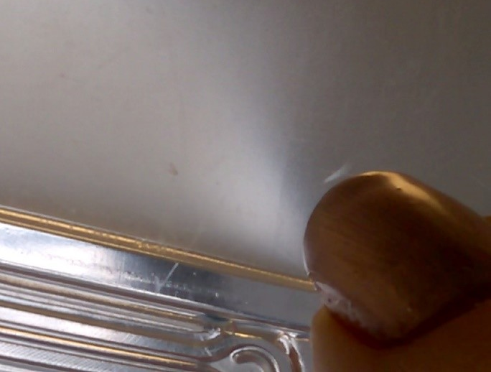
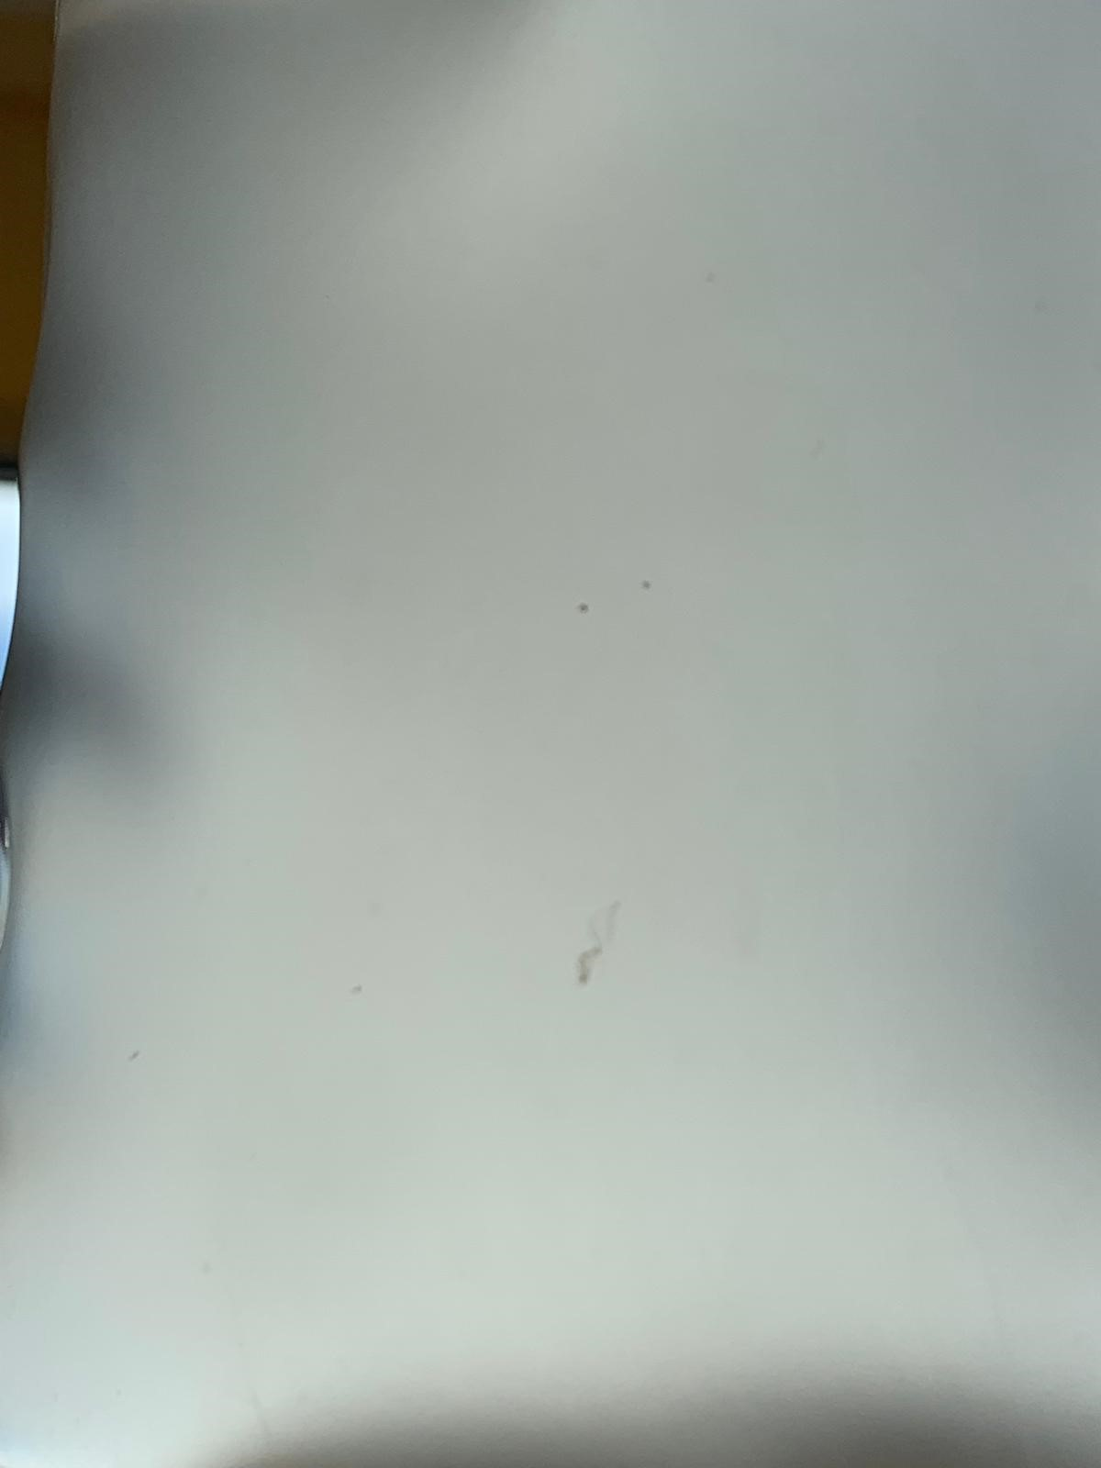
Small cell clumps may be dispersed by gentle massaging and are usually removed by an in-line giving set filter
Small specks of cell debris may be noted in the predominately single cell suspension
Small, irregular strands of cellular matter may be visible
Notes:
Images: © 2020 NHS Blood and Transplant. All rights reserved.

Slide 9
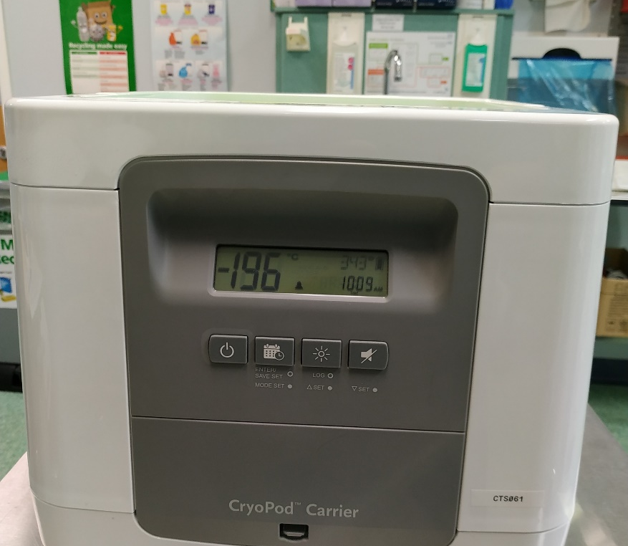
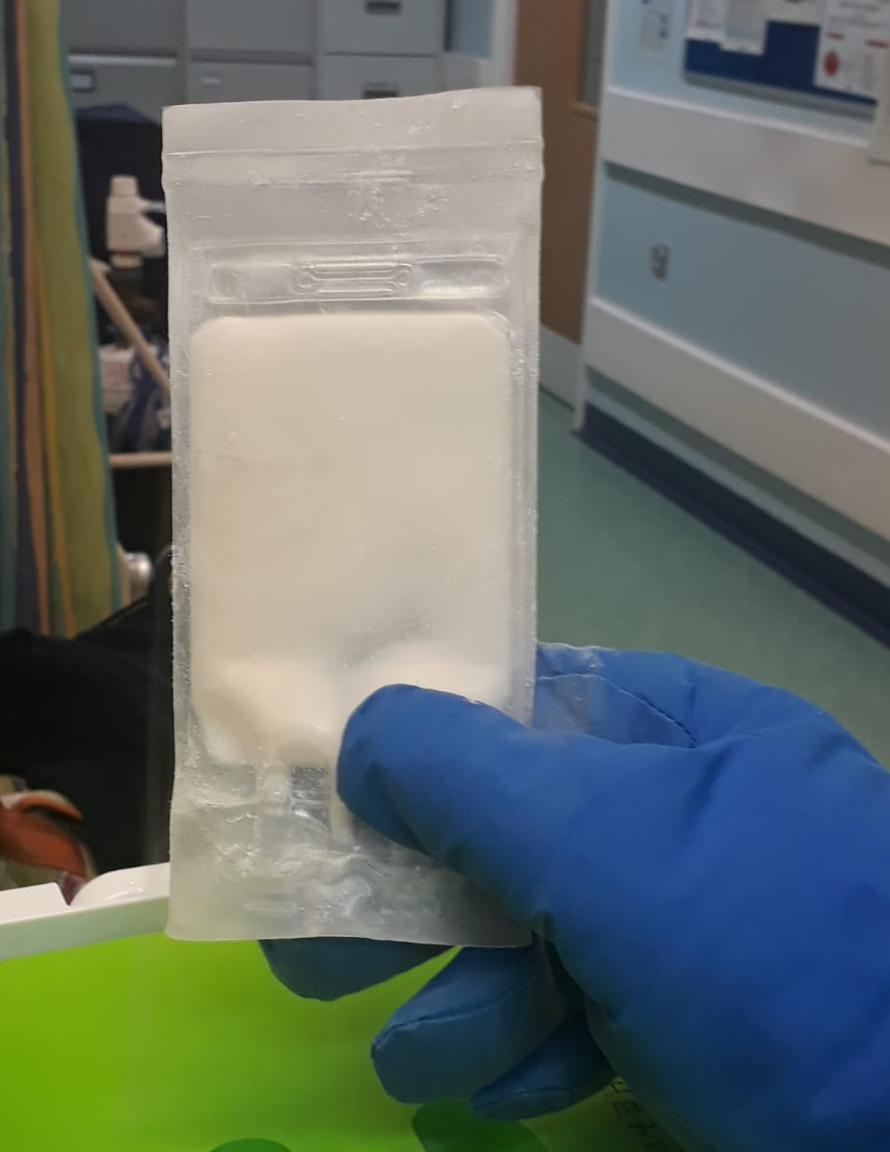
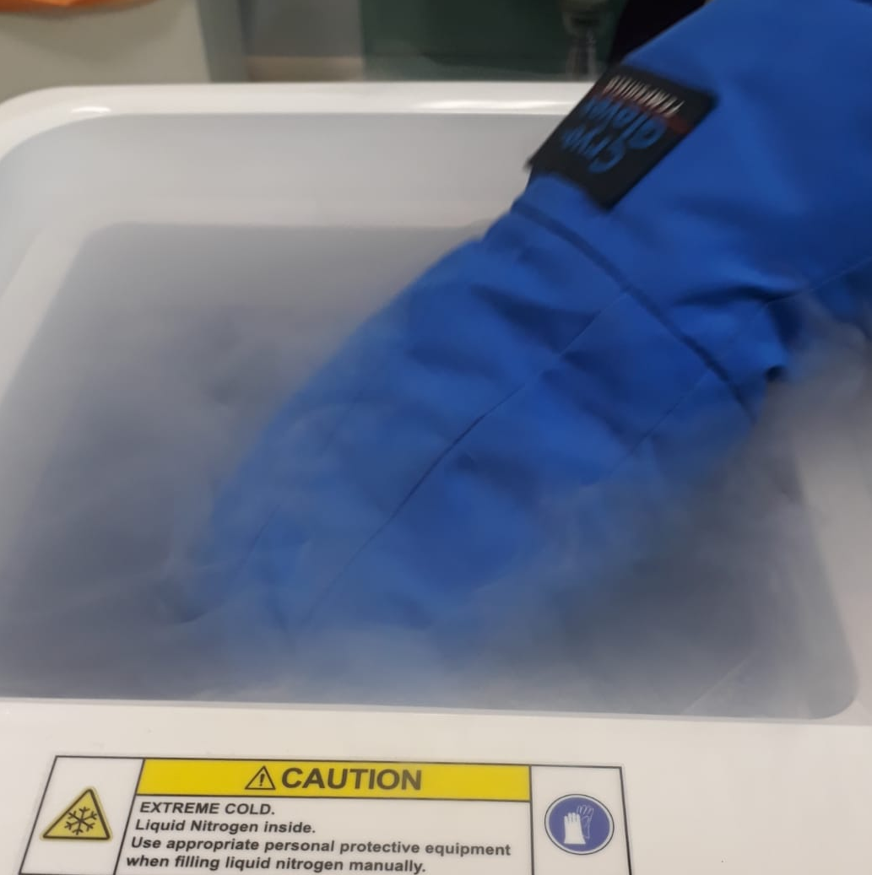
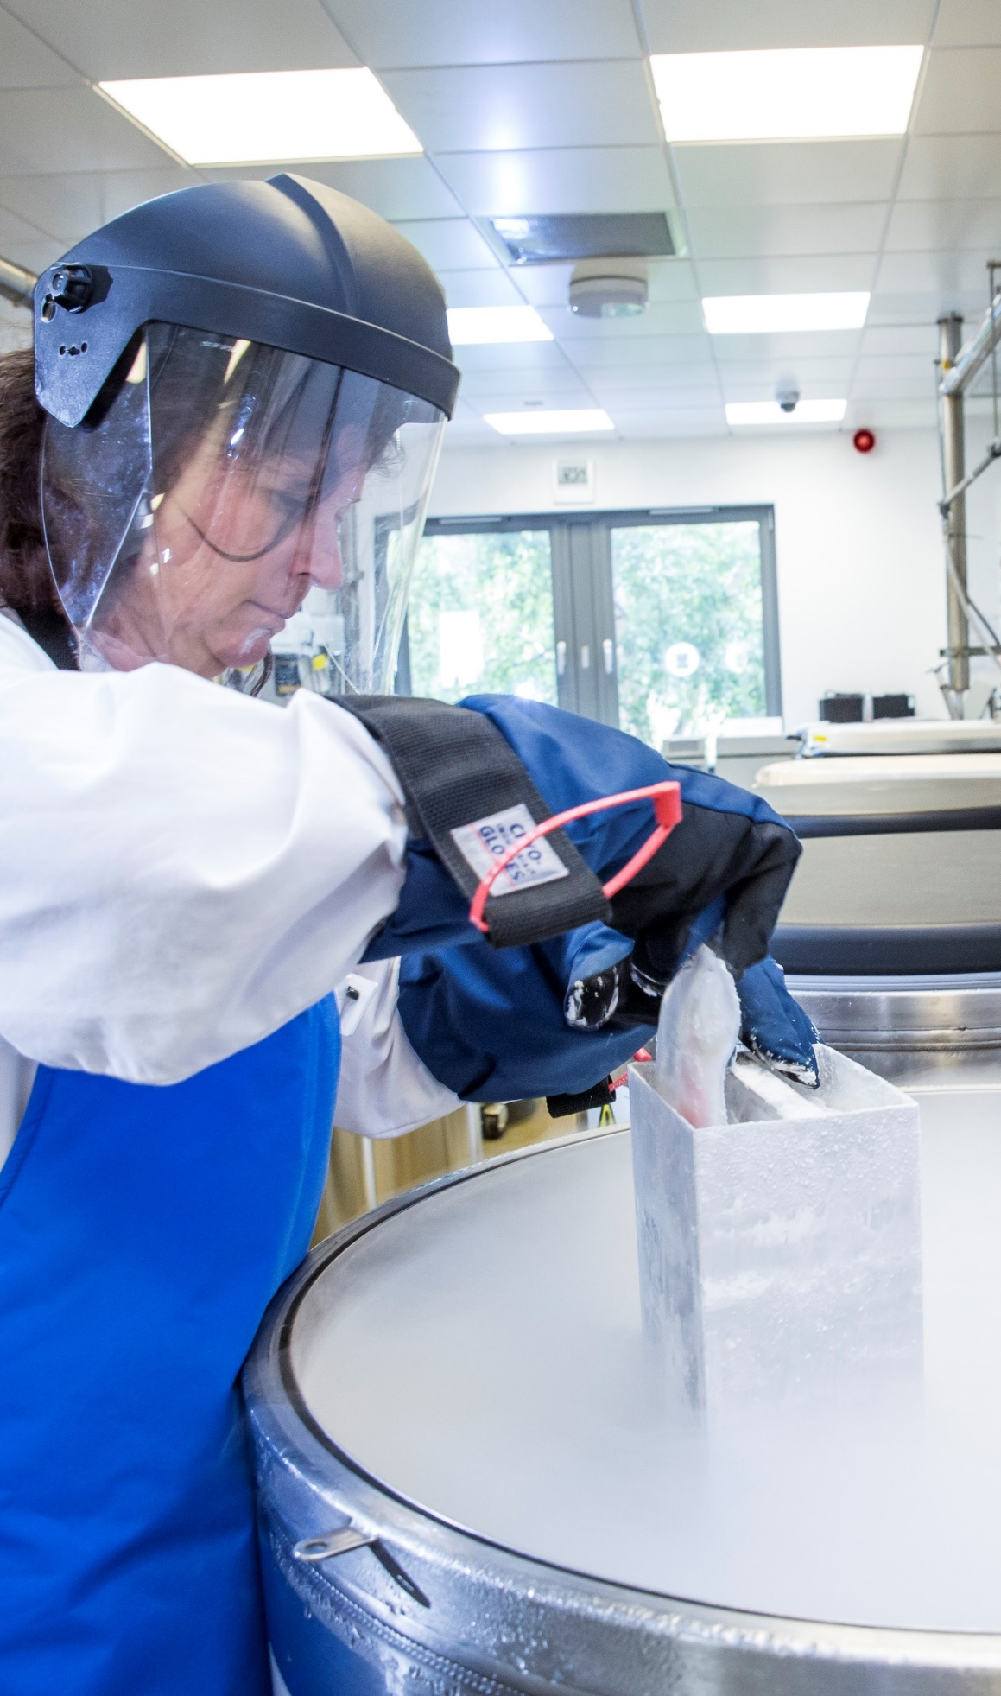

Frozen products
Frozen cell therapy medicinal products may be more susceptible to cell clumping than fresh products.
Freeze-thawing carries a risk of damaging or killing a proportion of the cells, leading to cell debris and dead or dying cells which may cause aggregates.
Risk can be minimised by following carefully validated procedures for freeze and thaw processes.
Notes:
Images:
Top row: University Hospitals Birmingham NHS Foundation Trust.
Bottom row: © 2020 NHS Blood and Transplant. All rights reserved.

Slide 10
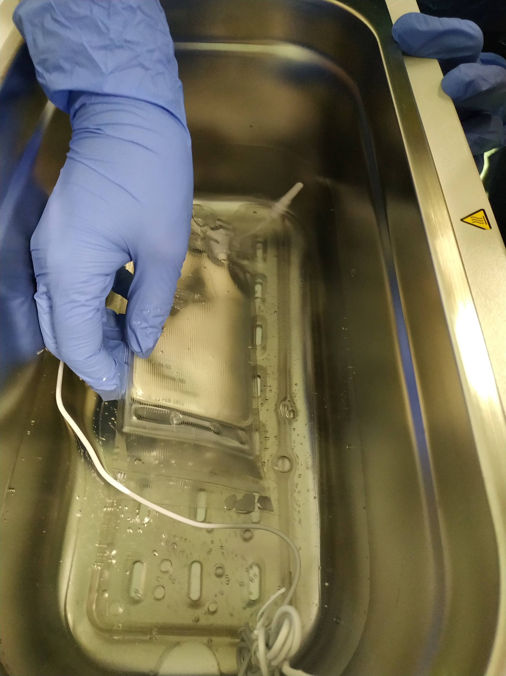
Thawing (1 of 2)
If there are multiple bags, administer the first bag before thawing the next.
Use a clean water bath or other thawing device.
If the product is not already double wrapped, it should be thawed inside a sterile, sealable bag.
Rate and temperature of thawing can impact on cell viability and function – follow the protocol and use a temperature alarm if one is available.
Administer within acceptable timeframe as per protocol and avoid delay once thawing starts:
  Minimise distance from thawing area to patient;
  Ensure clinical area and patient is ready before starting to thaw the product;
  Cryoprotectant is toxic to cells once thawed – administer the thawed product promptly.
Notes:
Image: University Hospitals Birmingham NHS Foundation Trust.

Slide 11
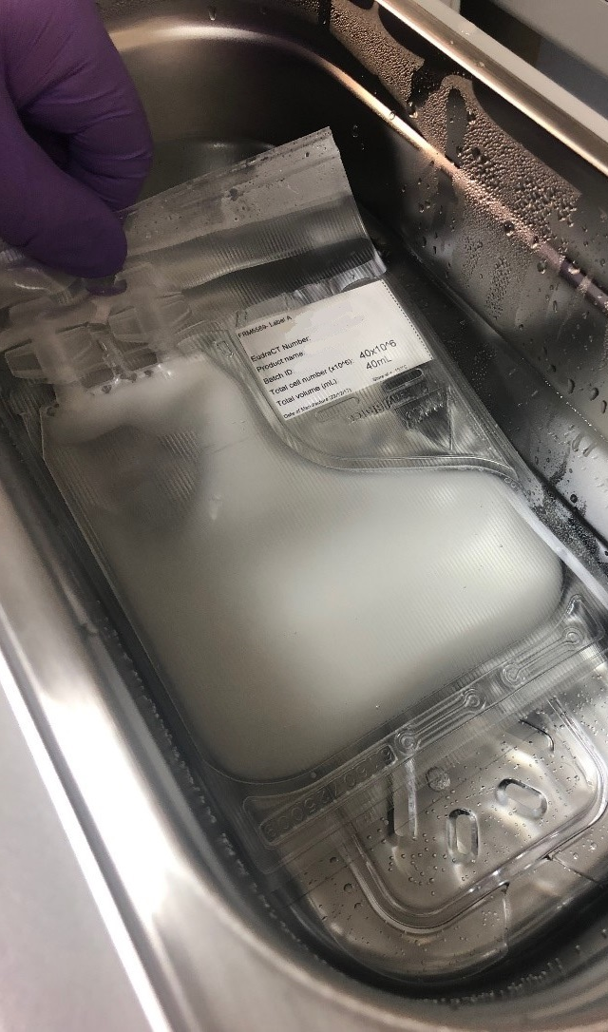
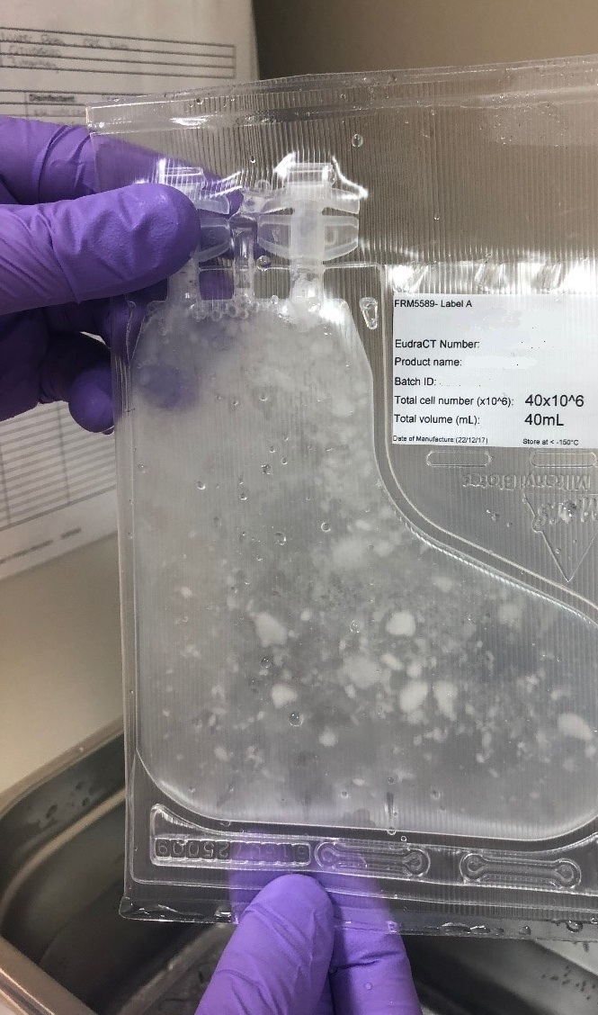
Thawing (2 of 2)
Handle products appropriately as directed by the manufacturer and/or trial sponsor.
Gentle manipulation may be recommended during thawing but try to avoid generating bubbles.
It is good practice to remove the product from the thawing device when few pieces of ice remain (see far right) and gently massage until fully thawed.
Appearance will vary from product to product!
Follow an approved SOP and ensure staff are appropriately trained for each product.
Notes:
Images: © 2020 NHS Blood and Transplant. All rights reserved.

Slide 12

4-minute video of cell therapy product being thawed (no sound)
If you are unable to view this video, please access it via this link:
https://www.theattcnetwork.co.uk/wp-content/uploads/2020/11/NHSBT-Product-thawing-video.mp4
Notes:
Video: © 2020 NHS Blood and Transplant. All rights reserved.

Slide 13
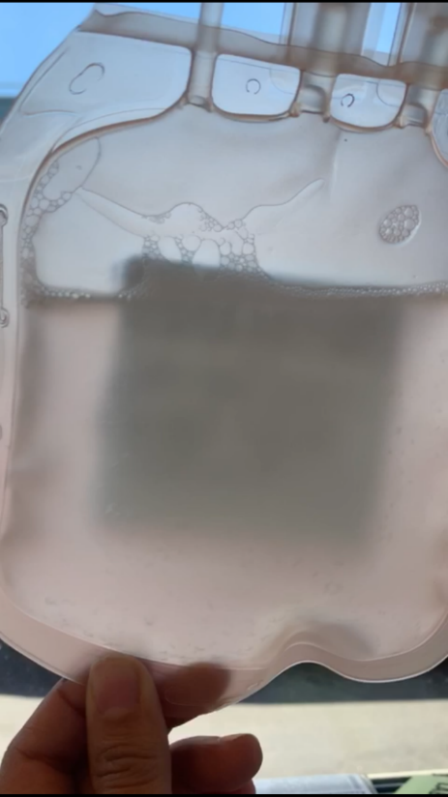
Fresh or thawed products
(including products thawed & diluted before administration)
Maintain the product at an appropriate temperature. Best practice to minimise handling & use pre-cooled cool packs.
Handle the product carefully and minimise mechanical forces (e.g. shear force through a syringe or violent manipulation of the bag). Try to avoid shaking or generating bubbles.
Administer within acceptable timeframe as per protocol.
Conduct a visual inspection – this can be aided by holding the product up against the light.
Appearance will vary from product to product!
Follow an approved SOP and ensure all staff are appropriately trained for each product.
Cell suspensions may appear cloudy
Notes:
Image: © 2020 NHS Blood and Transplant. All rights reserved.

Slide 14
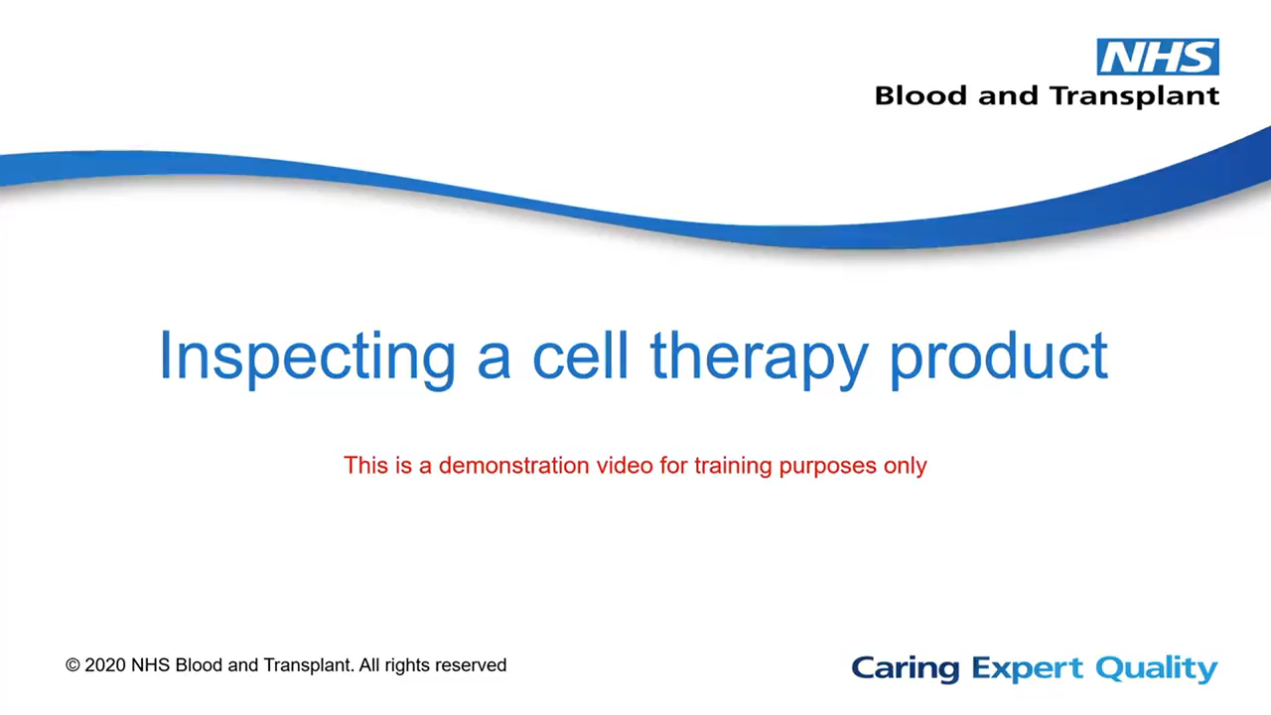
2-minute video of cell therapy product bag inspection (no sound)
If you are unable to view this video, please access it via this link:
https://www.theattcnetwork.co.uk/wp-content/uploads/2020/11/NHSBT-Product-inspection-video.mp4
Notes:
Video: © 2020 NHS Blood and Transplant. All rights reserved.

Slide 15
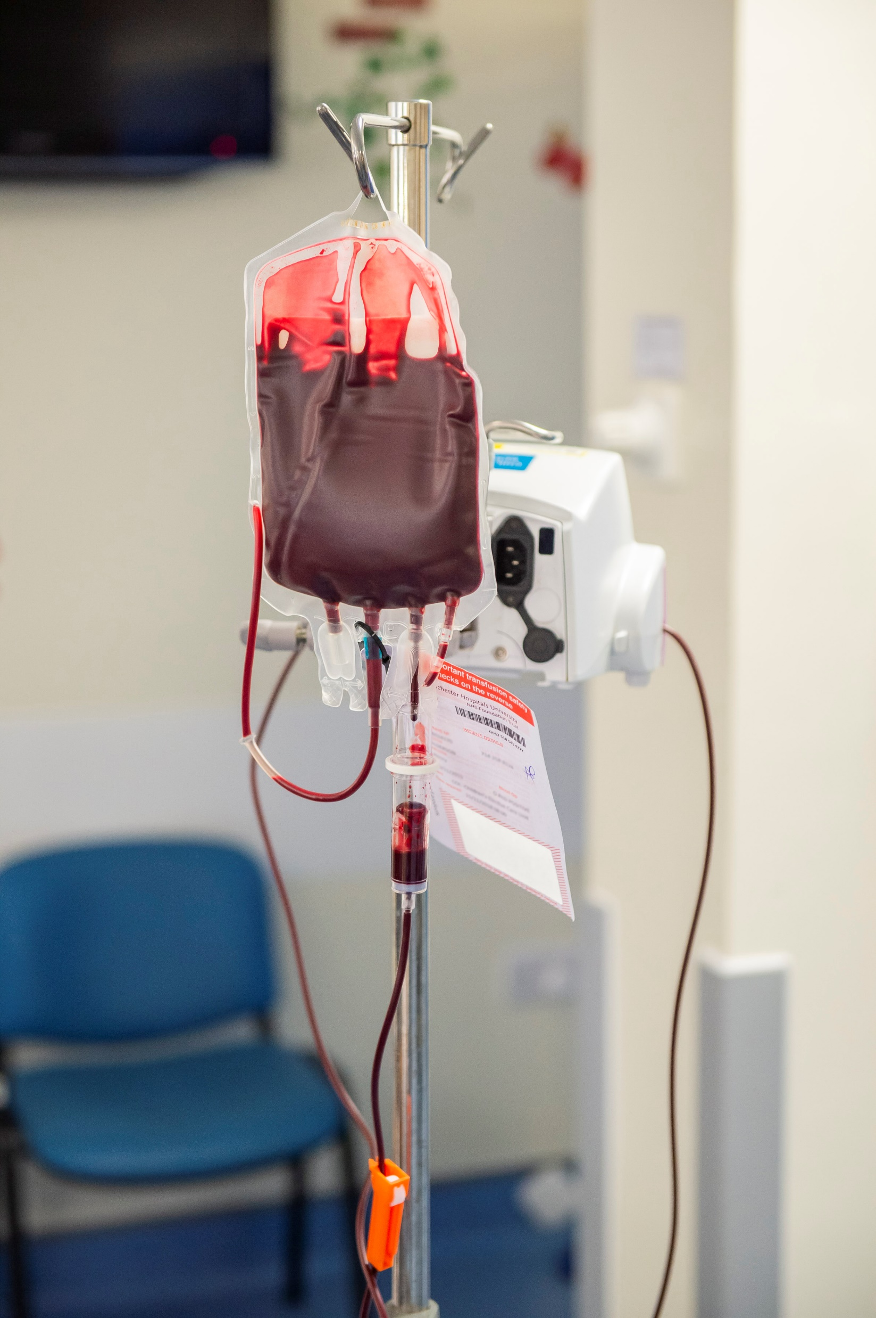
Filters and giving sets
If using an infusion set, use the correct one for the product!
  Standard intravenous fluid administration set = 15 µM filter
  Standard blood administration set = 170-200 µM filter
Some products may be recommended to be administered via a filter-free giving set.
The dose may be significantly reduced if cells are removed due to inappropriate use of a filter.
Filtering will remove most large cell clumps, although viable cells can also be caught up in the clumps and removed by the filter, thereby reducing the dose.
Notes:
Image: © 2020 NHS Blood and Transplant. All rights reserved.

Slide 16

Clinical implications of cell clumping
Cell clumps may increase the risk of:
  Line occlusion
  Phlebitis (inflammation of a vein)
  Thrombus (clot in a blood vessel causing reduced blood flow)
  Embolus (mass which moves through the bloodstream before lodging in a vessel and blocking blood flow).
The therapeutic dose may be reduced (to an unknown extent) due to cells being caught up in clumps and removed by a filter before reaching the patient.
Notes:
Image: Adrian Wressell, Heart of England NHS FT. CC BY

Slide 17
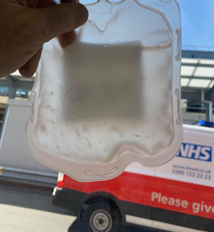
What to do if concerned about product appearance
A cell therapy product containing many large clumps like this may not be suitable for infusion
For each product, consider:
  Who needs to be informed if there is a problem?
  Who has the final say on whether to proceed?
  Speak to the relevant medical consultant and the product manufacturer as soon as possible.
  For clinical trials, the relevant contact details should be captured in the IMP manual.
Staff should know in advance the correct procedure to follow if administration of the therapy is delayed due to:
  Clinical reasons e.g. patient not ready
  Logistical reasons e.g. equipment failure
  Concern about the product e.g. large cell clumps visible.
Notes:
Image: © 2020 NHS Blood and Transplant. All rights reserved.

Slide 18





Further reading
Working as part of
Particulates in Cell Therapy Products – An important issue for commercialization
https://cellculturedish.com/particulates-in-cell-therapy-products-an-important-issue-for-commercialization/
European Pharmacopoeia: New Chapter on Visual Inspection for Visible Particles
https://www.gmp-compliance.org/gmp-news/european-pharmacopoeia-new-chapter-on-visual-inspection-for-visible-particles
© 2020 NHS Blood and Transplant. All rights reserved.

Slide 19

Acknowledgements
Produced by Dr Ceri Roberts, Scientific Training Manager – Cellular and Molecular Therapies, NHS Blood and Transplant
With thanks to:
Jacqui Thompson, Lead Translational Therapy Scientist – CMT, NHS Blood and Transplant
Dr Eric Austin, Lead Training Specialist – CMT, NHS Blood and Transplant
Dr Nia Evans, Consultant Pharmacist Advanced Therapies and Haematology, Cardiff & Vale UHB
Laura-Jayne Keating, National Pharmacy Lead Quality Assurance, Cardiff and Vale UHB
Amisha Desai, Advanced Clinical Pharmacist – Trials, University Hospitals Birmingham NFT
Kathryn Rodden, Senior Research Sister MW-ATTC, University Hospitals Birmingham NFT
Dr Anna Rowe, Trial Management Team Leader, Inflammation – Advanced and Cellular Therapy, University of Birmingham
Dr Steve Elliman, Chief Scientific Officer at Orbsen Therapeutics Ltd
Dr Ryan Guest, Director of Cell Production at Immetacyte Ltd
Working as part of
© 2020 NHS Blood and Transplant. All rights reserved.

